Slide 1
Settlements
Pattern, Function, Hierarchy and Service provision

Slide 2
1.5 Settlements and service provision
Explain the patterns of settlement - Dispersed, linear, and nucleated settlement patterns
Influence of physical factors (including relief, soil, water supply) and other factors (including accessibility, resources)
You should be able to:
Describe and explain the factors which may influence the sites, growth and functions of settlements
Give reasons for the hierarchy of settlements and services - High-, middle- and low-order settlements and services. Sphere of influence and threshold population
Case Study required for 1.5 • Settlement and service provision in an area

Slide 3
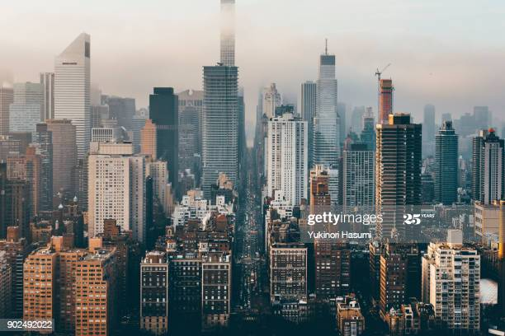
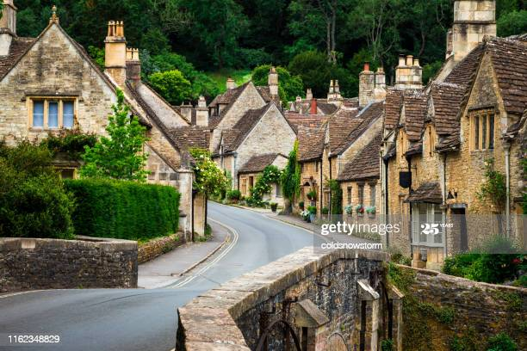
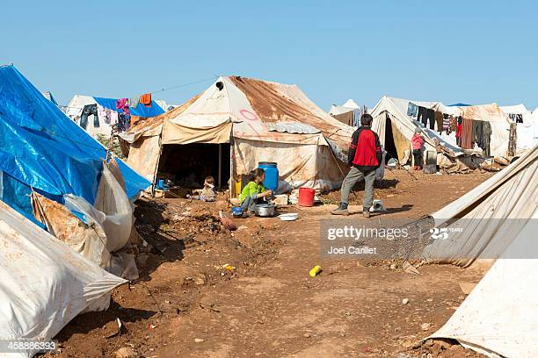
What is a settlement?
These images can all be classified as settlements. Look carefully at them and then write your own definition of the key term ‘settlement’.

Slide 4
Settlements
Compare your definition to the text book definition: A settlement is a place where people live. A settlement may be as small as a single house in a remote area or as a large as a mega city (a city with over 10 million residents).
A settlement may be permanent or temporary. An example of a temporary settlement is a refugee camp.
Settlements are changing all the time due to population change, technological advances and changes in the way we live our lives. For example, the internet enables people to work from home now which means that we don’t all have to live close to our workplaces. This has an effect on settlement population, which affects service provision. In this unit we will look at why and how settlements develop and grow.

Slide 5
Settlement Pattern or Form
Settlement Pattern or Form is the shape of the settlement when you look at it from above. Settlements often developed in certain patterns because of the surrounding landscape or features. There are 4 main settlement patterns: Linear, Disperses, Nucleated and Planned.

Slide 6
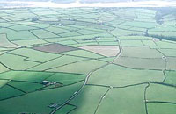
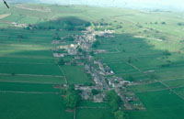
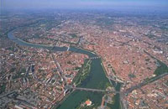
Settlement Patterns: Make a copy of each diagram
Dispersed / Scattered
Linear
Nucleated/
clustered

Slide 7
Settlement Pattern
They are common in sparsely populated areas. Often caused by the break-up of large farming estates into smaller farms and the enclosure of these areas by hedges. Also when the physical geography of the area is extreme (climate, and relief).
Often found in areas with defensive physical features or near to important junctions and crossroads that create trade and communication. Other physical features such as a shortage of dry, flat ground or water lead to people all locating in the same area.
Geographical features such as river valleys or major transport routes lead to this settlement pattern.
Read the descriptions and possible causes for the different patterns and match them to the right one:
Linear pattern
Dispersed pattern
Nucleated pattern

Slide 8
Settlement Pattern
Dispersed patterned settlements are common in sparsely populated areas. Often caused by the break-up of large farming estates into smaller farms and the enclosure of these areas by hedges. Also when the physical geography of the area is extreme (climate, and relief).
Nucleated patterned settlements are often found in areas with defensive physical features or near to important junctions and crossroads that create trade and communication. Other physical features such as a shortage of dry, flat ground or water lead to people all locating in the same area.
Geographical features such as river valleys or major transport routes lead to Linear Patterned settlements.
Check your answers
Linear pattern
Dispersed pattern
Nucleated pattern

Slide 9
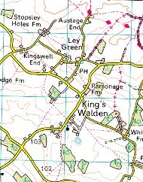
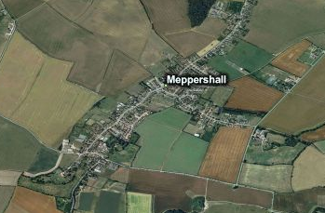
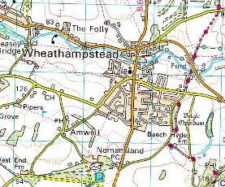
Nucleated, Linear or Dispersed?
For each of the images above decide if the settlement pattern is Nucleated, Dispersed or Linear and suggest reasons for this pattern based on the evidence you see in the image.
Now use google maps or google earth to look at the area where you live from above. Find examples of each settlement pattern in your area and try to explain why the settlements have that pattern.

Slide 10
Nucleated, Linear or Dispersed?
Wheathampstead: Nucleated. There is evidence on the map of a cross roads which could be an important junction for transportation and communication, there is also a church which may have been a central part of the original settlement.
Kings Walden: Dispersed. There is evidence on the map that the area is made up of farms (parsonage farm).
Meppershall: Linear. There is evidence from the image that the settlement follows the line of a main road which may be a major transport route.

Slide 11
Advantages
Disadvantages
Good communication and transport links
Good close relations with neighbours, often close working relations.
Good service provision
Space to grow crops
Quiet and peaceful
Sheltered in valley from elements
Far from services and transport links
Noisy and busy
Limited services
Crime and competition for space leads to high price for land
Isolated, especially in bad weather.
Limited space to build due to steep sided valleys.
Advantages and disadvantages
Use what you have learnt about settlement patterns to match each advantage and disadvantage to the correct pattern (some may be more than one pattern).

Slide 12
Advantages
Disadvantages
Good communication and transport links Linear and Nucleated
Close relations with neighbours, often close working relations. Linear and Nucleated
Good service provision Nucleated
Space to grow crops: Dispersed
Quiet and peaceful: Dispersed
Sheltered in valley from elements: Linear or Nucleated
Far from services and transport links: Dispersed
Noisy and busy: Nucleated
Limited services: Dispersed or Linear
Crime and competition for space leads to high price for land: Nucleated
Isolated, especially in bad weather: Dispersed
Limited space to build due to steep sided valleys: Linear
Advantages and disadvantages
Use what you have learnt about settlement patterns to match each advantage and disadvantage to the correct pattern. Check your answers.

Slide 13
Site describes the point at which a settlement is located, it describes the land it is build on. Factors such as relief, soil, water supply and other resources were important in choosing the sites of early settlements.
Situation describes where the settlement is located in relation to the surrounding features such as other settlements, mountains, rivers and communications (roads, etc.). It is the situation of a settlement that determines whether it will grow from a small village into a large town or city.
What is it about a site that attracts a settlement? Watch this video and make notes on the features. (online geographer)
Site and Situation

Slide 14
Wet point sites - water supply needed to drink, wash and water crops and animals.
Dry point sites - these are away from the risk of flooding.
Rich agricultural soil - for crops and pasture for grazing.
Flat land /Relief– easier to build and farm on flat level land
Defensive sites - such as higher ground so that in the past enemies could be seen from a distance.
Aspect - the sunny side of a deep valley.
Sheltered - from cold prevailing winds and rain.
Gap towns - in a gap between two areas of higher ground.
Resources - such as wood, coal and minerals important for industry, eg coal reserves.
Bridging point - a fording point or bridging point, where you can cross a river.
Trading centres - often settlements grow where natural route ways and rivers meet.
Features of a site and situation
Check that you have notes on each of these features.

Slide 15
Settlement site and Situation
Looking at the map below of Southampton, what physical features do you think made it an attractive site for a settlement?

Slide 16
Settlement site and Situation
Looking at the map below of Southampton, what physical features do you think made it an attractive site for a settlement?
Flat land for building on
Bridging point
Trading centre
Resources
Wet point site

Slide 17
Settlement function
Settlement functions: the activities that take place in a settlement. A settlement usually has more than one function but one is often more important than the others. Settlement functions can be grouped into a number of categories, such as residential, recreational, retail, government, entertainment and industrial.
Most large settlements in MEDC’s (more economically developed countries) are multifunctional and perform a range of functions such as retail, education and industry.
However, when settlements first started to grow, most had only one distinct function, and others developed as the settlement grew.
https://www.internetgeography.net/

Slide 18
Examples of functions
Port - the original function of cities such as Liverpool and Southampton. Both are still ports, but this function has diminished in importance and they are now multifunctional.
Market town - Watford was originally a market town, and although it still holds a regular market, it is now a thriving multifunctional centre.
Resort - Southport was a popular Victorian seaside resort, although it now has many functions and is a commuter settlement for Liverpool.
Industrial centre - Sheffield developed as an important centre in the iron and steel industry. Although steel is still produced, its prominence has declined and Sheffield is a thriving multifunctional city.
For each example above suggest which site features it would have originally needed to enabled it to fulfil this function.
Look on Google maps at these locations now and see what other functions they have. Eg can you see the university in Sheffield?

Slide 19
There is a clear relationship between the size of a settlement population and the number of functions and services it provides. You can see on the graph that as the size of the population increases the number of functions and services that they provide also increases. It is a positive correlation.
The settlements can be classified as High order, Middle order and Low order settlements based on their service provision. This is known as the Settlement Hierarchy.
Settlement Hierarchy
P Guinness, G Nagle, AS Geography, Concepts and Cases Hodder.
The order of settlements in terms of their size.

Slide 20
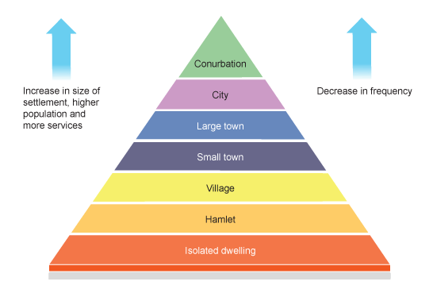
Settlement Hierarchy
The pyramid shape shows that the number of settlements decreases as you move up the hierarchy. There are more small settlements than there are large urban conurbations or mega cities.
Look at a large scale map of your area (google maps) and list the number of villages, small towns and cities within 20 - 50 miles of your house. If you live in a very remote place use your capital city instead.
Make a copy of the diagram and add some of your examples.

Slide 21
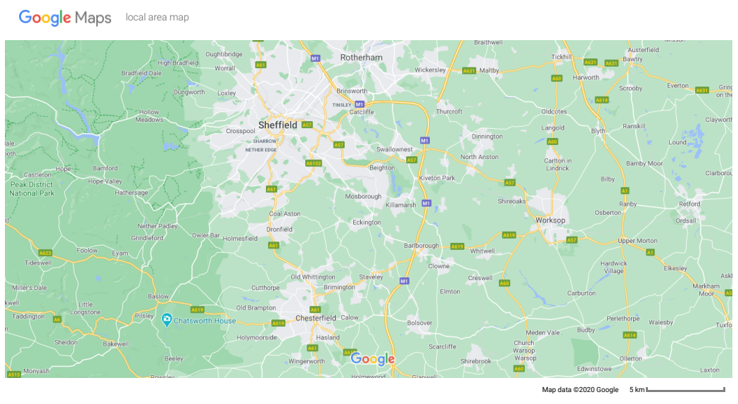
Here you can clearly see that there are more small settlements; villages and towns in this local area than there are cities.

Slide 22
Arrange the goods & services on the next slide into a table to show where you would find them: Town, Village, Hamlet (some may be all three).
Here you can see an example table started.
What do you notice about the number of services in each settlement type?
Why do you think that is?
There are some exceptions to this pattern. Some small tourist villages have many more services and goods than normal as during the summer their population increases.
Hamlet | Village | Town
Newspaper | Hairdresser | Hairdresser
Milk | Milk | Milk
Post office | Primary School | Primary School
 | Newspaper | Newspaper
 | Post office | Post office
 | Butcher | Butcher
 |  | Cinema
 |  | Hospital
 |  | New shoes
Settlement Hierarchy

Slide 23
Arrange these goods & services into a table to show where you would find them: City, Town or Local Village (some may be all three).
Train station
Airport
Court of Law
Football stadium
Large indoor shopping centre
Hotel
Pub/restaurant
Government offices
Milk
New Car
Hospital
Cinema
New shoes
Newspaper
Butcher
New computer
Solicitor
Hairdresser
Groceries
New Furniture
Dentist
Primary School
University
Post office
Jeweller
Restaurant
Settlement Hierarchy

Slide 24
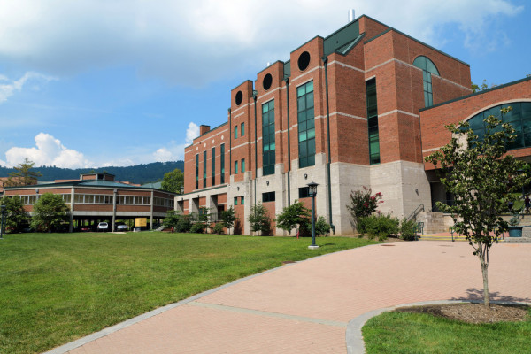
In a small settlement we don’t find services that cater for large numbers of people such as cinemas and large supermarkets – these businesses need enough customers to remain profitable (Threshold population) so they are found in large towns and cities. These large settlements also have good transport routes so those who do not live there can still easily access them.
We also find public services such as Universities and Hospitals in larger settlements as they serve more people. Goods that you don’t have to buy often, such as cars and furniture, are also sold in larger settlements. These services are known as High Order Goods and Services.
Goods that we buy often or services we visit frequently are called Low order goods and services..
Settlement Hierarchy

Slide 25
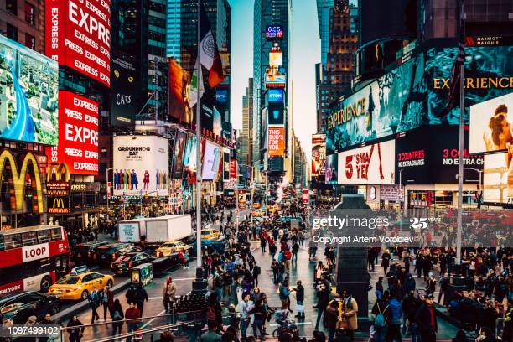
People are willing to travel further for high order goods and services. The distance people will travel is called the range of the service or goods. Large settlements also have good transport routes so those who do not live there can still easily access them.
High order goods have a larger range than low order goods
Settlement Hierarchy
A City serves a large population, not just those who live there but also the villages and towns that surround it. This is called it’s Sphere of Influence.
Some cities like New York and Paris have a global Sphere of Influence.
The distance people are willing to travel also influences the development of villages and towns – watch this

Slide 26
Settlement case study
Using Southampton as your case study, research how it has grown and how it’s function has changed over the years. Include details about it’s sphere of influence and the services it provides as it has grown. There are some links on the next slide.

Slide 27
Southampton case study
Independent newspaper article
Guardian article
BBC article
Case study of Southampton
You can also do a google search on Southampton to get population figures. Looking on the current google map of the city you can see the services located there, for example the university, hospital, Ikea, Airport and find the nearest other like service. From this you can work out the distance that people travel to reach the service in Southampton.
If you would rather research your local city that’s fine, just find the same information for your city of choice so that you have an example to use in your exams.
We will build on this case study later in the unit too so reading the articles to get a good understanding of the city will be useful.

Slide 28
Southampton case study for settlement and service provision
Using Southampton as your case study, research how it has grown and how it’s function has changed over the years. Include details about it’s sphere of influence and the services it provides as it has grown.
Describe the hierarchy of settlements in the Southampton area (Hampshire).
Suggest the differences that there might be between the services in Southampton (map here) and the services in Sholing (see map here).

Slide 29
Key terms review: check that you have notes for each term.
Settlement hierarchy is when settlements within an area or country are ranked in order based on population size, number and range of services and size of sphere of influence
Sphere of influence is the area served by a settlement
Functions are what a settlement does, what is it’s main purpose e.g. tourism, industry, administrative centre, port etc.
High order services/goods have a high threshold population and large range examples include furniture, cars, electrical items such as TVs, financial expertise etc. These are comparison goods and services.
Low order services/goods have a low threshold population and small range examples include bread, a newspaper, hairdressing. These are convenience goods.
Range means the distance somebody is prepared to travel for a particular good or service
Threshold population is the minimum number of people needed to justify (or support) the provision of a particular good or service.

Slide 30
Quick quiz: Which type of settlement:
Has a large sphere of influence?
Has mainly low order services and goods?
Probably only has one function?
Has the largest population?
What is the relationship between the provision of high order services and goods and population? ( can you use the key term Threshold population in your answer)
What services or goods have a larger range and which have a smaller range?
How many levels are there in the hierarchy of settlements?
Which settlement is highest in the hierarchy?
Why does the size of a population influence the services provided in a settlement?
What is the term used to describe the greatest distance that people travel to access a service?

Slide 31
Exam Practice A
Study Fig 3A which shows a rural area in England, along with 3B and 3C which show the settlements of Saxby All Saints and Winteringham.
Winteringham is a nucleated settlement. What is meant by nucleated settlement?
Suggest two reasons why Saxby All Saints is a linear settlement.
Describe the distribution of rural settlements in the area shown by Fig 3A.
Suggest reasons for the distribution of the settlements which you have described in part (iii).

Slide 32
B. Study Fig 4, a map showing the population of market towns in part of eastern England, along with their spheres of influence.
Give three different examples of the types of service in the towns shown on Fig 4 to which people from surrounding rural settlements might travel. (3)
Using evidence from Fig 4, describe and suggest reasons for the differences in the size and shape of the spheres of influence of Holbeach and King’s Lynn. (5)
Many settlements have grown over the years into large urban areas. These include towns and cities with main functions such as:
Ports
Industrial towns
Tourist resorts
Administrative centres
Capital cities
For a named example of a large settlement which you have studied, identify its main function and explain the reasons for it’s growth. (7)

Slide 33
A i, Settlement which has grown up around a central point, or is clustered with buildings close together.
ii, You could refer to:
the steep slope preventing expansion to the east
the flood plain or marshy land preventing expansion to the west
growth along the main road
iii, Possible answers include:
dispersed/spread out/1 to 3 km away from each other
In lines/linear pattern
North-south
On or around 30 m, or on lowland
On gentle sloping land
Both sides of the river
At least 2km away from the River Ancholme
Close together east of the rover
Along roads
North of Brigg.
iv Reasons include:
Spread out to serve farming communities
On roads for access
Away from the river to avoid flooding
Below 30 m for shelter
Nearby water supply
flat/gentle slopes for ease of building
For food supply from valley
B, i Types of services could include:
Retail, e.g. specialist shops or departments stores
Leisure, e.g. cinema or sports centre
Education, e.g. schools or university
Medical, e.g. hospital
Financial services eg, banks
Large supermarket for weekly shop
A market for farmers
ii, You should describe and suggest reasons for the differences in the spheres of influence. Try to make comparisons rather than writing two separate accounts:
Kings Lynn had a larger sphere of influence than Holbeach because it has a large population and high order service. Holbeach has a regular shaped sphere of influence but Kings Lynn’s position close to the coast affects the shape of its sphere of influence. There is also the impact of competing market towns.
C, You should refer to an example you have studied. Name the function and refer to any urban settlement in an LEDC or MEDC. The functions could include any relevant. Give reasons for the growth by referring to your example.
Answers!!

