Slide 1

Language
The Giver

Slide 2
Can you guess what these phrases describe?
Black fizzy sugar
Snapchat machine with a camera
Potato sticks
New child
Coca cola
Smart phone
Chips/Fries
Baby

Slide 3
Language
At times, governments and organisations have sought to control language in order to control the way people think about things. Can you think of any ways in which this might have happened?
“They are mere words, and words can be molded until they clothe ideas and disguise.” - Joseph Goebbels (Nazi party minister for propaganda).

Slide 4
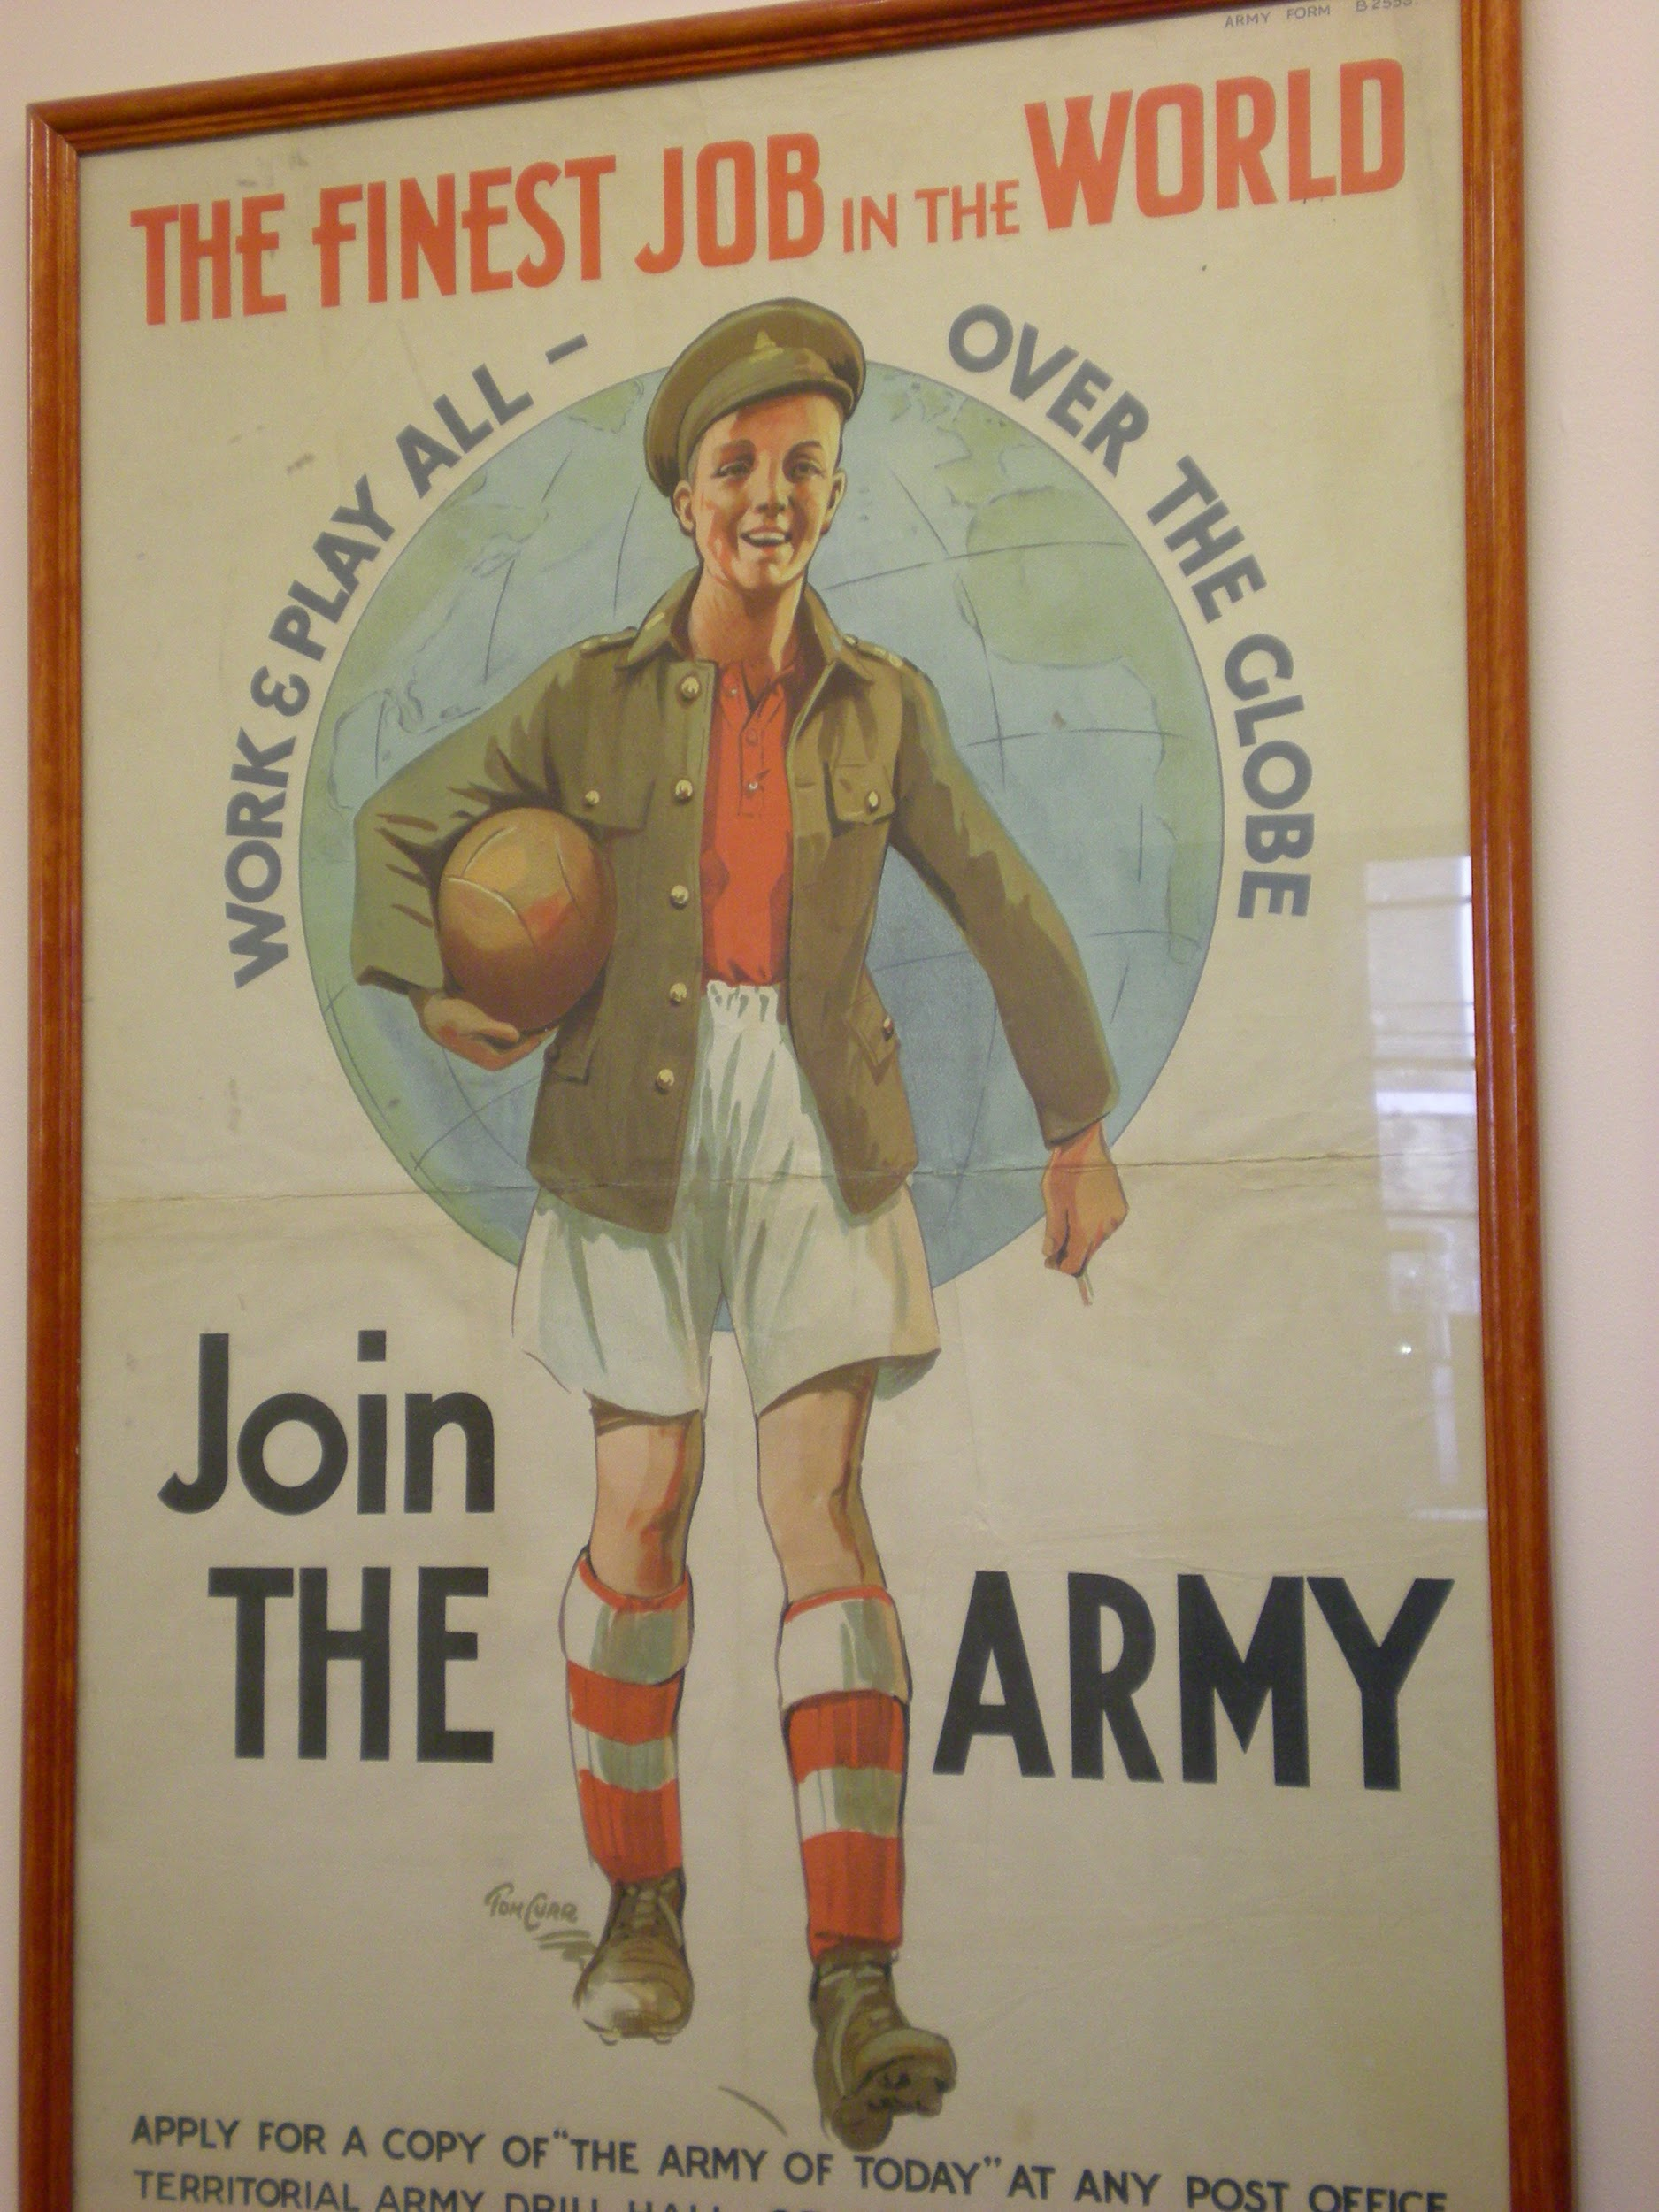

Who’s for the game?
Who’s for the game, the biggest that’s played,The red crashing game of a fight?
Who’ll grip and tackle the job unafraid?
And who thinks he’d rather sit tight?
These WW2 posters and rhyme show how language is used to make war seem like a fun thing to be part of.
Your country is up to her neck in a fight, And she’s looking and calling for you.

Slide 5
Translate
These are all words used to describe certain things in Jonas’ society. See if you can translate what they mean:
Dwelling
Newchild
Family unit
Comfort object
Birthmother
Release

Slide 6
Precision of language
What’s the difference between ‘distraught’ and ‘distracted’? Why might the society prefer one over the other?
"I left home at the correct time but when I was riding along near the hatchery, the crew was separating some salmon. I guess I just got distraught, watching them.
"I apologize to my classmates," Asher concluded. He smoothed his rumpled tunic and sat down.
"We accept your apology, Asher." The class recited the standard response in unison. Many of the students were biting their lips to keep from laughing.
"I accept your apology, Asher," the Instructor said. He was smiling. "And I thank you, because once again you have provided an opportunity for a lesson in language. 'Distraught' is too strong an adjective to describe salmon-viewing." He turned and wrote "distraught" on the instructional board. Beside it he wrote "distracted."

Slide 7
Click on the link to watch a clip from the film adaptation of The Giver.
Notice how precise their use of language is.
Use of language
https://www.youtube.com/watch?v=Huge2mdf0FE

Slide 8
Precision of language
Read through the extract from chapter 16 (on the next slide) and answer the following questions:
UNDERSTANDING: What two questions do Jonas’ parents think are more accurate than “Do you love me”?
ANALYSIS: What effect does the short sentence have at the end of the extract?
INTERPRETATION: Why do you think Jonas is nervous to ask his question?
INTERPRETATION: Why do you think Jonas’ parents prefer ‘enjoy’ and ‘take pride’ to ‘love’?
Using this example as your evidence, explain how Lowry’s fictional society is controlled by the precise use of language. (PEE)

Slide 9
“Father? Mother?” Jonas asked tentatively after the evening meal. “ I have a question I want to ask you.”
“What is it Jonas?” his father asked.
He made himself say the words, though he felt flushed with embarrassment. He had rehearsed them in his mind all the way home from the Annex.
“Do you love me?”
There was an awkward silence for a moment. Then Father gave a little chuckle. “Jonas. You, of all people. Precious of language, please!”
“What do you mean?” Jonas asked. Amusement was not at all what he had anticipated.
“Your father means that you used a very generalised word, so meaningless that it’s become almost obsolete,” his mother explained carefully.
Jonas stared at them. Meaningless? He had never before felt anything as meaningful as the memory.
“And of course our community can’t function smoothly if people don’t use precise language. You could ask, “Do you enjoy me?” The answer is ‘Yes,’” his mother said.
“Or, “ his father suggested, ‘Do you take pride in my accomplishments?’ And the answer is wholeheartedly ‘Yes.’”
“Do you understand why it’s inappropriate to use a word like ‘love’?” Mother asked.
Jonas nodded. “Yes, thank you, I do.” he replied slowly.
It was his first lie to his parents.

Slide 10
Now that you know about Jonas’ family and their lives, pretend you just went on a visit to Jonas’ house. Write a letter to one of your friends or family members, describing the way Jonas and his family live. Compare how your life is similar or different to Jonas’ life.

Slide 11
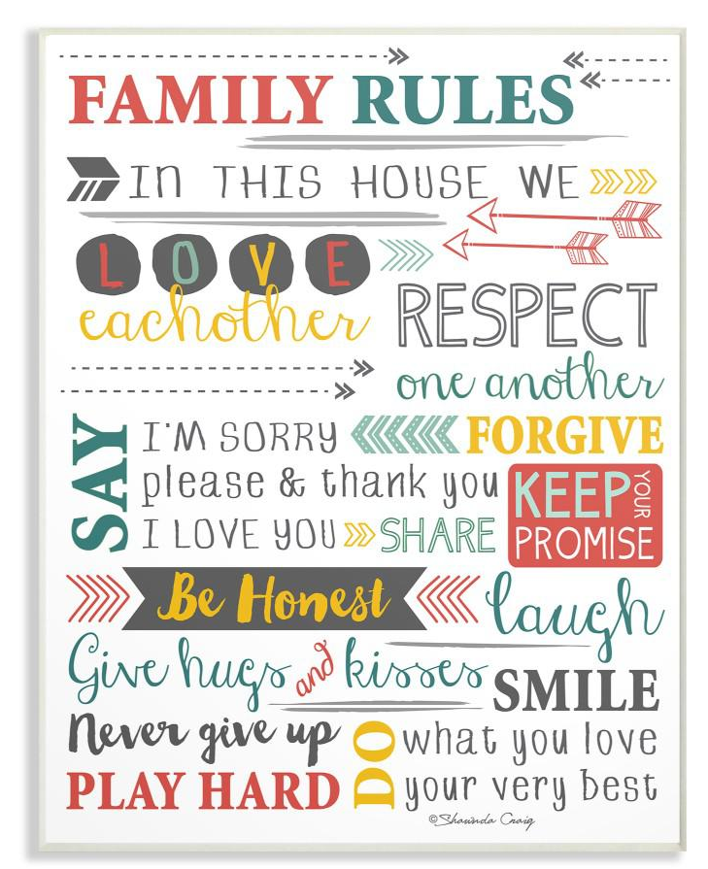
RULES!!!
There are several rules in the community. Although some of them may sound silly, there is reason to each rule created. Think of some of the rules that you have noticed so far. Pick 2 and try to explain the reasons the community have for imposing them.
Now imagine you are a parent, what 3 rules would you choose to govern your family. For each rule explain your reasons for making it.

