Slide 1
The Giver
Introduction

Slide 2

Memories
In your exercise book, write down 3 memories you have from your childhood. They can be happy memories, sad memories, exciting events or painful occurrences.
My first beach holiday
Feeding the ducks at the park
Broke my collarbone in PE

Slide 3
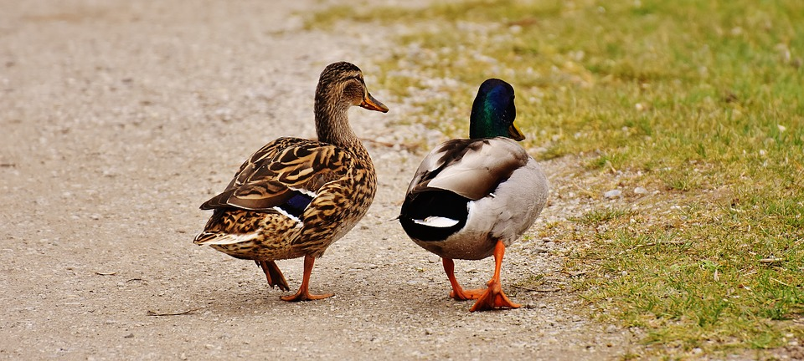
Expand
Take 30 seconds to expand one of your 3 memories, explaining why it stands out in your mind.

Slide 4
Think
Are there any memories, in your list or otherwise, that you would prefer to forget?
What if it were possible to forget unwanted memories? Would that be a good thing or a bad thing?
Write your answer in full sentences. Make sure you give reasons for your response.

Slide 5
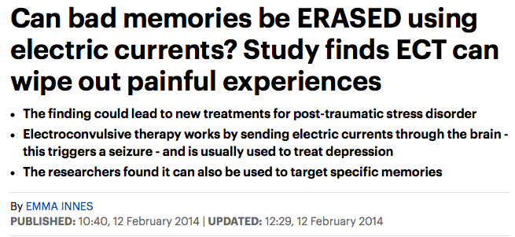
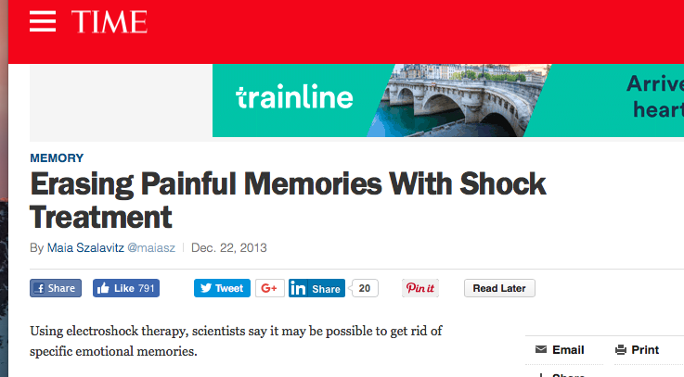
How could this sort of treatment be beneficial?
What could be some of the dangers?

Slide 6

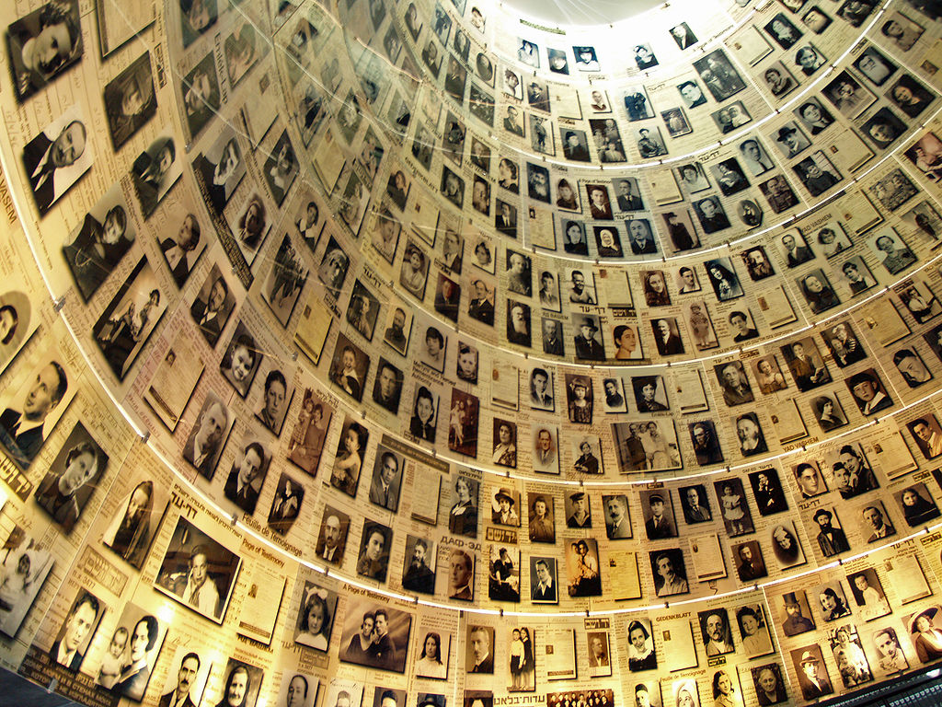
Holocaust memorial day
January 27th marks the international Holocaust Memorial Day, where we are called to reflect on the horrible atrocities committed by the Nazi government in Germany towards 6 million Jews (and other minorities).
Do you think it would be a good/bad thing for humanity to forget that suffering like the Holocaust ever happened? Why/why not?

Slide 7
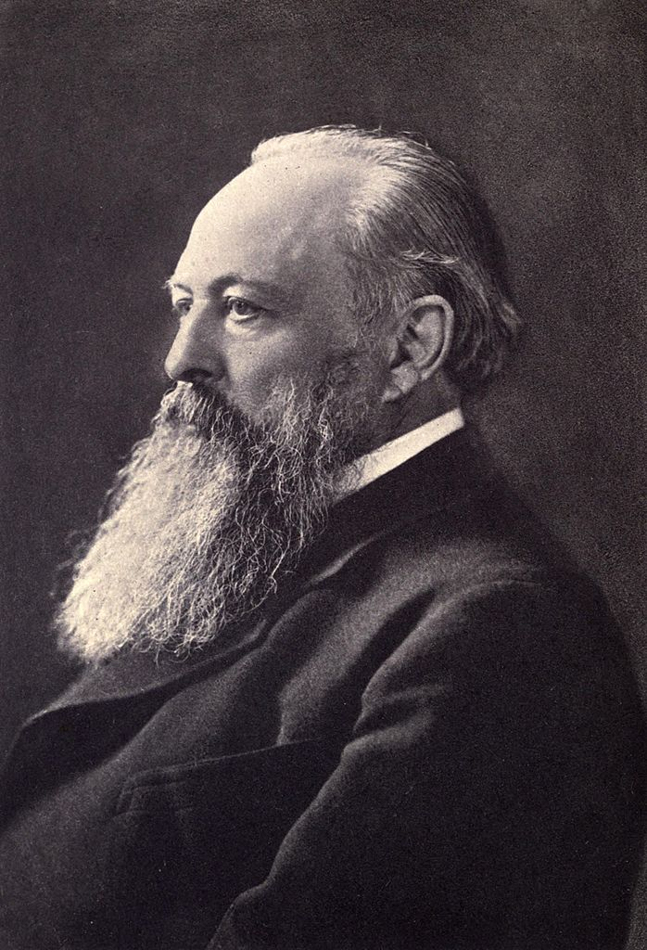
Those who refuse to learn from history are doomed to repeat it.
Lord Acton - 1895

Slide 8

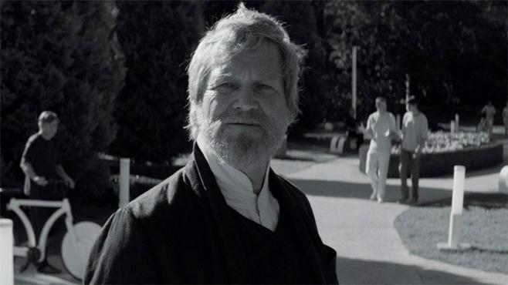
The Giver
Author: Lois Lowry
Published: 1993
Premise: Set in a non-specific time in the far future where the community has successfully managed to control memory, emotion, colour and more, in order to create peace and equality between all people.

Slide 9
The Giver
In the next few weeks you will read The Giver and consider the challenging ideas that the book explores. You will also be asked to reflect and consider your own opinion about some difficult concepts.
Read Chapter 1 and answer the questions on the following slide.

Slide 10
The Giver
1. Describe Jonas’ community.
2. Describe Jonas’ family. What do his parents do?
3. Who is Asher?
4. What do they discuss in their ritual of feeling sharing?
5. What is this “Ceremony of 12”?

Slide 11
Theme 1: Identity &
Equality
The Giver

Slide 12

Identity & Equality
In what way is everyone being equal a good thing?
Could it ever be a bad thing?

Slide 13
Identity
What do you know about identity? Start this activity by looking up the definition of “identity.” Then on a spider diagram write down any ideas and characteristics of your identity that you can think of. What makes you unique? Who are you?

Slide 14
Your task
“The best way to solve society’s problems is for everyone to be the same.”
Do you agree or disagree?
Use the techniques on the following slides and the writing frame to write a piece of persuasive writing. Try to persuade the reader to your view. It can be in the form of a letter or a speech.

Slide 15
Persuasive writing preparation:
First you have to decide do you agree or disagree with the statement?
Now that you have decided you can start to build your case.
As you go through each slide or technique try to think of a way you might use this device in your writing.
On a spider diagram, write your statement in the middle and then for each technique, add an idea that you could use in your writing. This will be a source for you to draw from when you are putting your speech or letter together.

Slide 16
Writing persuasively
Repetition
Alliteration
Personal Pronoun
List of 3
Opinion as fact
Statistic
Emotive Language
Rhetorical Question Example/Anecdote
Remember your Purpose and your Audience.

Slide 17

Emotive Language: Appeal to the heart!
Language is used to generate emotions in the reader such as:
Fear, guilt, empathy, altruism , desire , admiration and sympathy.
Breathtaking, pathetic, disgusting, appalling, disgraceful, admirable……
Thousands of innocent families…..

Slide 18

Hyperbole
Credible exaggeration for effect
“Adds amazing luster for infinite, mirror-like shine” for Brilliant Brunette shampoo.
REDBULL- It gives you wings!
"Diamonds are forever" - DeBeers

Slide 19
Examples and Anecdotes
To help the reader empathise with the subject on a personal level and have sympathy for your opinion.
Let me tell you about my friend…
In my experience…..
This family is typical of…..

Slide 20
Use of Superlatives
Biggest, brightest, tastiest, creamiest, freshest, quickest , best, most, worst, etc.
Superlatives state that something is the best, e.g. the bravest man.
Superlatives often end in -est, but sometimes have the word most in front of the adjective, e.g. most nervous.

Slide 21
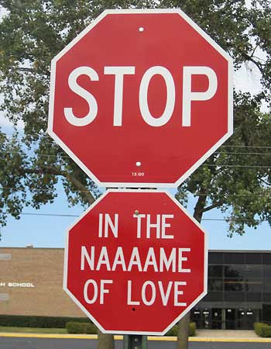
Directive Language: Imperatives
This gives instructions or orders. In this way, the readers feel as if you are speaking directly to them.
‘You must agree that...’
‘Don’t dismiss this ...’
‘Don’t believe that...’
‘Believe it…..

Slide 22
Rhetorical Questions
These are questions that are directed at the readers, but do not require answers. Again the readers feel as if they are being spoken to directly.
Examples:
'What time do you call this?'
'Who wouldn't want to be a millionaire?'
‘Do we really want our planet to survive?’
'Wouldn’t you feel happier if you could wear what you wanted to school?'

Slide 23
Persuasive Words or Phrases
These will make your audience think that they should either agree with your point of view or else be seen as unreasonable.
Obviously, without a doubt, undeniably,
surely, definitely, certainly etc.

Slide 24

Persuasive Techniques
Don’t you think that it is wrong?
This is an awful shame.
9/10 people agree with me.
We can do it. We must do it.
Today, you can make a difference.
Do it for the real, right reasons.
It is a good, exciting and brilliant idea.
Everyone knows that this idea is the best.

Slide 25
Click on this link to watch an example of a persuasive speech to inspire you.
12 year old silences the world
https://www.youtube.com/watch?v=lv4fWhObaTM
Listen to the speech twice and try and pick out some of the persuasive techniques the girl has used in her speech.
Which bits do you find most effective?
Now look through the examples on the following slides before starting your own piece of persuasive writing.

Slide 26
Evoke sympathy – “We’ve raised all the money to come here ourselves, to come 5000 miles to tell that you must change your ways.”
Clear purpose/intension – “I have no hidden agenda. I am fighting for my future.”
Juxtaposition - “Losing one’s future is not like losing an election or losing a few points on the stock market.”
Clear voice, emphasis on important words.
Effective
Rhetorical
Devices

Slide 27
Use of first person – “I used to go fishing in Vancouver, my home, with my dad, until few years ago we found the fish full of cancers.”
Rhetorical question – “Did you have to worry of these things when you were my age?”
“Are we even on your list of priorities?”
Use of second person – “I’m only a child and I don’t have all the solutions, but I want you to realise neither do you.”
Imperatives /list- “You don’t know how to fix the holes in the ozone layer, you don’t know how to bring the salmon back up our dead stream. You don’t know how to bring back an animal now extinct. And you can’t bring the forest that once grew.”
Effective
Rhetorical
Devices

Slide 28
Appeal - “If you don’t know how to fix it, please, stop breaking it.”
Emotive words/comparison/ Use of second person - Here you may be delegates of your government, business people, organisers and reports or politicians. But really you’re mothers and fathers; sisters and brothers; aunts and uncles; and all of you are someone’s child.”
Use of facts - “I’m only a child but I know we’re all part of a family, 5 billion strong. In fact, 30 million species strong.”
Repetition - “I’m only a child but I know we’re all in this together. “
Effective
Rhetorical
Devices

Slide 29
Offering solution - “I am only a child yet I know if all the money spent on war was spent on finding environmental answers, ending poverty and finding treaties, what a wonderful place this earth would be.”
Imperative -“Do not forget why you’re attending this conferences, who you’re doing this for.”
Effective
Rhetorical
Devices

Slide 30
Now it’s your turn…
Use the writing frame to help you plan.

Slide 31
Your task
“The best way to solve society’s problems is for everyone to be the same.”
Do you agree or disagree?
Use the techniques on the following slides and the writing frame to write a piece of persuasive writing. Try to persuade the reader to your view. It can be in the form of a letter or a speech.

Slide 32
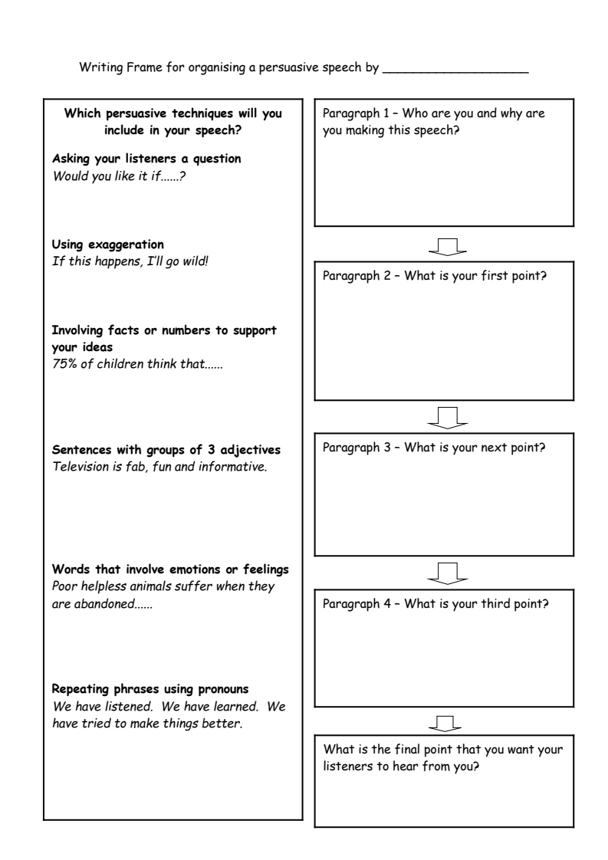
Print off a copy of the writing frame if you need to.

Slide 33
Character study: Jonas
The Giver

Slide 34
First impressions
We can tell a lot about someone based on a few key details. What are your immediate assumptions about:
A man in a smart suit
A dog with red eyes
A thin girl with a pale face
Read the following extract, what are your first impressions of Jonas?
Writers will often describe characters with a few key details, leaving you to fill in the rest.

Slide 35
Jonas
Then all of the citizens had been ordered to go into the nearest building and stay there. IMMEDIATELY, the rasping voice through the speakers had said. LEAVE YOUR BICYCLES WHERE THEY ARE.
Instantly, obediently, Jonas had dropped his bike on its side on the path behind his family's dwelling. He had run indoors and stayed there, alone. His parents were both at work, and his little sister, Lily, was at the Childcare Center where she spent her after-school hours.
Looking through the front window, he had seen no people: none of the busy afternoon crew of Street Cleaners, Landscape Workers, and Food Delivery people who usually populated the community at that time of day. He saw only the abandoned bikes here and there on their sides; an upturned wheel on one was still revolving slowly.
He had been frightened then. The sense of his own community silent, waiting, had made his stomach churn. He had trembled.
But it had been nothing. Within minutes the speakers had crackled again, and the voice, reassuring now and less urgent, had explained that a Pilot-in-Training had misread his navigational instructions and made a wrong turn. Desperately the Pilot had been trying to make his way back before his error was noticed.

Slide 36
Jonas
Instantly, obediently, Jonas had dropped his bike on its side on the path behind his family's dwelling. He had run indoors and stayed there, alone. His parents were both at work, and his little sister, Lily, was at the Childcare Center where she spent her after-school hours.
What does his reaction here tell us about him?

Slide 37
How to write about it
We PEE! Point Evidence Explain.
Using just this shorter part of the exert put together a PEE paragraph explaining your first impressions of Jonas.
Point:
Evidence:
Explanation: Link the evidence to the point.

Slide 38
What do we learn about Jonas in Chapter One? EXAMPLE
POINT: A direct answer to the question.
E.g. In Chapter One, we can see that Jonas is very nervous.
EVIDENCE: A quote to back up the Point
E.g. This can be seen from where he drops his bike “Instantly, obediently”.
EXPLANATION: How does the Evidence back up the Point?
E.g. The adverbs suggest that Jonas is afraid of getting into trouble, and immediately seeks to do what he is told.

Slide 39
All together
Quote is embedded - it flows in a full sentence
In Chapter One, we can see that Jonas is very nervous. This can be seen from where he drops his bike “Instantly, obediently”. The adverbs suggest that Jonas is afraid of getting into trouble, and immediately seeks to do what he is told.
The technique the writer uses is identified

Slide 40
Read the whole exert again from the previous slide. Now write your own PEE of your first impressions of Jonas from chapter one. You can include your first PEE paragraph.
Point – In chapter 1 our first impression of Jonas are...
Evidence – This can be seen from where….
Explanation – This suggests that he is…..
Try to write 2 or 3 PEE’s.
Extension: if you can think of any other part of chapter one that reveals something about Jonas you can include that too.

