Slide 1
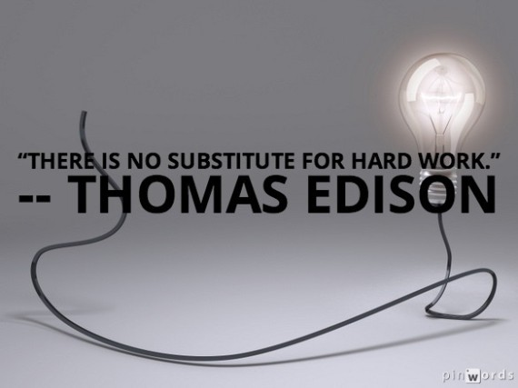
Literacy pack – term 5
Name:_____________________
Year:_______ Form:_________
Teacher:___________________

Slide 3


Section one: How to construct your writing
To be completed by:
______________________________
What do I need to complete?
Spelling test 1
Complete the Do you understand these words? page
Read the rules about apostrophes.
Complete the tasks on omission
Complete the tasks on metalanguage
Read and complete the tasks on prepositions
Complete the extended writing task
New vocabulary W and X
Reading comprehension: Pole to Pole (Part 1)
Self Assessment: What do I still need to practise from this section?

Slide 4
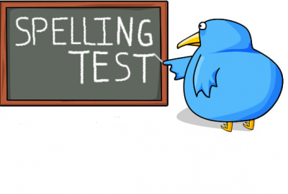
Spelling test 1
You will be tested on your spellings in every
literacy lesson.
You are expected to get at least 17/20 right each time. If you do not manage this you will need to re-take the test at another time.
 | Read | Write | Cover and write
Commonly misspelt words | Acceptable
 | Amateur
 | Acquire
 | Acquit
 | Catastrophe
 | Conscientious
 | Embarrassment
 | Exceed
 | Precede
 | Supersede
 | Gauge
 | Guarantee
 | Harass
 | Humorous
 | Ignorance
Topic specific words
Notes:
http://www.saveteacherssundays.com/spelling/

Slide 5

Do you know what all these words mean?
If there are any words on your spelling list that you don’t understand then write them underneath with a definition.
Word | Definition

Slide 6
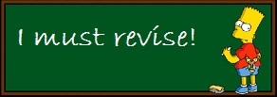





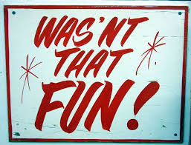
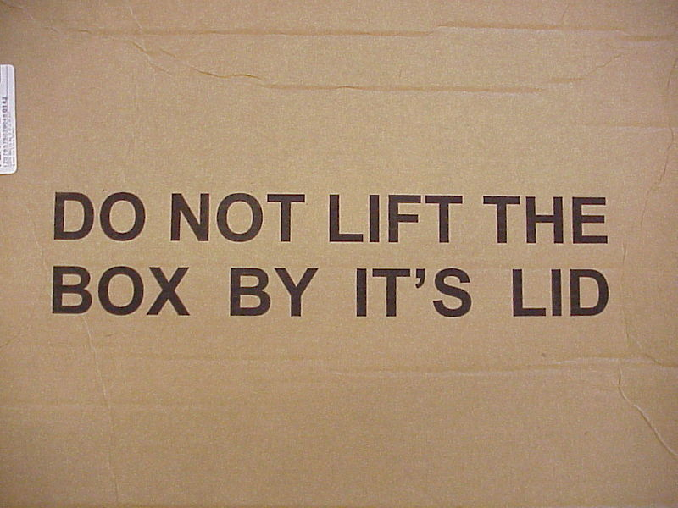
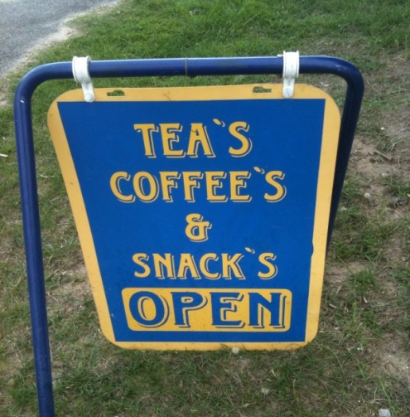
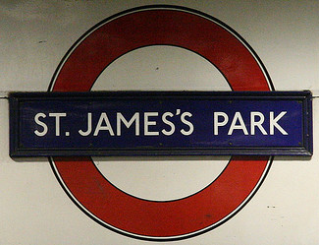
Revising
The rules about apostrophes
We have looked at apostrophes in some of the books before but we still need to practise them! Re-read the rules about apostrophes below.
You never use an apostrophe when you are talking about a plural, for example, you would have one shoe and two shoes – it would never be shoe’s.
You use an apostrophe in omission – to omit something is to take it away, this is your root word – in this case, when you omit one or more letters. For example, do not becomes don’t – you use the apostrophe in the place of the o here.
You can also use an apostrophe to show possession, before an s to say that one subject of a sentence owns the next subject in a sentence. For example, Katie’s pencil case – this tells us that Katie owns the pencil case.
Exception to the rule: If the person or subject already ends in an s then the apostrophe comes after the s and no extra s is added. For example, James’ pile of books.
Task:
Can you correct these errors?

Slide 7


We are going to now on rule 2 – omission.
You use an apostrophe in omission – to omit something is to take it away, this is your root word – in this case, when you omit one or more letters. For example, do not becomes don’t – you use the apostrophe in the place of the o here.
Task 1: change these words into shorter words by omitting letters. Replace the missing letters with an apostrophe.
Do not | I am | Where is | Who is
Don’t
It is | Is not | Could not | Who would
Are not | Does not | Did not | Cannot
You are | Had not | I had | I have
New rule!
If you are writing a formal piece then you should write all words in full. It is considered too informal to use contractions and omissions.

Slide 8



Metalanguage continued
We looked at metalanguage in the last booklet. Write a short definition below of what this is. If you can’t remember then you can always ask a friend!
Why is it important to understand metalanguage?
Last time I told you – why is it important for you to understand metalanguage? Explain below.
Find the definition of the word and write it in your own words.
Write a sentence using the type of metalanguage you have defined. Circle or underline the metalanguage.
Word: Noun
Definition: A person, place or thing – if it is a proper noun then you need to use a capital letter. These are always the subject of the sentence.
Sentence: The princess was exceptionally beautiful.
Word: Acronym
Definition:
Sentence:

Slide 9
Word: Analogy
Definition:
Sentence:
Word: Antagonist
Definition:
Sentence:
Word: Cliché
Definition:
Sentence:
Word: Genre
Definition:
Sentence:
Word: Irony
Definition:
Sentence:

Slide 10
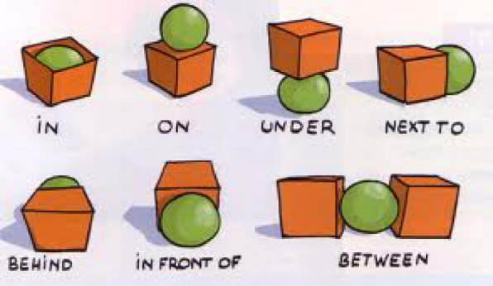

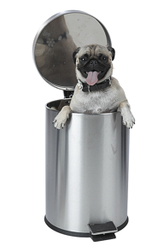
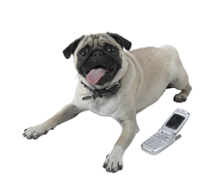
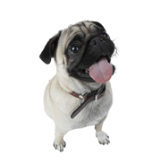
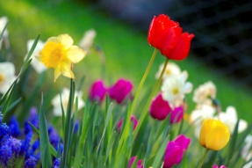
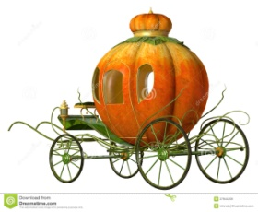
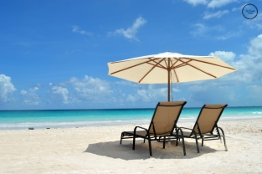

Prepositions
A preposition is a word we use in our writing to explain where something is – this makes our writing more detailed.
It is not only to show where a noun is physically but it can also show where it is in time.
The puppy is on the floor. | The puppy is in the bin! | The puppy is beside the phone.
The above are all physical prepositions.
In the spring, I always want to plant some beautiful flowers. | At midnight the coach turned into a pumpkin! | During the summer I like to lay on the beach.
The above are all prepositions linked to time.

Slide 11
Preposition word bank
about above according to across after against along along with among apart from around as as for at because of before | behind below beneath beside between beyond by by means of concerning despite down during except except for excepting for | from in in addition to in back of in case of in front of in place of inside in spite of instead of into like near next of off on | onto on top of out out of outside over past regarding round since through throughout till to toward under underneath | unlike until up upon up to with within without
Task:
Make a word bank for time prepositions
Notes:
http://www.chompchomp.com/terms/preposition.htm

Slide 12

Extended writing
Using all your knowledge of sentence structure so far
you are going to create a short, descriptive story.
Fill in the boxes under the titles.
Add in some ambitious adjectives to describe your choices above.
Write a minimum of three paragraphs using all of these ideas . Be as creative as possible!
Swap your work with your partner and get them to highlight the most effective paragraph and to explain why. Avoid phrases like “It makes the reader want to read on.” and focus on using your metalanguage.
Character | Preposition (physical) | Preposition (Time) | Proper noun | Abstract noun
Adjectives bank

Slide 13
You have been given two pages to ensure you write as much as possible!

Slide 15
Word (Adjective)
Letter
W
Definition
Sentence (using your word):
Synonyms
Antonyms
Word (Adjective)
Letter
X
Definition
Sentence (using your word):
Synonyms
Antonyms

Slide 16
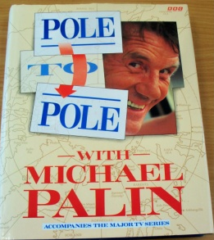
Pole to Pole by Michael Palin
Reading comprehension : Read the extract and answer the questions in as much detail as possible.
Chapter 1: The North Pole
It's 3.45 on a Saturday afternoon and I'm seventeen miles from the North Pole. Somewhere, a long way away, people are doing sensible things like watching cricket or digging gardens or pushing prams or visiting their mothers-in-law.
I'm squeezed tight into a small, noisy aeroplane descending through stale grey cloud towards an enormous expanse of cracked and drifting ice. With me are Nigel Meakin and his camera, Fraser Barber and his tape-recorder and Roger Mills and his pipe. With our two pilots, Russ Bomberry and Dan Parnham, we are the only human beings within 500 miles. Outside my window one of our two propeller-driven engines slowly eats away at a fuel supply which must last us another six hours at least. In little more than ten minutes our pilot will have to fashion a landing strip out of nothing more than a piece of ice - strong enough to withstand an impact of 12,500 lbs at eighty miles an hour. Below the ice the sea is 14,000 feet deep.
I'm sure I'm not the only one of us looking down on this desolate wilderness who hasn't wished, for an impure moment, that the North Pole, rather than being in the middle of an ocean, was solid, well marked and even supplied with a hut and a coffee machine. But the cracked and fissured ice-pack offers no comfortable reassurance - no glimmer of any reward to the traveller who has made his way to the top of the world. The Arctic Ocean, known to the Victorians as the Sea of Ancient Ice, stares balefully back as we descend towards it, reflecting nothing but the question: Why?
It's too late to ask the producer now, too late to begin to speculate why I so eagerly agreed to come here, and completely out of order even to mention that if we survive this ice landing we have only another 12,500 miles to go.
At two minutes past four our De Havilland Twin Otter, designed in the fifties and much loved and trusted by Arctic flyers, is finally over the North Pole. One almost looks for a point, a peak, a curve offering tantalizing glimpses of those huge land masses - Alaska, Siberia, Scandinavia and Canada - which back on to the Arctic. But all there is to see is ice and the nearer we get to it the more evident it is that the ice is not in good shape. Russ, a self-contained, taciturn man about whom I know nothing other than that my life is in his hands, leans forward from the controls, scanning the conditions below and frowning.
Technology cannot help him now. The decision as to how, when and ultimately whether to drop the plane onto the ice is for his judgement alone.

Slide 17

He clearly doesn't like what he sees and, by my watch, we have circled the roof of the world for nearly thirty minutes before a change in engine note indicates that he is at last throttling back in preparation for a landing. We drop low, running in over a tongue of open water, Russ staring hard at the ice as ridge walls taller than I'd expected rush up to meet us. Brace myself for impact, but it never comes. At the last minute Russ thrusts the overhead throttle control forward and pulls us up banking steeply away. He checks the fuel gauge and asks Dan, the young co-pilot, to connect up one of the drums for in-flight refuelling. Dan squeezes his way from the cockpit to the back of the plane, where he begins to fiddle around with spanners and tubes until the aircraft is rich with the smell of kerosene. The Pole remains 100 feet below us, tantalizingly elusive, probably in the middle of a black pool of melted water. Russ takes advantage of some marginally increased sunlight to attempt a second landing. Once again hearts rise towards mouths as the engines slow and a blur of ice and snow and pitch-black sea rises towards us, but once again Russ snatches the plane from the ice at the last moment and we soar away, relieved and cheated.
I make a mental note never to complain about a landing ever again. Russ circles and banks the plane for another fifteen minutes, patiently examining the floating ice for yet another attempt.
uestions
You will continue to read this chapter in section 2 of the booklet.
What do we learn about Michael Palin in this extract? (don’t forget to use inference)
In paragraph two, what dangers are presented to us about the landing? Use quotes to back up your ideas.
What do we learn about the North Pole in this extract?
Highlight 8 ambitious vocabulary choices (that you don’t already know) and ; a) explain what they mean , and b) write another, complex or compound, sentence to show your understanding.
What atmosphere is created in this excerpt? Use quotes to back up your ideas.

Slide 18
Answer your questions in detail here:

Slide 21

Section two: Which voice?
To be completed by:
______________________________
What do I need to complete over the next two weeks?
Spelling test 2
Complete Do you know the meaning of this word? page
Read Point of view when telling a story
Read the pages on Active and Passive voice
Complete the task on the active and passive voice
Complete the extended writing
New Vocabulary: Y and Z
Comprehension on Pole to Pole (Part 2)
Self Assessment: What do I still need to practise from this section?

Slide 22
Spelling test 2
You will be tested on your spellings in every
literacy lesson.
You are expected to get at least 17/20 right each time. If you do not manage this you will need to re-take the test at another time.
 | Read | Write | Cover and write
Commonly misspelt words | Immediate
 | Indispensable
 | Inoculate
 | Judgement
 | Liaison
 | Manoeuvre
 | Memento
 | Mischievous
 | Occurrence
 | Perseverance
 | Threshold
 | Tyranny
 | Loose
 | Lose
 | Legitimate
Topic specific words

Slide 23
Do you know what all these words mean?
If there are any words on your spelling list that you don’t understand then write them underneath with a definition.
Word | Definition

Slide 24
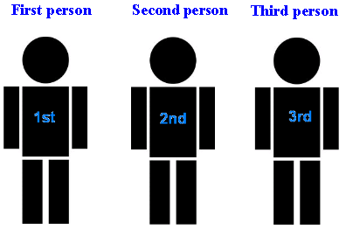
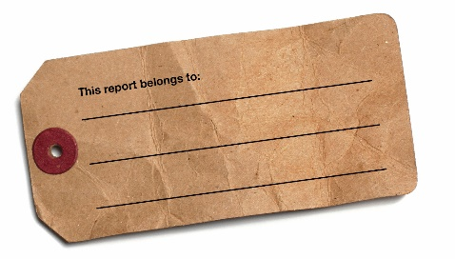
Point of view when telling a story
Who is talking? Who is our narrator?
First person means you are talking from a personal perspective. You use words like I, we, me or mine (and other first person pronouns).
This means that you only get the perspective (point of view) of that person. You often use this when telling a story, writing a diary entry or a blog.
You may see internal thought here and description of what can be seen but the account will be biased.
Second person is where you only use the pronouns you and yours.
This is often used when telling someone how to do something (like I am here!)
Third person is when you only use the pronouns referring to another person – never to yourself - for example; he, her, she, him, it etc.
This is the most common form of writing when telling a story, it allows the writer to look at different aspects of the story, not just the view of the protagonist.
You can look at all angles of the scene in this account.
On the next page you are going to write three different perspectives of the same event; one in first, one in second and one in third person.
Think about how each one will be different.
Task
There has been a bank robbery on a busy shopping street in the middle of winter.
Think about which character you will play in each style.
Scenario

Slide 27

Active Voice
Write down the definition of active (this will help us understand the meaning of the phrase active voice.
Task
The active voice is a phrase we use to describe the way in which a sentence is constructed – more metalanguage!
A sentence has the subject before the verb. The subject directly does the verb.
See below how we break it down! to help you understand.
The subject/noun is before the verb.
The verb admiring comes after the subject but notice that was is also highlighted here.
The prince was admiring the sunset.
By using was in conjunction with the verb and having the verb come after the noun, we know that the sentence is actively happening – this is active voice – the verb is currently ongoing.

Slide 28
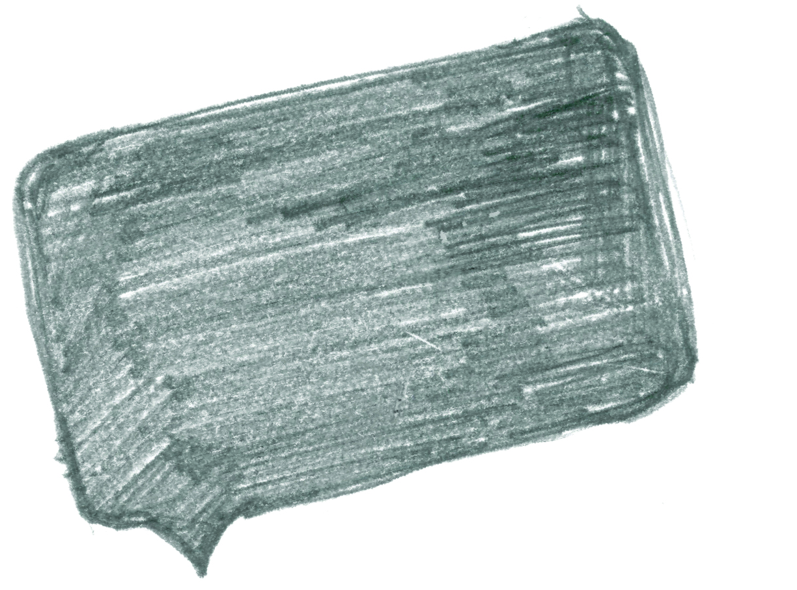
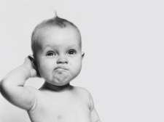
Passive Voice
Task
Write down the definition of passive (this will help us understand the meaning of the phrase passive voice.
So, how do we make this into the passive voice?
The subject has no impact on the verb, it is having something done to it.
See below how we break it down! to help you understand.
The subject/noun is not doing anything.
The verb admired comes after the subject but notice that was being is also highlighted here.
The sunset was being admired by the prince.
The other noun in the sentence has moved to the end.
By using was being in conjunction with the verb we know that the main subject of the sentence is passive and not doing anything. The verb is still ongoing.

Slide 29
Task: active or passive voice?
Below you need to complete the following steps:
Highlight the main subject
Highlight the verb
Indicate at the end if this is (A) active voice or (P) passive voice
Re-write the sentence to transform it into the opposite voice
Key:
Main subject
Verb
Sentence | A or P?
Sarah was drawing a picture. | A
E.g. A picture was being drawn by Sarah.
The very expensive vase was broken by Lisa.
The cat was purring loudly in the afternoon sunshine.
The sky was erupting with loud claps of thunder.
Quietly, the mouse was scurrying from the kitchen.
As the sun rose, in the trees the birds were chirping melodically.
The globe was spinning out of control on the teacher’s desk.

Slide 30
Write a short piece of descriptive writing using all of the techniques we have looked at in this booklet.
Stimulus: An ancient skull found on a doorstep.
Task
When you are done you must highlight all the techniques you have used – use the key below to help you do this.
Key:
 | Active voice |  | Compound sentence |  | Time preposition
 | Passive voice |  | Simple sentence |  | Place preposition
 | Complex sentence |  | 8 ambitious words
I have used_____________ person to write my piece.

Slide 32
Word (Adjective)
Letter
Y
Definition
Sentence (using your word):
Synonyms
Antonyms
Letter
Word (Adjective)
Z
Definition
Sentence (using your word):
Synonyms
Antonyms

Slide 33
Pole to Pole by Michael Palin
Reading comprehension : Read the extract and answer the questions in as much detail as possible.
Chapter 1: The North Pole (Continued)
This time there is no pull-out. Six hours after leaving Eureka Base on Ellesmere Island, Canada, the wheels and skis of the Twin Otter find the ground, bounce, hit, bounce, hit, swerve, slide and finally grip the slithery hummocked surface. We are down and safe. I check the time on my watch, and realize that at this point it could be whatever time I wanted it to be. Japanese time, Indian time, New York time or London time - they're all the same at the Pole. It is ten o'clock at night in London.
Home seems impossibly far away as we step out onto a rough base of ice and snow. It looks secure but water channels only a few yards away and the fact that Russ will not risk switching off the aircraft engines in case the ice should split reminds us that this is a lethal landscape. Finding the highest point in the vicinity - a pile of fractured ice-blocks, soaring to three and a half feet, I plant our 'North Pole' (kindly loaned to us by the Canadians) and we take our photos. The air is still, and a watery sun filters through grey-edged cloud giving the place a forlorn and lonely aspect. The temperature is minus twenty-five Centigrade. This is considered warm.
After an hour's filming, we defer to Russ's polite impatience and return to the aircraft. Concerned about fuel, he takes off quickly and unceremoniously, as if the North Pole were just another bus stop.
We have planned to follow the thirty degree East meridian all the way to the South Pole, but straight away there are problems. There is only enough fuel left to reach the nearest airstrip, a Danish base in Greenland. Even this is 480 miles away, and beyond radio range at the moment. We have no option but to fly in hope.
For some reason the only liquid we have been provided with for our journey is a litre can of tomato juice which doesn't last long between six people, and it is a thirsty, underfed, cramped and exhausted little group that puts down at Nord Base, Greenland, with only twenty-five minutes of fuel left. We have been away from the rest of the world for ten minutes short of twelve hours.
There is not a soul to be seen.
Russ, armed with registration documents and proof of identity, trudges off into the distance to try and raise someone.
We wait by the aircraft, in a curious state of mental and physical limbo. The only one who seems really happy is Roger, who is at last able to light up his pipe.

Slide 34
After what feels like an eternity, Russ returns with a young Danish soldier who is in a state of considerable shock. No one had told him we were coming, and it being three o'clock in the morning on the north coast of Greenland, 700 miles from the nearest settlement, a knock on the door must have been like the start of a horror movie.
He bravely tries to laugh it off, 'We thought it could only be Father Christmas', before offering us what we are dying for - food and drink and a bed for the night. So day one ends in country one, which turns out, quite unexpectedly, to be Denmark.
The midnight sun is shining brightly when I climb into a bunk at 3.30 a.m., and equally brightly when I wake at half-past nine. From 15 October the sun will disappear below the horizon and not rise again until the end of February, but for now, in mid-May, day merges seamlessly into day.
Greenland is a part of the kingdom of Denmark - a massive, almost uninhabited ice-cap over fifty times the size of its mother country. The base at Nord is manned for the Danish government by five soldiers, but one of them is away, so Henny, Jack, Kent and Kenneth are running the place at the moment.
Two big supply planes come in each year bringing all they need - fresh videos, books, food and drink, and equipment. The only thing they don't like is that it means letters . . . 'Not receiving them, writing them,' they explain.
They're so friendly, open and hospitable that there is a great temptation to abandon the journey and stay here, drinking fresh coffee with rich Danish bread, and gazing out to a view of icy fiords bathed in crisp bright sunshine. I ask Jack if the snow ever disappears.
'Oh yes,' he assures me, 'it melts in July. And starts snowing again in August.'
uestions
How does Palin feel about being at the North Pole?
How does he feel about home?
“There is not a soul to be seen.” What is the effect of this paragraph on the reader? (Hint: look at structure)
What do we learn about Greenland in this extract?
What do we learn about the landscape / environment?
How do you think Michael Palin is feeling at this point in the journey?
What do you think it would be like to live in this part of Greenland, based on the information you have read?

Slide 35
Answer your questions in detail here:

Slide 37
Spelling test time
 | Test 1 | Test 2
Commonly misspelt words
Topic specific words
 | Total: /20 | Total: /20

Slide 38
Choose your words wisely!
Relevant | Interesting | Ambitious

