Slide 1

Skellig
by David Almond

Slide 2
First impressions
Before we begin reading the book lets consider our first impressions based on the book covers and the book’s title.
What comes to mind when you hear the word Skellig?
Have a look through the book covers on the next slide and answer the following questions:
What do you think the book Skellig might be about?
What Genre do you think it is?

Slide 3

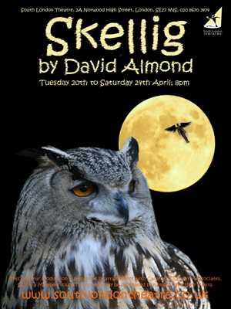

What do you think the book Skellig might be about?
What Genre do you think it is?

Slide 4

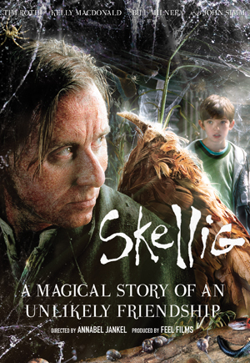
The book has also been made into a film.
Do these covers give you any more clues?

Slide 5
First Impressions
Read the following opening sentences from famous children's books, choose your favourite and explain why it draws you in:
‘All children except one grow up.’
‘Once there were four children whose names were Peter, Susan, Edmund and Lucy.’
‘The hottest day of the summer was drawing to a close and a drowsy silence lay over the square houses of Privet Close.’
The title, cover and blurb of a book are all important elements in attracting people to read a book and publishers spend a lot of time and money getting it right.
The opening sentences are equally important as this is where you are either drawn into the book to read more or decide that it’s not for you.

Slide 6
First Impressions
‘I found him in the garage on a Sunday afternoon. It was the day after we moved into Falconer Road. The winter was ending. Mum had said we’d be moving just in time for the spring. Nobody else was there. Just me. The others were inside the house with Doctor Death, worrying about the baby.
He was lying there in the darkness behind the tea chests, in the dust and dirt. It was as if he’d been there forever. He was filthy and pale and dried out and I thought he was dead. I couldn’t have been more wrong. I’d soon begin to see the truth about him, that there’d never been another creature like him in the world.’
Now have a go at writing the opening sentences to a story from 2 of the following genres:
Romance
Sci-fi
Adventure
Horror
Comedy
Now lets read the opening sentences of Skellig, how does it make you feel?

Slide 7
Timeline Task
Use two pages in your book to create a timeline which will be filled in as we read the book. Mark on the chapters as your reference. It has 46 chapters.
As we read you will add a short summary (one or two sentences) for each chapter and a key quote(s) on the opposite side. So, each chapter will have a summary and a quote to go with it.

Slide 8
Read Chapter 1 and 2
David Almond writes a detailed description of the garage in Michael’s rear garden. He makes the description interesting by:
Giving details of the structure of the building, eg the floor, walls, ceiling.
Listing a large number of objects which are in the garage.
Using adjectives to give more information about shape, colour, condition. (eg ancient newspapers)
Using Michael’s senses to describe his impressions of the garage in different ways.

Slide 9
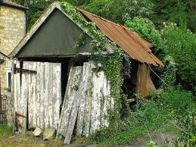
“
“Rusty nails were scattered on the floor”

Slide 10
Pick out the descriptive elements in the passages below
My most valuable possession is an old, slightly warped blond guitar--the first instrument I taught myself how to play. It's nothing fancy, just a Madeira folk guitar, all scuffed and scratched and finger-printed. At the top is a bramble of copper-wound strings, each one hooked through the eye of a silver tuning key. The strings are stretched down a long, slim neck, its frets tarnished, the wood worn by years of fingers pressing chords and picking notes. The body of the Madeira is shaped like an enormous yellow pear, one that was slightly damaged in shipping. The blond wood has been chipped and gouged to grey, particularly where the pick guard fell off years ago. No, it's not a beautiful instrument, but it still lets me make music, and for that I will always treasure it.

Slide 11
Pick out the descriptive elements in the passages below
The Blond Guitar
My most valuable possession is an old, slightly warped blond guitar--the first instrument I taught myself how to play. It's nothing fancy, just a Madeira folk guitar, all scuffed and scratched and finger-printed. At the top is a bramble of copper-wound strings, each one hooked through the eye of a silver tuning key. The strings are stretched down a long, slim neck, its frets tarnished, the wood worn by years of fingers pressing chords and picking notes. The body of the Madeira is shaped like an enormous yellow pear, one that was slightly damaged in shipping. The blond wood has been chipped and gouged to grey, particularly where the pick guard fell off years ago. No, it's not a beautiful instrument, but it still lets me make music, and for that I will always treasure it.

Slide 12

Descriptive writing
For each of the following see if you can give an example from the text about the garage.
Personification
Interesting adjective, vivid description
Imagery appealing to senses
Similes and metaphors
Comparative language
Pre-modified nouns (eg dazzling sequined gown)
Vivid verbs

Slide 13
Complete the text with appropriate words.
One of the best things I did last summer was to climb the Crimpiau hills in North Wales. From the moment I parked the car, there was a ________ fragrance in the air, of pine trees and fresh water from the nearby river which ran along the footpath I was going to follow. The sound of the flowing water was ____________ and I just had to crouch down and taste it. It was _______, so fresh and pure, and felt really ________. As I looked up I could see the mountain it had been running down. It was a _____________ mountain, and I knew I’d be back another time to climb it. As I started walking, I could hear the ________ sound of sheep that were grazing on the opposite field. I knew I would have to walk through the ________ looking field and got ready to get my shoes muddy! The sheep looked _________ and were chewing away at the abundance of grass that was growing on the huge field. As I turned around the corner, I could see the __________ sight of the Crimpiau hills ahead of me, and couldn’t wait to be stood at the top, looking at the _______ views and feeling the ________ wind on my face.

Slide 14
Look at the image on the following slide and write a short descriptive piece. Try to recreate the picture in the readers mind with your words.
Think about all the senses, what you hear, see, smell, touch/feel, taste.
Use metaphor and similes to compare it to things people may know.
Personification
Interesting adjectives (describes a noun) – be creative
Pre-modify nouns
Powerful verbs and adverbs (describes a verb)
Alliteration
Onomatopoeia
Shape, colour, size, position, condition, atmosphere
Zoom in closer to certain parts
Zoom out and give the big picture.

Slide 15
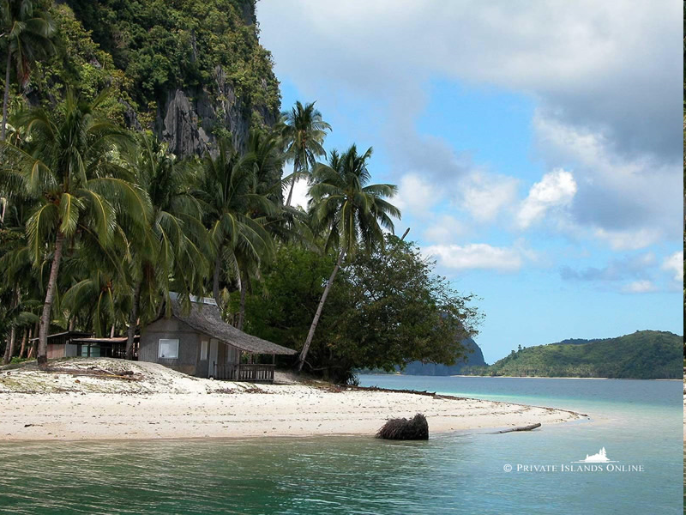

Slide 16
The next section looks at how to structure extended answers using Point, Evidence, Explain: PEE.

Slide 17


WHAT DOES IT MEAN???
Point
Evidence
Explanation
…and what does that mean???

Slide 18

Point – A statement that you want to make
Evidence – A quote from the text
Explanation – Explain what the quote means and how it helps to demonstrate your point

Slide 19

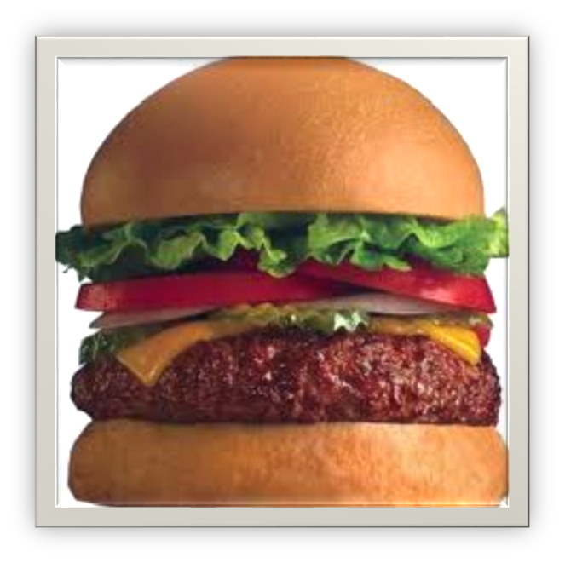
Point
Evidence
Explanation
If you leave either the top, filling or base out, it is not a proper hamburger!
The same is true when you answer a literature question. If you leave either the Point, Evidence or Explanation out, it is not a proper answer!

Slide 20


We use PEE to answer comprehension questions about literature (novels)
And later…
You will use it to write literature essays!

Slide 21
Here is an example answer to the following question:
When Skellig talks to Michael, what does Michael find unpleasant?
When Skellig talks to Michael, Michael thinks that Skellig smells repulsive. This is clear when Michael narrates, “I tried not to breathe, not to smell him.” When someone smells terrible, one does not want to get too close or to breathe in the smell. Although Michael wants to help Skellig, he holds his breathe to avoid smelling the obnoxious odour emanating from Skellig, who also smelt of “Chinese Food” and “other dead things he ate.”
Work out where the Point, Evidence and Explanation are.

Slide 22

When Skellig talks to Michael, Michael thinks that Skellig smells repulsive. This is clear when Michael narrates, “I tried not to breathe, not to smell him.” When someone smells terrible, one does not want to get too close or to breathe in the smell. Although Michael wants to help Skellig, he holds his breathe to avoid smelling the obnoxious odour emanating from Skellig, who also smelt of “Chinese Food” and “other dead things he ate.”

Slide 23

Point – What is your answer in very simple terms.
Evidence – This is a ‘quote’ taken from the text to prove or support what it is that you are saying.
Explanation – This is where you give a more detailed explanation of the point and quote. It is good to include your own personal opinion here.

Slide 24


Explain Skellig’s eating habits.
( Reference pg 27)
Now write a PEE answer using
a quote from the text.

Slide 25

It is clear that Skellig did not have pleasant table manners and was a very messy eater. When Skellig ate the Chinese food, ‘The red sauce trickled down from his lips, down over his chin on to his black jacket.’ This shows that he eats in a disgusting way and doesn’t seem to care that he spills food all over himself. It could be because he was in a rush to eat, since he hadn’t eaten for a long time, or perhaps he was not used to other people watching him eat.

Slide 26

Select the sections of the text below that give the answer to these questions.
  What woke Michael up after his dream?
  What time was it when Michael woke up?
  How did Michael move through the house?
  How does Michael describe the garden?
‘Then the baby was bawling in the room next door and I woke up.
I lay listening to Mum cooing and comforting and the baby squeaking and hissing. The birds were singing outside. When the feed was over and I was sure everyone was asleep, I crept out of bed, got my torch, pulled some clothes on and tiptoed past their room. I took a jar of aspirin from the bathroom. I went downstairs, opened the back door and tiptoed into the wilderness.’

Slide 27
In the extract from ‘Skellig’, Michael is woken up by his baby sister’s crying. The text says the baby was bawling in the next room and I woke up. The word bawling suggests that she was crying very loudly. Michael has probably woken up in the very early morning because the text says the birds were singing outside. The sound of the birds, together with the baby crying, may have influenced Michael’s dream. It is obvious that Michael doesn’t want his family to wake, or to be aware of what he is doing, as the passage says that he tiptoed around the house. This is because he wants to keep his meetings with Skellig a secret. The garden is described as a wilderness, which suggests a wild, overgrown place. Michael may also be describing his garden as a wilderness as a way of expressing his disapproval of the overgrown garden, because he is upset that he has had to move house and therefore sees his new surroundings negatively.

Slide 28

‘At lunch time I went to her front garden. She was sitting there on the lawn, on a spread-out blanket beneath the tree. She had her books, her pencils, her paints scattered around her. I was off school again. All morning I’d been clearing the wilderness again. Dad had been working in the front room, painting, stripping the walls, getting ready to hang wallpaper.
‘The mystery man,’ she said. ‘Hello again.’
She had a book open at a skeleton of a bird. She’d been copying this into her sketchbook.
‘You’re doing science?’ I said.
She laughed.
‘See how school shutters you,’ she said. ‘I’m drawing, painting, reading, looking. I’m feeling the sun and the air on my skin. I’m listening to the blackbird’s song. I’m opening my mind. Ha! School!’’
You may like to start your paragraph like this:
In this extract from the novel ‘Skellig’ the author David Almond reveals more about the character Mina.

Slide 29

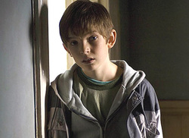
Read Chapter 4 and 5.
Try to put your self in Michael’s place. He has just moved house, has a long new bus journey to make, his new little sister is born premature and his new house needs a lot of work to make it comfortable so his parents are busy and stressed.
At the end of chapter 5 draw a mind map all about Michael. How he is feeling, what he might be thinking. Try to link in quotes and explanations to your map for each of your points.

Slide 30

How is Michael feeling about life at his new house?
Use your mind map to help you answer this question.
Remember to PEE – Point, Evidence, Explain.
Each PEE can be a new paragraph.
In your conclusion make sure you bring all your points together
and answer the question directly.

Slide 31

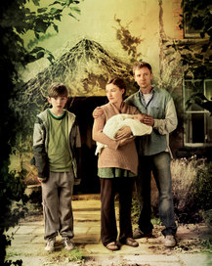
How are Michael’s parents presented in Chapter 8?
Create a mind map like the one on the next slide to gather your information and plan your answer.
Remember each new subject or topic becomes a new paragraph.
Once you have gathered your information you can write up your answer. You can use the framework on the slide below if you need to.

Slide 32
Planning our Answers and Finding Quotations
He is loving
“He reached out, tickled the baby’s chin and kissed her”
Mum
Michael’s mum and dad
She is fussy
“She tried to make a fuss of me”
Dad

Slide 33
Michael’s dad is presented as……………..
…………………………………………………………………………………….
This is evident when…………………....................
………………………………………………..“………………………………...”
This suggests that……..…………………………………………...
………………………………………………………………………………………..

Slide 34

In this chapter the writer vividly portrays the anxiety and concern experienced by Michael’s family. Copy out the following statements, and find quotations to support them.
The family doctor is given an ominous name.
Michael’s mum loses her temper.
Michael’s mum breaks into tears.
Michael’s dad tries to convince his son that everything will be well.
Angels are referred to, hinting at death.
Skeletons are also referred to, yet again suggesting death.
Michael’s mum tries to be cheerful for Michael

Slide 35
Authors use different techniques to create tension these include:
  Using short simple sentences
  Using figurative language /imagery and inferred meaning
  Connotations
  Description of setting or characters
  Repetition
  Onomatopoeias
Written task
How does David Almond create tension and anxiety in chapter 12 of Skellig? Use PEE to answer.

Slide 36

Remember to add your chapter summaries to your timeline with appropriate key quote for each one.

Slide 37
The next section looks at poetry analysis and the use of imagery as a literary technique.
This section covers from Chapter 20 onwards so before continuing make sure you have read this far in the book.

Slide 38
Chapter 20 onwards
Poetry analysis

Slide 39
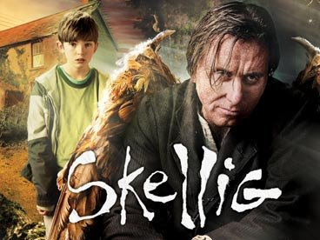
Mina’s Character
What two things was Michael worried about when he was taking Mina to meet the man in the garage? (pg 70-71)
Mina repeatedly asks the man who he is. What are his answers?
What process does Mina say is linked to calcification and what does this mean? (pg74)
What does she really mean when she says this?

Slide 40
Chapter 21
What effect does the adjective extraordinary give to the reader in the quotation above.
Mina and Michael plan to take Skellig to the old stone house. ‘He’s an extraordinary being’ says Mina about Skellig. ‘ She’s extraordinary’ says Michael to his dad about Mina.
Explain why the metaphor of thunder is used in the following quotation: “My heart was thundering.” (Chapter 21, page 77)

Slide 41
What is the significance of Michael’s dream at the start of chapter 22?
How does it reveal Michael’s feelings about what is happening?
Describe how the writer makes the image of a nightmare effective in the following quotation: “they had a table of knives and scissors and saws.” (pg78)
In chapter 22, on the bottom of pg 79, the man in the garage claims to be ‘as weak as a baby’. What is Mina’s response to this? Use your own words.
What surprising things do Michael and Mina discover about the man as they start to move him? (pg 80,81)
What effect do the emotive words “astonishment” and “joy” create on page 82.
Why do you think Skellig eventually tells Mina his name? Explain your answer with reference to the text.
Chapter 22

Slide 42
School v’s homeschool
Mina is home-schooled and Michael goes to a normal state school.
What is Mina’s criticism of Michael’s homework? (pg 84 & 85)
Read William Blake’s poem about a school boy of the following slide.

Slide 43
I love to rise in a summer morn
When the birds sing on every tree;
The distant huntsman winds his horn,
And the sky-lark sings with me.
O! what sweet company.
But to go to school in a summer morn,
O! it drives all joy away;
Under a cruel eye outworn,
The little ones spend the day
In sighing and dismay.
Ah! then at times I drooping sit,
And spend many an anxious hour,
Nor in my book can I take delight,
Nor sit in learning's bower,
Worn thro' with the dreary shower.
How can the bird that is born for joy
Sit in a cage and sing?
How can a child, when fears annoy,
But droop his tender wing,
And forget his youthful spring?
O! father & mother, if buds are nip'd
And blossoms blown away,
And if the tender plants are strip'd
Of their joy in the springing day,
By sorrow and care's dismay,
How shall the summer arise in joy,
Or the summer fruits appear?
Or how shall we gather what griefs destroy,
Or bless the mellowing year,
When the blasts of winter appear?
‘The Schoolboy’ by William Blake

Slide 44
Creating tone when reading
What does it mean to create tone when you are reading?
How do you create a sad or depressing tone when you are reading?
How do you create a happy or upbeat tone when you are reading?
Read the first stanza in an angry tone
Read the second stanza in a soft tone.
How should this section of poem be read and how do you know?

Slide 45
I love to rise in a summer morn
When the birds sing on every tree;
The distant huntsman winds his horn,
And the sky-lark sings with me.
O! what sweet company.
But to go to school in a summer morn,
O! it drives all joy away;
Under a cruel eye outworn,
The little ones spend the day
In sighing and dismay.
Ah! then at times I drooping sit,
And spend many an anxious hour,
Nor in my book can I take delight,
Nor sit in learning's bower,
Worn thro' with the dreary shower.
How can the bird that is born for joy
Sit in a cage and sing?
How can a child, when fears annoy,
But droop his tender wing,
And forget his youthful spring?
O! father & mother, if buds are nip'd
And blossoms blown away,
And if the tender plants are strip'd
Of their joy in the springing day,
By sorrow and care's dismay,
How shall the summer arise in joy,
Or the summer fruits appear?
Or how shall we gather what griefs destroy,
Or bless the mellowing year,
When the blasts of winter appear?
‘The Schoolboy’ by William Blake

Slide 46
Connotation
Create a list of words from the second and third stanza of the poem that tell the reader that it should be read in a harder tone of voice.
Next to the words you have written, write down connotations related to those words.
For example: drives = pushes, powerful, force

Slide 47
I love to rise in a summer morn When the birds sing on every tree; The distant huntsman winds his horn, And the sky-lark sings with me. O! what sweet company.
Stanza 1
What is the tone of this stanza? How do we know this? Does it change?

Slide 48
Stanza 2
But to go to school in a summer morn, O! it drives all joy away; Under a cruel eye outworn, The little ones spend the day In sighing and dismay.
What is the tone of this stanza? How do we know this?
Who do you think the ‘eye’ belongs to?

Slide 49
Stanza 3
Ah! then at times I drooping sit, And spend many an anxious hour, Nor in my book can I take delight, Nor sit in learning's bower, Worn thro' with the dreary shower.
What does his posture suggest about his feelings towards school?

Slide 50
Stanza 4
How can the bird that is born for joy Sit in a cage and sing? How can a child, when fears annoy, But droop his tender wing, And forget his youthful spring?
How does this stanza link to Skellig?

Slide 51
Stanza 5
O! father & mother, if buds are nip'd And blossoms blown away, And if the tender plants are strip'd Of their joy in the springing day, By sorrow and care's dismay,
Can you spot the metaphor?
Notes:
Buds and tender plants refer to children/pupils
<number>

Slide 52
Stanza 6
How shall the summer arise in joy, Or the summer fruits appear? Or how shall we gather what griefs destroy, Or bless the mellowing year, When the blasts of winter appear?
What does this stanza tell us about Blake’s view on school?
Notes:
That it ruins our joy
<number>

Slide 53
Discussion.
In pairs discuss the positives and negatives of being schooled at home.

Slide 54
Home Schooling
Positives | Negatives

Slide 55
Discussion.
Now discuss the positives and negatives of going to school.

Slide 56
Going to school
Positives | Negatives

Slide 57
Chapter 24-27: Symbolism
Chapter 24
Mina and Michael go to see Skellig in the old stone house, which we learn Mina has inherited from her grandfather. Skellig has moved higher up and the children see his wings.
How does David Almond use light in this chapter? What do you think it symbolises? (represents)
Chapter 26
Mina and Michael talk about the archaeopteryx. There is a lot of symbolism in this short chapter: the dinosaur that was too heavy to become a bird, the blackbird, the baby’s fluttering heart, evolution and dreams. Then Leakey and Coot see them and make fun of them.
Why do you think the author uses symbolism?
Notes:
Symbolism – adds depth and creates meaning to atmosphere, or description to setting or characters because of the meaning associated to the symbol. Can add tension, suspense.
<number>

Slide 58
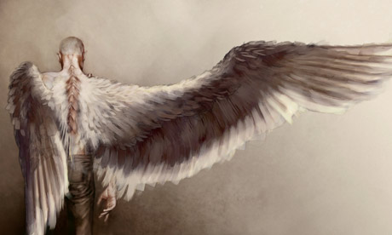
Chapter 31
The children go into the old house and find the owls are feeding Skellig. Michael and Mina and Skellig dance or fly. It seems that they all have wings.
How does the reader’s view of Skellig change in this chapter?

Slide 59
I dreamt a dream! what can it mean?
And that I was a maiden Queen:
Guarded by an Angel mild;
Witless woe, was neerbeguil’d!
And I wept both night and day
And he wip’d my tears away
And I wept both day and night
And hid from him my hearts delight
So he took his wings and fled:
Then the morn blush’d rosy red:
I dried my tears & armd my fears,
With ten thousand shields and spears.
Soon my Angel came again;
I was arm’d, he came in vain:
For the time of youth was fled
And grey hairs were on my head.
The Angel
Chapter 34
Michael goes to have dinner with Mina and her mum. Mina’s mum recites Blake’s poem ‘The Angel’.

Slide 60
Questions for Analysing ‘The Angel.
In your own words, describe what you think the poem is about.
Who is the speaker in the poem? What are they like?
What might be meant by, ‘heart’s delight’? (line 8)
Why does the angel fly away? (line 9)
What might the colour red (line 10) be a symbol of?
Underline the words that relate to fighting in the poem.
What has happened to the woman in the last two lines?
What tone does the poem have? Which words reveal this tone? Are any words repeated? Why?
What do you think is the main theme or the central message of the poem?
Are there any images that help the poet communicate certain ideas?
Is there any rhythm or rhyme that contributes to the overall effect of the poem?
What is the overall structure of the poem and does it add anything to the effect of the poem?

Slide 61
The speaker is the woman who dreams they are a ‘Maiden Queen.’ She was manipulative as she used weeping to keep the angel with her but the angel was not deceived or seduced by this ‘witless’ weeping.
Some possible answers
‘Hearts delight’ may mean that which is infinitely precious to her. In this case it may be the joy of his presence with her.
The angel fled because the maiden queen hid from him her ‘heart’s delight.’ Maybe it could be she refused to allow the angel to see the delight she found in his presence and his ministering to her in love.
Red could be a symbol of love or passion.
In the last two lines of the poem, the woman has grown old since ‘grey hairs’ were on her head. It also says that the time of her ‘youth had fled’ which clearly indicates that she is not young anymore
There are two lines repeated in the second stanza. ‘And I wept both day and night’ is repeated again, emphasising the excessive weeping that she is using to keep the angel attending to her.

Slide 62
Answers continued
One central theme is the effect on our openness to the spiritual world, if we become self-sufficient. The woman as a child was aware of the angel’s presence with her and benefitted from his care of her. As time passed, she shared less with him and progressively hardened herself by arming her fears without the angels help. When he came again when she was older, it was ‘in vain’ as she was used to surviving on her own.
William Blake uses an image of an Angel who has come to offer selfless love and comfort. Angels are considered to be holy and the helpers of men. In Stanza one it indicates that the Maiden Queen is ‘Guarded by an angel mild’ and the angel serves her by wiping her tears away or comforting her. This alludes to the idea that we have guardian angels who watch out for us.
The other images that are used in the poem are warlike such as when she ‘armd’ her ‘fears with ten thousand shields and spears.’ These metaphors communicate that as the woman grows older and gains experience and cynicism; she puts up defences and strengthens herself against any perceived threats.
Images of the Maiden Queen: Queens are powerful entities with authority.
The opening stanza uses the technique of rhetorical questioning. The speaker, who is the maiden queen, is bewildered or perplexed by the dream and hence asks the question about her dream, ‘what can it mean?’
Blake uses alliteration in the phrase ‘witless woe’ and this has an unnatural feel to it as it is said, drawing attention to the concocted or excessive weeping of the maiden queen.

Slide 63
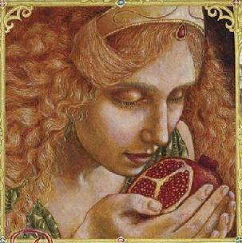
Chapter 38
Mina’s mum tells the children about Persephone.
Mina and Michael go to find Skellig, but he’s not there. Michael feels inside that the baby’s heart has stopped and he blacks out.
Read the story of Persephone and Demeter on the 2 next slides then answer this question:
How does the story of Persephone relate to what is happening in ‘Skellig’?

Slide 64
Demeter and Persephone
Zeus had three sisters. Hera, his wife and sister, was the goddess of marriage and the queen of all the gods. Hestia, another of his sisters, was a much loved goddess by the woman of Greece - Hestia was the goddess of home and hearth.
His third sister, Demeter, was in charge of the harvest. All the gods’ jobs were important. Demeter's job was very important. If she was upset, the crops could die. Everyone, gods and mortals, worked hard to keep Demeter happy. What made her happy was enjoying the company of her daughter, Persephone.
Persephone had grown into a beautiful young woman, with a smile for everyone. One day, while picking flowers in the fields, Hades, her uncle, the god of the underworld, noticed her. Hades was normally a gloomy fellow. But Persephone’s beauty had dazzled him. He fell in love instantly. Quickly, before anyone could interfere, he kidnapped Persephone and hurled his chariot down into the darkest depths of the underworld, taking Persephone with him.
Locked in a room in the Hall of Hades, Persephone cried and cried. She refused to speak to Hades. And she refused to eat. Legend said if you ate anything in Hades, you could never leave. She did not know if the legend was true, but she did not want to risk it in case someone came to rescue her.

Slide 65
Nearly a week went by. Finally, unable to bear her hunger, Persephone ate six pomegranate seeds. It seemed her fate was sealed. She would have to live in the Underworld forever.
Meanwhile, back on earth, Zeus was worried about the crops. The people would die if the crops failed. If that happened, who would worship Zeus? He had to do something. Zeus did what he often did. He sent Hermes, his youngest son, the messenger, to crack a deal, this time with Hades.
Even as a baby, Hermes was great at making deals. Everyone knew that. But this deal might be the challenge of his life. His uncle Hades, king of the underworld, was really in love. This was no passing fancy.
When Hermes heard that Persephone had eaten six pomegranate seeds, he had to think quickly. The deal he made with Hades was that if Persephone would marry Hades, she would live as queen of the underworld for six months out of the year. However, each spring, Persephone would return and live on earth for the other six months of the year. Hades agreed. Zeus agreed. Persephone agreed. And finally, Demeter agreed.
Each spring, Demeter makes sure all the flowers bloom in welcome when her daughter, Queen of the Underworld, returns to her. Each fall, when Persephone returns to Hades, Demeter cries, and lets all the crops die until spring, when the cycle starts again.

Slide 66
Unanswered questions
Tension
As we come to the end of the book the story reaches it’s climax.
How does the author create tension and suspense?
Short sentence structures
Which of the following can you find evidence of?
Cliff hangers
Language
Setting

Slide 67
Here are two examples of PQA answers to the question.
Point – Tension is created through the reader not knowing stuff.
Quote – It says “my hands were trembling”
Analysis – This tells me that he is really scared.
P- Tension is created predominantly through the reader not knowing what is going to happen next.
Q- The extract explains that his Dad wants Michael to “come and see” something he found.
A- This tells me that Michael, quite like the reader does not know what is going to happen next. This creates tension because the reader wants to find out the next development in the plot and will ultimately keep reading to do so. This creates a sense of tension, as the reader and Michael wonder what his dad has in store for him.
Can you explain why one answer is better than the other?

Slide 68
The End...
How do you feel about how the story ends?
Are there any questions left unanswered?
Is there anything you would change about the ending? Explain.
Would you recommend Skellig?

Slide 69
References
This resources was put together from a variety of different sources including:
Hope School Cambodia.

