Slide 1

Kensuke’s Kingdom
by Michael Morpurgo
Notes:
<number>

Slide 2
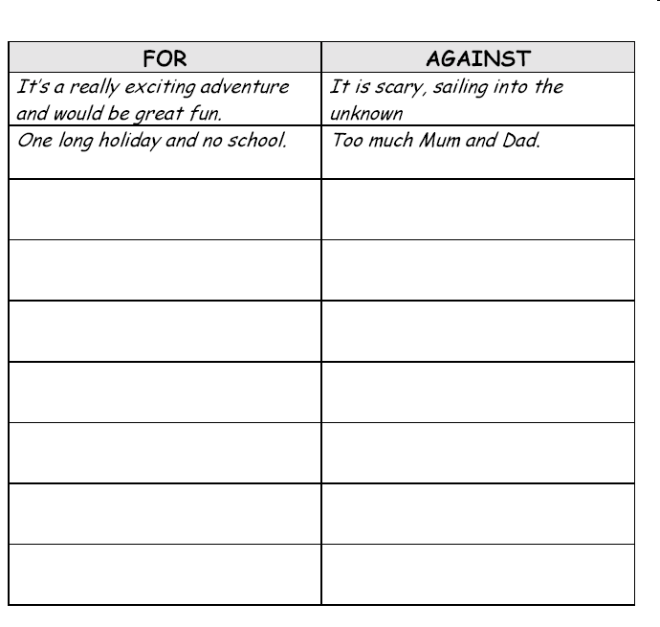
The Adventure of a lifetime?
This is a story about what happens to Michael when his family set out on a sailing adventure together. We can see from the picture on the front and the blurb that things don’t go quite to plan.
Do you think that it would be a good idea for your family to do something like this?
Complete a chart like this with your reasons FOR and AGAINST.
Notes:
<number>

Slide 3
The Adventure of a lifetime?
Use the writing frame below and your ideas from the previous slide to plan and write a balanced argument on sailing around the world.
SAILING AROUND THE WORLD
I am not sure that sailing around the world with my family would be a good thing because...
On the other hand...
However...
One good thing about it would be...
Nevertheless...
Another point of view is...
In conclusion...
When you have written your first draft check your spelling and punctuation very carefully, then go on and write your up your final piece of writing.
Notes:
<number>

Slide 4
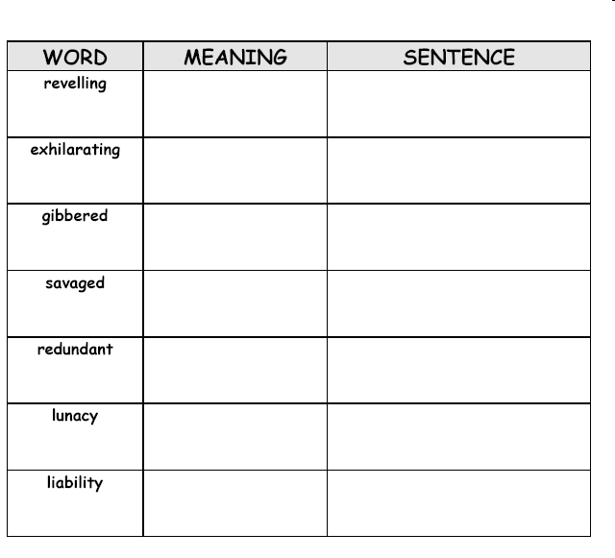
Expand your vocabulary
Read through Chapter 1 of the book. You will find that the author, Michael Morpurgo, uses some challenging words.
Using a dictionary look up the meaning of the following words and write them in a table like the one below. Add any other words you come across that you don’t understand and find the meaning of them too.
Now write a sentence using the word to show that you understand how to use it.
Notes:
<number>

Slide 5
The Adventure of a lifetime?
Once you have read Chapter 1 answer these questions:
Give two reasons why Michael has decided to tell his story now.
Why did Michael’s father call St Joseph’s School ‘the monkey school’?
Explain why the Mudlarks won more matches when they played at home.
Look at page seven. ‘…her eyes filled with fierce tears’. What does the adjective ‘fierce’ suggest about how mum is feeling?
Why were Sundays special to Michael’s family?
Notes:
<number>

Slide 6
Powerful words
You have seen that choosing a particular adjective to describe an action can add a lot of meaning to a sentence.
In the example ‘fierce tears’ is shows us that Michael’s Mum was angry and upset. Have a go at a changing these sentences by adding powerful adjectives to convey the connecting emotion. If you need more help the next slide is a multiple choice version.
The woman walked purposefully along the beach. | Change this to show the woman is feeling sad.
He screamed frantically at his parents. | Change this so that the boy is happy.
The girl laughed hysterically at her brother. | Change this so we can tell that the girls is being mean to her brother.
The father looked carefully for his son at the school gates. | Change this so that we can tell that the father is in a hurry.
Notes:
<number>

Slide 7
Powerful words
You have seen that choosing a particular adjective to describe an action can add a lot of meaning to a sentence.
In the example ‘fierce tears’ is shows us that Michael’s Mum was angry and upset. Have a go at a changing these sentences by adding powerful adjectives to convey the connecting emotion.
Sentence | Change the emotion | Choices
The woman walked purposefully along the beach. | Change this to show the woman is feeling sad. | Slowly Directly hesitantly
He screamed frantically at his parents. | Change this so that the boy is happy. | Excitedly Loudly joyfully
The girl laughed hysterically at her brother. | Change this so we can tell that the girls is being mean to her brother. | Loudly Sneakily sneeringly
The father looked carefully for his son at the school gates. | Change this so that we can tell that the father is in a hurry. | Impatiently lazily Frantically
Notes:
<number>

Slide 8
Powerful words
Have a look at the possible answers highlighted below.
Choosing the right adjective is important for writers and is one way that they convey extra meaning to the readers. Look out for other good examples of powerful adjectives as you read the book.
Sentence | Change the emotion | Choices
The woman walked purposefully along the beach. | Change this to show the woman is feeling sad. | Slowly Directly Hesitantly
He screamed frantically at his parents. | Change this so that the boy is happy. | Excitedly Loudly Joyfully
The girl laughed hysterically at her brother. | Change this so we can tell that the girls is being mean to her brother. | Jokingly Sneakily Sneeringly
The father looked carefully for his son at the school gates. | Change this so that we can tell that the father is in a hurry. | Impatiently Lazily Frantically
Notes:
<number>

Slide 9
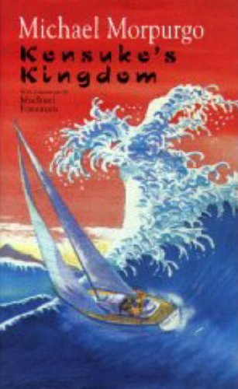
Shared Reading
There is a significant change at the end of chapter 1. Answer the following questions:
Why do the family stop sailing?
What is the atmosphere like in the house?
What happened to Michael’s best friend?
What happens to Michael’s father and why?
Describe Michael’s Dad when they meet up again. What sort of mood is he in? Pick out words from the text as evidence of this.
For example: ‘Michael’s Dad is________ when they met up again in Fareham. We see this in Chapter 1 when the author writes….’
Notes:
<number>

Slide 10
The Big Adventure
Other than water and food, what would you take with you on a journey like this?
What if you could only take 5 items?
List your 5 items and in full sentences explain the reasons for your choices.
e.g. The first thing I would take is a compass as this will help me know the direction I am traveling in, so that I don’t get lost.
Notes:
<number>

Slide 11
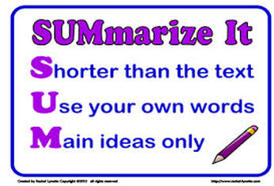
Chapter 2
Read through chapter 2. Now we will try and summarise the chapter.
Summarising is an important skill and it is harder than you think. It requires you to carefully select only the most important bits of information from a text and it is not easy, it can feel like you are leaving out all the interesting details!
It can be useful to think in terms of the basic facts – who, what, where, when and how?
Try to summarise what happens in chapter 2 in only 2 or 3 sentences.

Slide 12
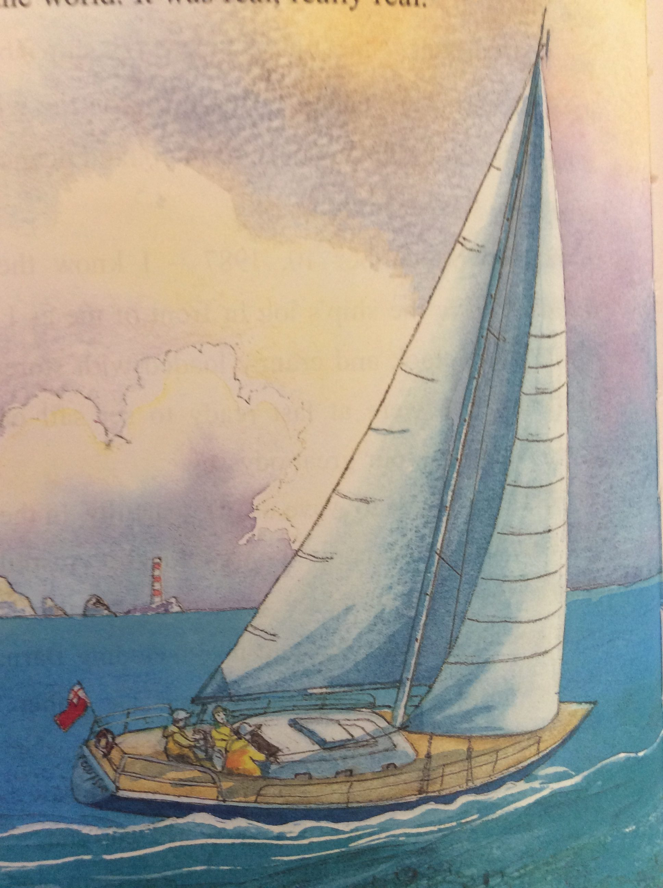
Chapter 2 summary
Here is an example of a summary of chapter 2. Copy and complete it using the words below.
In this chapter we learn about Michael’s ______ life on board the boat. We learn about the things he has to ______ and the tasks he has to _________. Michael has to keep a_______ of the adventure by writing a _______.
record, study, complete, daily, journal

Slide 13
Chapter 2 summary
Check you answers:
In this chapter we learn about Michael’s daily life on board the boat. We learn about the things he has to study and the tasks he has to complete. Michael has to keep a record of the adventure by writing a journal.

Slide 14
Chapter 3
Kensuke’s Kingdom
by Michael Morpurgo
Notes:
<number>

Slide 15
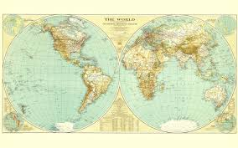
Chapter 3
Chapter three is written as the pages of Michaels log book, his journal. We read all about the journey so far.
As you read through the pages of this chapter make a note of the places they visit in the right order.
Now on a world map outline draw the path of their journey and label the places they stop off. You can also use the sketch maps he includes in this chapter to help you.
You will need to use an atlas and a base map. If you don’t have one you can print the next slide and use that as your base map.

Slide 16
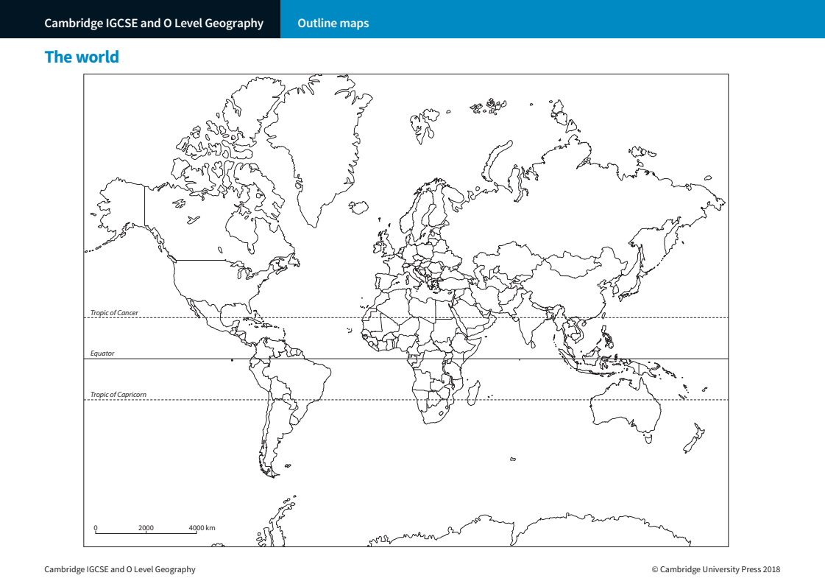

Slide 17
Chapter 3
Now that you have read chapter three which is written as the pages of Michaels log book consider the effect of this writing style. What do you notice about it?
How is it different to a newspaper report for example or a ‘normal’ narrative story style in a novel?
Why do you think the author decided to write the chapter in this way?
What effect does it have on you as the reader?
Journal entries can be used to make the reader see events from the characters perspective, and can also cover long periods of time quickly. It can also be used to reveal more about a characters personality, as we read their personal thoughts and perspectives. This can help the reader connect more to the person writing the journal.

Slide 18
Chapter 3
At the end of this chapter the real story starts, Michael is thrown overboard and the style of writing switches from a journal back to a narrative; he begins to tell his story again.
What do you notice about these two styles of writing, how are they different?
For each one answer the following questions:
Is it written in the first (I, we), second (you) or third person (he, she, it, they)?
Does it use formal or informal language?
Who is it writing for? (who is the intended audience)
Does it follow chronological order?

Slide 19
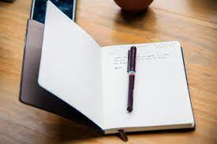
Chapter 3
Now you have read several of Michaels journal entries and have an idea of the style of writing needed for journal writing you are going to have a go.
Imagine that you are Michaels mum or dad. Pick a day of your journey so far (before the accident) and write an entry in your journal. You will have to use your imagination as we don’t know all the details, but you can use some of the information from Michaels journal entry.
For example, you might write an entry about playing football with Michael while they were in Brazil, or perhaps your time visiting family in Australia, or getting the boat fixed or cleaned at one of your stops.
Remember that a journal is personal, it tells the days events from your perspective, is often more informal and shares your feelings about the things that happened that day. It is usually intended to be read either by you at a later date or by a close friend or relative.

Slide 20
QUESTIONS ON CHAPTER 3
1. When Michael and his family first set sail, how many miles a day do they want to do?
2. How many miles a day do they actually do?
3. What game do Michael’s parents play?
4. What do they eat?
5. What creatures do they see off the coast of Africa?
6. In November they went to Brazil. Where did they stop?
7. What did Michael do in Brazil?
8. What did they do on Christmas Day?
9. Describe, in your own words, the incident with Stella Artois.
Notes:
<number>

Slide 21
Chapter 4
Notes:
<number>

Slide 22
Chapter 4
At the start of the chapter things get a bit scary for our protagonist as he falls overboard. Read these sections from the beginning of the chapter and look at how the author creates the tension and the serious atmosphere.
‘ The terrors came fast, one upon another. The lights of the Peggy Sue went away into the dark of the night, leaving me alone in the ocean, alone with the certainty that they were already too far away, that my cries for help could not possibly be heard.’
‘I would be eaten alive. Either that or I would drown slowly. Nothing could save me. I trod water, frantically searching the impenetrable darkness about me for something, anything to swim towards. There was nothing.’
‘Then a sudden glimpse of white in the sea. The breaking of a wave perhaps. But there were no waves. Stella! It had to be. I was so thankful, so relieved not to be all alone. I called out and swam towards her. She would keep bobbing away from me, vanishing, reappearing, then vanishing again. She had seemed so near, but it took several minutes of hard swimming before I came close enough to reach out and touch her. Only then did I realise my mistake. Stella’s head was mostly black. This was white. It was my football. I grabbed it and clung on, feeling the unexpected and wonderful buoyancy of it. I held on, treading water and calling for Stella. There was no answer. I called and I called. But every time I opened my mouth now, the seawater washed in. I had to give her up. I had to save myself if I could.
‘I mustn’t kick too much, just enough to keep my chin above the water, no more. Too much movement would attract the sharks. Morning must come soon. I had to hang on till then. I had to. The water wasn’t that cold. I had my football. I had a chance.’

Slide 23
Chapter 4
Authors use a lot of different techniques to make the reader feel different ways. When something bad happens the author wants the reader to feel the emotions and perhaps sympathise with the character, if there is a tense or scary event the author wants the reader to share the emotions. A good author uses different writing techniques to bring the reader on the journey with the characters of the book. Just like a chef uses different techniques to make a delicious meal; frying, baking, whisking etc.. each method creating different results, so an author uses different writing techniques.
When creating tension an author might use some of the following techniques:
Short sentences – these speed up the action.
Words with connotations – that imply danger or that have links to common scary or frightening events.
Punctuation – apostrophises!!! or ellipsis… These add dynamics to the writing: someone is shouting, excited or angry? And ellipsis can add suspense or tension by creating a pause.
They might also create an ebb and flow of action, something bad then a glimmer of hope, but then..no it’s bad again, but then hope again.
Repetition – repeating certain words can create emphasis, making the reader focus on that word.
Read the section again and see if you can find examples of some of these techniques. Write out your examples and explain the effect they have on you as the reader. If you find this hard I have highlighted sections on slide 19 to help you identify some of these techniques.

Slide 24
Chapter 4
‘ The terrors came fast, one upon another. The lights of the Peggy Sue went away into the dark of the night, leaving me alone in the ocean, alone with the certainty that they were already too far away, that my cries for help could not possibly be heard.’
‘I would be eaten alive. Either that or I would drown slowly. Nothing could save me. I trod water, frantically searching the impenetrable darkness about me for something, anything to swim towards. There was nothing.’
‘Then a sudden glimpse of white in the sea. The breaking of a wave perhaps. But there were no waves. Stella! It had to be. I was so thankful, so relieved not to be all alone. I called out and swam towards her. She would keep bobbing away from me, vanishing, reappearing, then vanishing again. She had seemed so near, but it took several minutes of hard swimming before I came close enough to reach out and touch her. Only then did I realise my mistake. Stella’s head was mostly black. This was white. It was my football. I grabbed it and clung on, feeling the unexpected and wonderful buoyancy of it. I held on, treading water and calling for Stella. There was no answer. I called and I called. But every time I opened my mouth now, the seawater washed in. I had to give her up. I had to save myself if I could.
‘I mustn’t kick too much, just enough to keep my chin above the water, no more. Too much movement would attract the sharks. Morning must come soon. I had to hang on till then. I had to. The water wasn’t that cold. I had my football. I had a chance.’

Slide 25
Chapter 4
I’ve highlighted some of the techniques below:
‘ The terrors came fast, one upon another. The lights of the Peggy Sue went away into the dark of the night, leaving me alone in the ocean, alone with the certainty that they were already too far away, that my cries for help could not possibly be heard.’
‘I would be eaten alive. Either that or I would drown slowly. Nothing could save me. I trod water, frantically searching the impenetrable darkness about me for something, anything to swim towards. There was nothing.’
‘Then a sudden glimpse of white in the sea. The breaking of a wave perhaps. But there were no waves. Stella! It had to be. I was so thankful, so relieved not to be all alone. I called out and swam towards her. She would keep bobbing away from me, vanishing, reappearing, then vanishing again. She had seemed so near, but it took several minutes of hard swimming before I came close enough to reach out and touch her. Only then did I realise my mistake. Stella’s head was mostly black. This was white. It was my football. I grabbed it and clung on, feeling the unexpected and wonderful buoyancy of it. I held on, treading water and calling for Stella. There was no answer. I called and I called. But every time I opened my mouth now, the seawater washed in. I had to give her up. I had to save myself if I could.
‘I mustn’t kick too much, just enough to keep my chin above the water, no more. Too much movement would attract the sharks. Morning must come soon. I had to hang on till then. I had to. The water wasn’t that cold. I had my football. I had a chance.’

Slide 26
Chapter 4
Continue reading chapter 4 to the end of the chapter.
We see that Stella and Michael have survived the sea and begin to explore the new land and Michael starts to think about how he is going to survive.
What things does Michael do to try to survive?
What is Michaels biggest problem?
How does Michael discover that there is someone else on the Island with him?
Read this extract below from near the end of the chapter.
‘A shadow under the trees moved and came lumbering out into the sunlight towards us. A monkey, a giant monkey. Not a gibbon at all. It moved slowly on all fours, and was brown, ginger-brown. An orang-utan, I was sure of it. He sat down just a few feet from me and considered me. I dared not move. When he’d seen enough, he scratched his neck casually, turned and made his way on all fours slowly back into the forest.’
This is from Michaels perspective. Have a go at writing it from the orang-utan’s perspective at seeing Michael and his dog on the beach.
What might he be thinking, do you think he’d be scared of Michael or Stella the dog barking?
Try to describe what the orang-utan sees, just like the author describes what Michael sees. Imagine looking through the orang-utans eyes at Michael and Stella and hearing Stella barking. Do you think it saw the fire and smelt the smoke before Michael did?

Slide 27
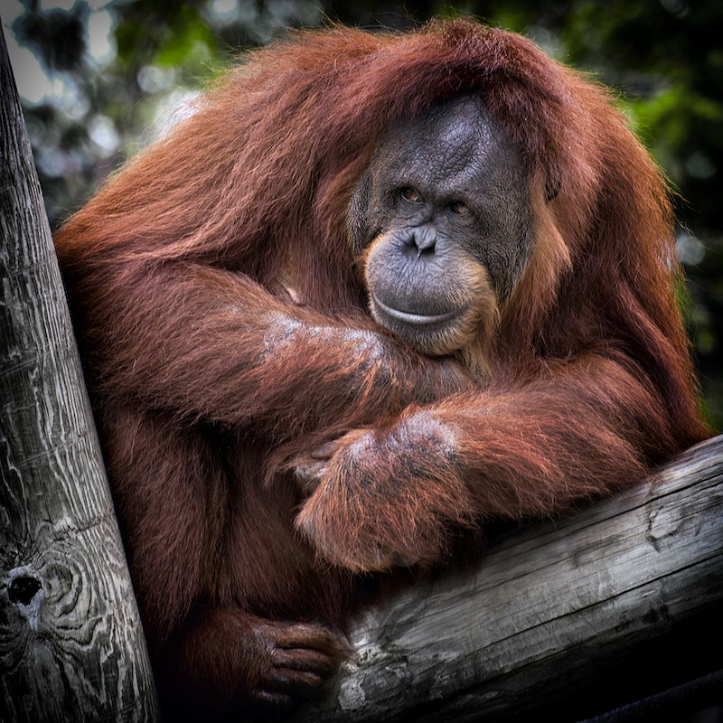
Chapter 4
Read this extract below from near the end of the chapter.
‘A shadow under the trees moved and came lumbering out into the sunlight towards us. A monkey, a giant monkey. Not a gibbon at all. It moved slowly on all fours, and was brown, ginger-brown. An orang-utan, I was sure of it. He sat down just a few feet from me and considered me. I dared not move. When he’d seen enough, he scratched his neck casually, turned and made his way on all fours slowly back into the forest.’
This is from Michaels perspective. Have a go at writing it from the orang-utan’s perspective at seeing Michael and his dog on the beach.
What might he be thinking, do you think he’d be scared of Michael or Stella the dog barking?
Try to describe what the orang-utan sees, just like the author describes what Michael sees. Imagine looking through the orang-utans eyes at Michael and Stella and hearing Stella barking.
Do you think it saw the fire and smelt the smoke before Michael did?

Slide 28
Chapter 4
Here’s an example from the orangutans perspective:
I was sitting under the trees when I hear a strange noise. I saw them standing there, watching me. What were these strange creatures? They did not move, so I slowly went towards them and sat down close by to get a better look. One was standing upright. He had arms and legs like me, but did not have any fur. The other was sat down and had four legs and a long face. I looked at them for a while, but they did not move. The smaller one was still making that loud noise. What strange creatures. I started to smell something strange, like fire and could see some smoke behind them so I went back into the forest to get away.

Slide 29
Chapter 5
Notes:
<number>

Slide 30
Chapter 5: Questions
1. How does Stella react towards Kensuke?
2. What does Kensuke suggest to Michael about the way they share the island?
3. Kensuke leaves food and water for Michael and Stella every morning. What do you think it means?
Notes:
<number>

Slide 31
Chapter Six
Read to the end of Chapter 6. We have learned a lot about Michael.
What sort of person do you think Michael is? Choose SIX of the words below that you think best describes him:
Brave, cowardly, lonely, determined, happy, sad, confused, clever, sensible, angry, foolish, naughty.
Now using these words write 6 sentences about Michael explaining why you think that and giving evidence from the book to back up your idea. For example:
I think Michael is.....determined............... because...he doesn’t give up and feel sorry for himself.....… for example in chapter…4.. Michael….goes walking around the Island looking for water so he can survive.
Notes:
<number>

Slide 32
Chapter 7
Read this article from the BBC about a Japanese soldier stranded on an Island long after WW2 had finished.
ArticleJapanese soldier
Have a look at the articles on the next few slides.

Slide 33
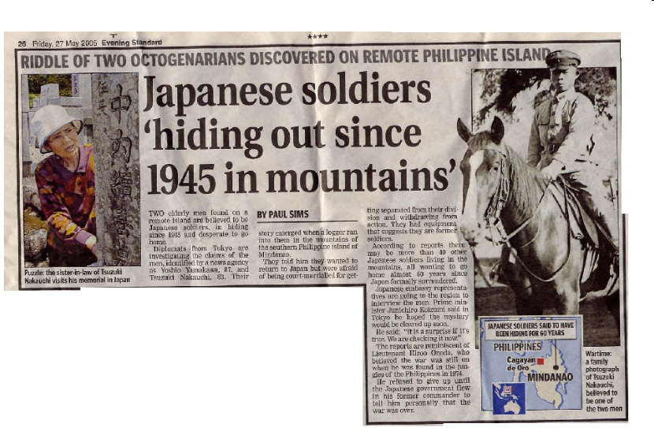
Notes:
<number>

Slide 34
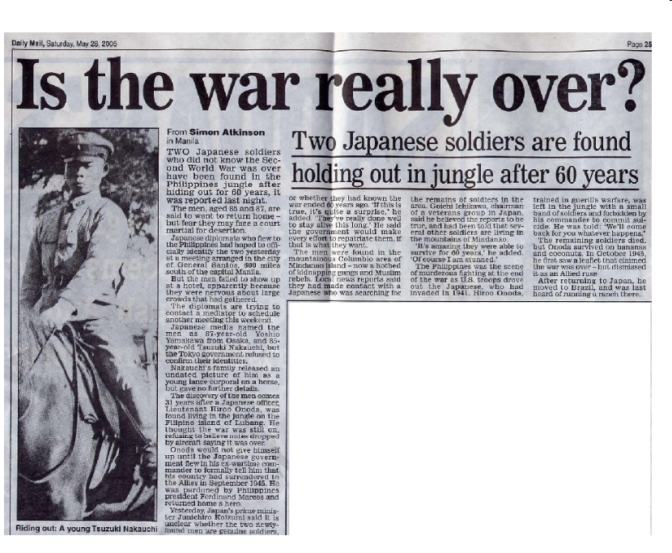
Do you think these articles are true?
Research them article on the internet.
Notes:
<number>

Slide 35
Chapter 8
Read through chapter 8 and then answer these questions:
1. Why does Michael feel that he has to hide his message in the coke bottle?
2. What were Kensuke’s hopes for the future?
3. What has been lost now, between Michael and Kensuke?
Notes:
<number>

Slide 36
To complete a timeline using information from the text.
Complete a time line of Kensuke’s life, from his birth in Japan until he is in the boat with Michael telling his story; include all the significant events.
Birth in Japan
Notes:
<number>

Slide 37
To use evidence from the text effectively.
1. List three things Kensuke teaches Michael.
2. Describe a typical day for Michael and Kensuke.
3. How do you think Michael now feels about Kensuke, and why?
4. Carefully read pages 101-102, and then draw a plan of Kensuke’s cave in your book. Think about what you have read and label your picture with some quotes.
Notes:
<number>

Slide 38
Chapter 9 - Questions
1. Describe the atmosphere between Michael and Kensuke at the beginning of the chapter.
2. What is it that makes Kensuke change his mind about Michael staying on the island?
3. What developments in the world does Michael describe to Kensuke?
Notes:
<number>

Slide 39
Chapter 10 - Questions
1. Describe the rain on the island, and the effect it has on Michael and Kensuke.
2. What happened to the binoculars?
3. How do Michael and Kensuke save the orangutans from the
poachers?
4. What do the poachers do on the island?
5. What were they doing when Kensuke spotted the sail?
6. What does Michael see that makes him realise it’s the Peggy Sue?
7. What are Kensuke’s reasons for staying behind?
8. Do you think that Kensuke has made the right decision? Explain
your views.
Notes:
<number>

Slide 40
Hope you enjoyed reading.

