Slide 1
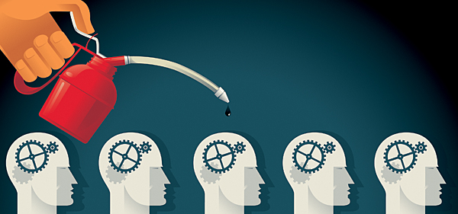
Literacy pack – term 6
Name:_____________________
Year:_______ Form:_________
Teacher:___________________

Slide 3
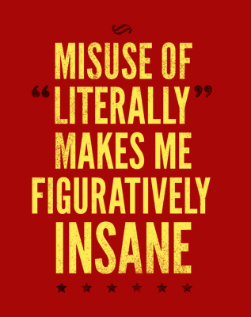

Section one: Denotation and connotation
To be completed by:
______________________________
What do I need to complete?
Spelling test 1
Complete the Do you understand these words? page
Complete the Think a Link page
Read the page on Denotation and Connotation
Complete the task on Denotation and Connotation: words
Complete the task on Denotation and Connotation: phrases
Picking out relevant quotes and phrases
Answer the question on Curley’s Wife
Complete the task: Apply your knowledge
Complete the task: A task for your friend
New vocabulary Ph and Th
Reading comprehension: England’s most capped Player
Self Assessment: What do I still need to practise from this section?

Slide 4
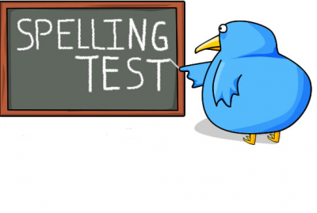
Spelling test 1
You will be tested on your spellings in every
literacy lesson.
You are expected to get at least 17/20 right each time. If you do not manage this you will need to re-take the test at another time.
 | Read | Write | Cover and write
Commonly misspelt words | Does not
 | Doesn’t
 | Actually
 | Although
 | Argument
 | Audible
 | Audience
 | Autumn
 | Beautiful
 | Beginning
 | Believe
 | Beneath
 | Conclusion
 | Conscience
 | Consequence
Topic specific words
Notes:
http://www.saveteacherssundays.com/spelling/

Slide 5

Do you know what all these words mean?
If there are any words on your spelling list that you don’t understand then write them underneath with a definition.
Word | Definition

Slide 6

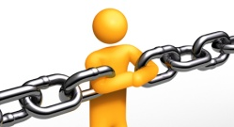

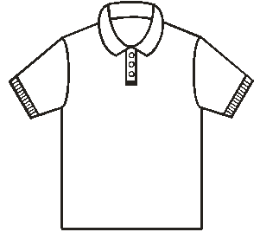
Can you think a link?
Sometimes when we learn words it helps us to learn a rhyme or a saying to help us remember how to spell the word.
Necessary
Every shirt has one Collar (represents the C) and two sleeves (represents the double ss)
Can you create any for the words in the spelling list to help you remember them?
Word | Think a link

Slide 7
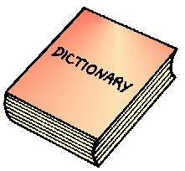
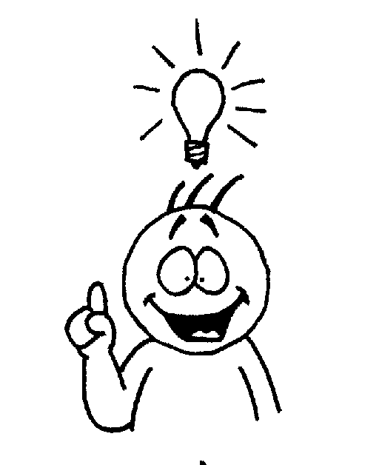

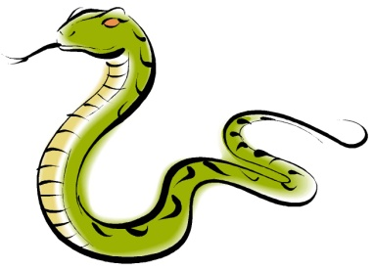
Denotation or Connotation
We have previously looked at literally and figuratively in our literacy packs – we’re going to look at this in more detail now and how it will affect our understanding when analysing a text.
Denotation – the literal meaning of what is being said. You do not need to infer anything from this, it is the dictionary definition.
Connotation – what we infer from the chosen quotes. What is implied by the words that the writer has chosen? You need to look for deeper layers of meaning.
Snake
Denotation | Connotation
Dictionary definition: a long limbless reptile that has no eyelids, a short tail, and jaws that are capable of considerable extension. Some snakes have a venomous bite. | Implied: If used in comparison to a person they may be considered as evil or deceitful. They may also be thought of as slippery and therefore easily escapes a situation. You could also use it to describe the movement of an object to show that is has a fluid movement.

Slide 8

Denotation or Connotation: Words
Complete the denotation and connotation of each word – we will move onto phrases next.
Task
 | Denotation | Connotation
Blood
Red
Black
Saint
Blue
Light
Heart

Slide 9
Denotation or Connotation: Phrases
Complete the denotation and connotation of each word or phrase.
Tip: look at the important words in the sentence to decipher the whole meaning.
Task
 | Denotation | Connotation
“My lips, two blushing pilgrims, ready stand To smooth that rough touch with a tender kiss.” Romeo to Juliet
“Both men glanced up, for the rectangle of sunshine in the doorway was cut off.” As Curley’s Wife enters the barn in Of Mice and Men
“She had full, rouged lips and wide-spaced eyes, heavily made up. Her ﬁngernails were red.” Curley’s Wife – Of Mice and Men
“handsome, clever, and rich, with a comfortable home and happy disposition,” Description of Emma from Emma
“He felt as though he were wandering in the forests of the sea bottom, lost in a monstrous world where he himself was the monster. He was alone.” Description of Winston Smith from 1984

Slide 10

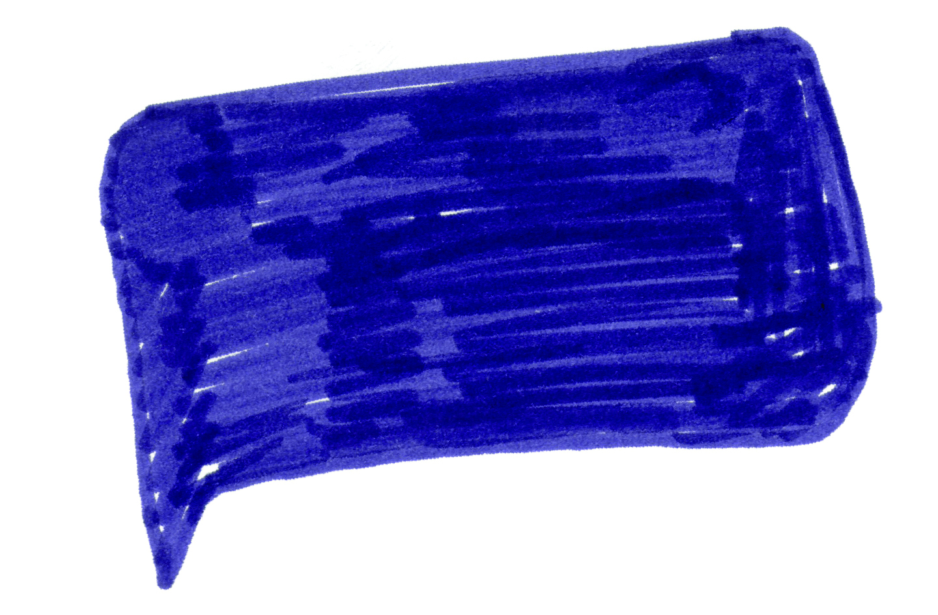
When you are choosing a phrase or a quote to show the writer’s effect you need to ensure that you are choosing something relevant and interesting to talk about!
How can we make it relevant?
Here is an extract from Of Mice and Men and it talks about the character of Curley’s Wife. This extract tells us a lot about her character merely based on her description.
In the previous section we looked at the quote “for the rectangle of sunshine in the doorway was cut off.” The denotation can tell us that the area is very bright and the weather is sunny at the time but when we are analysing we often have to think outside the box in several layers of meaning. For example, Sunshine can often represent hope and by her standing in the doorway and blocking this out could signify that she will in someway destroy their hope.
Both men glanced up, for the rectangle of sunshine in the doorway was cut off. A girl was standing there looking in. She had full, rouged lips and wide-spaced eyes, heavily made up. Her fingernails were red. Her hair hung in little rolled clusters, like sausages. She wore a cotton house dress and red mules, on the insteps of which were little bouquets of red ostrich feathers. ‘I’m lookin’ for Curley,’ she said. Her voice had a nasal, brittle quality.
What do we find out about Curley’s Wife in this extract?
Read through the extract and highlight any key words or phrases that tells you something about Curley’s Wife. Number your points up – there are at least 4 more. Remember to be precise and relevant.
2. Explain what the connotations are in that specific piece.

Slide 11

You have been given two pages to ensure you write as much as possible!

Slide 13
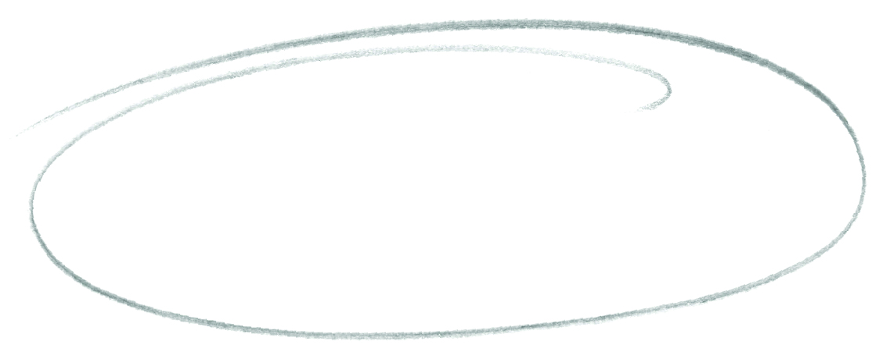
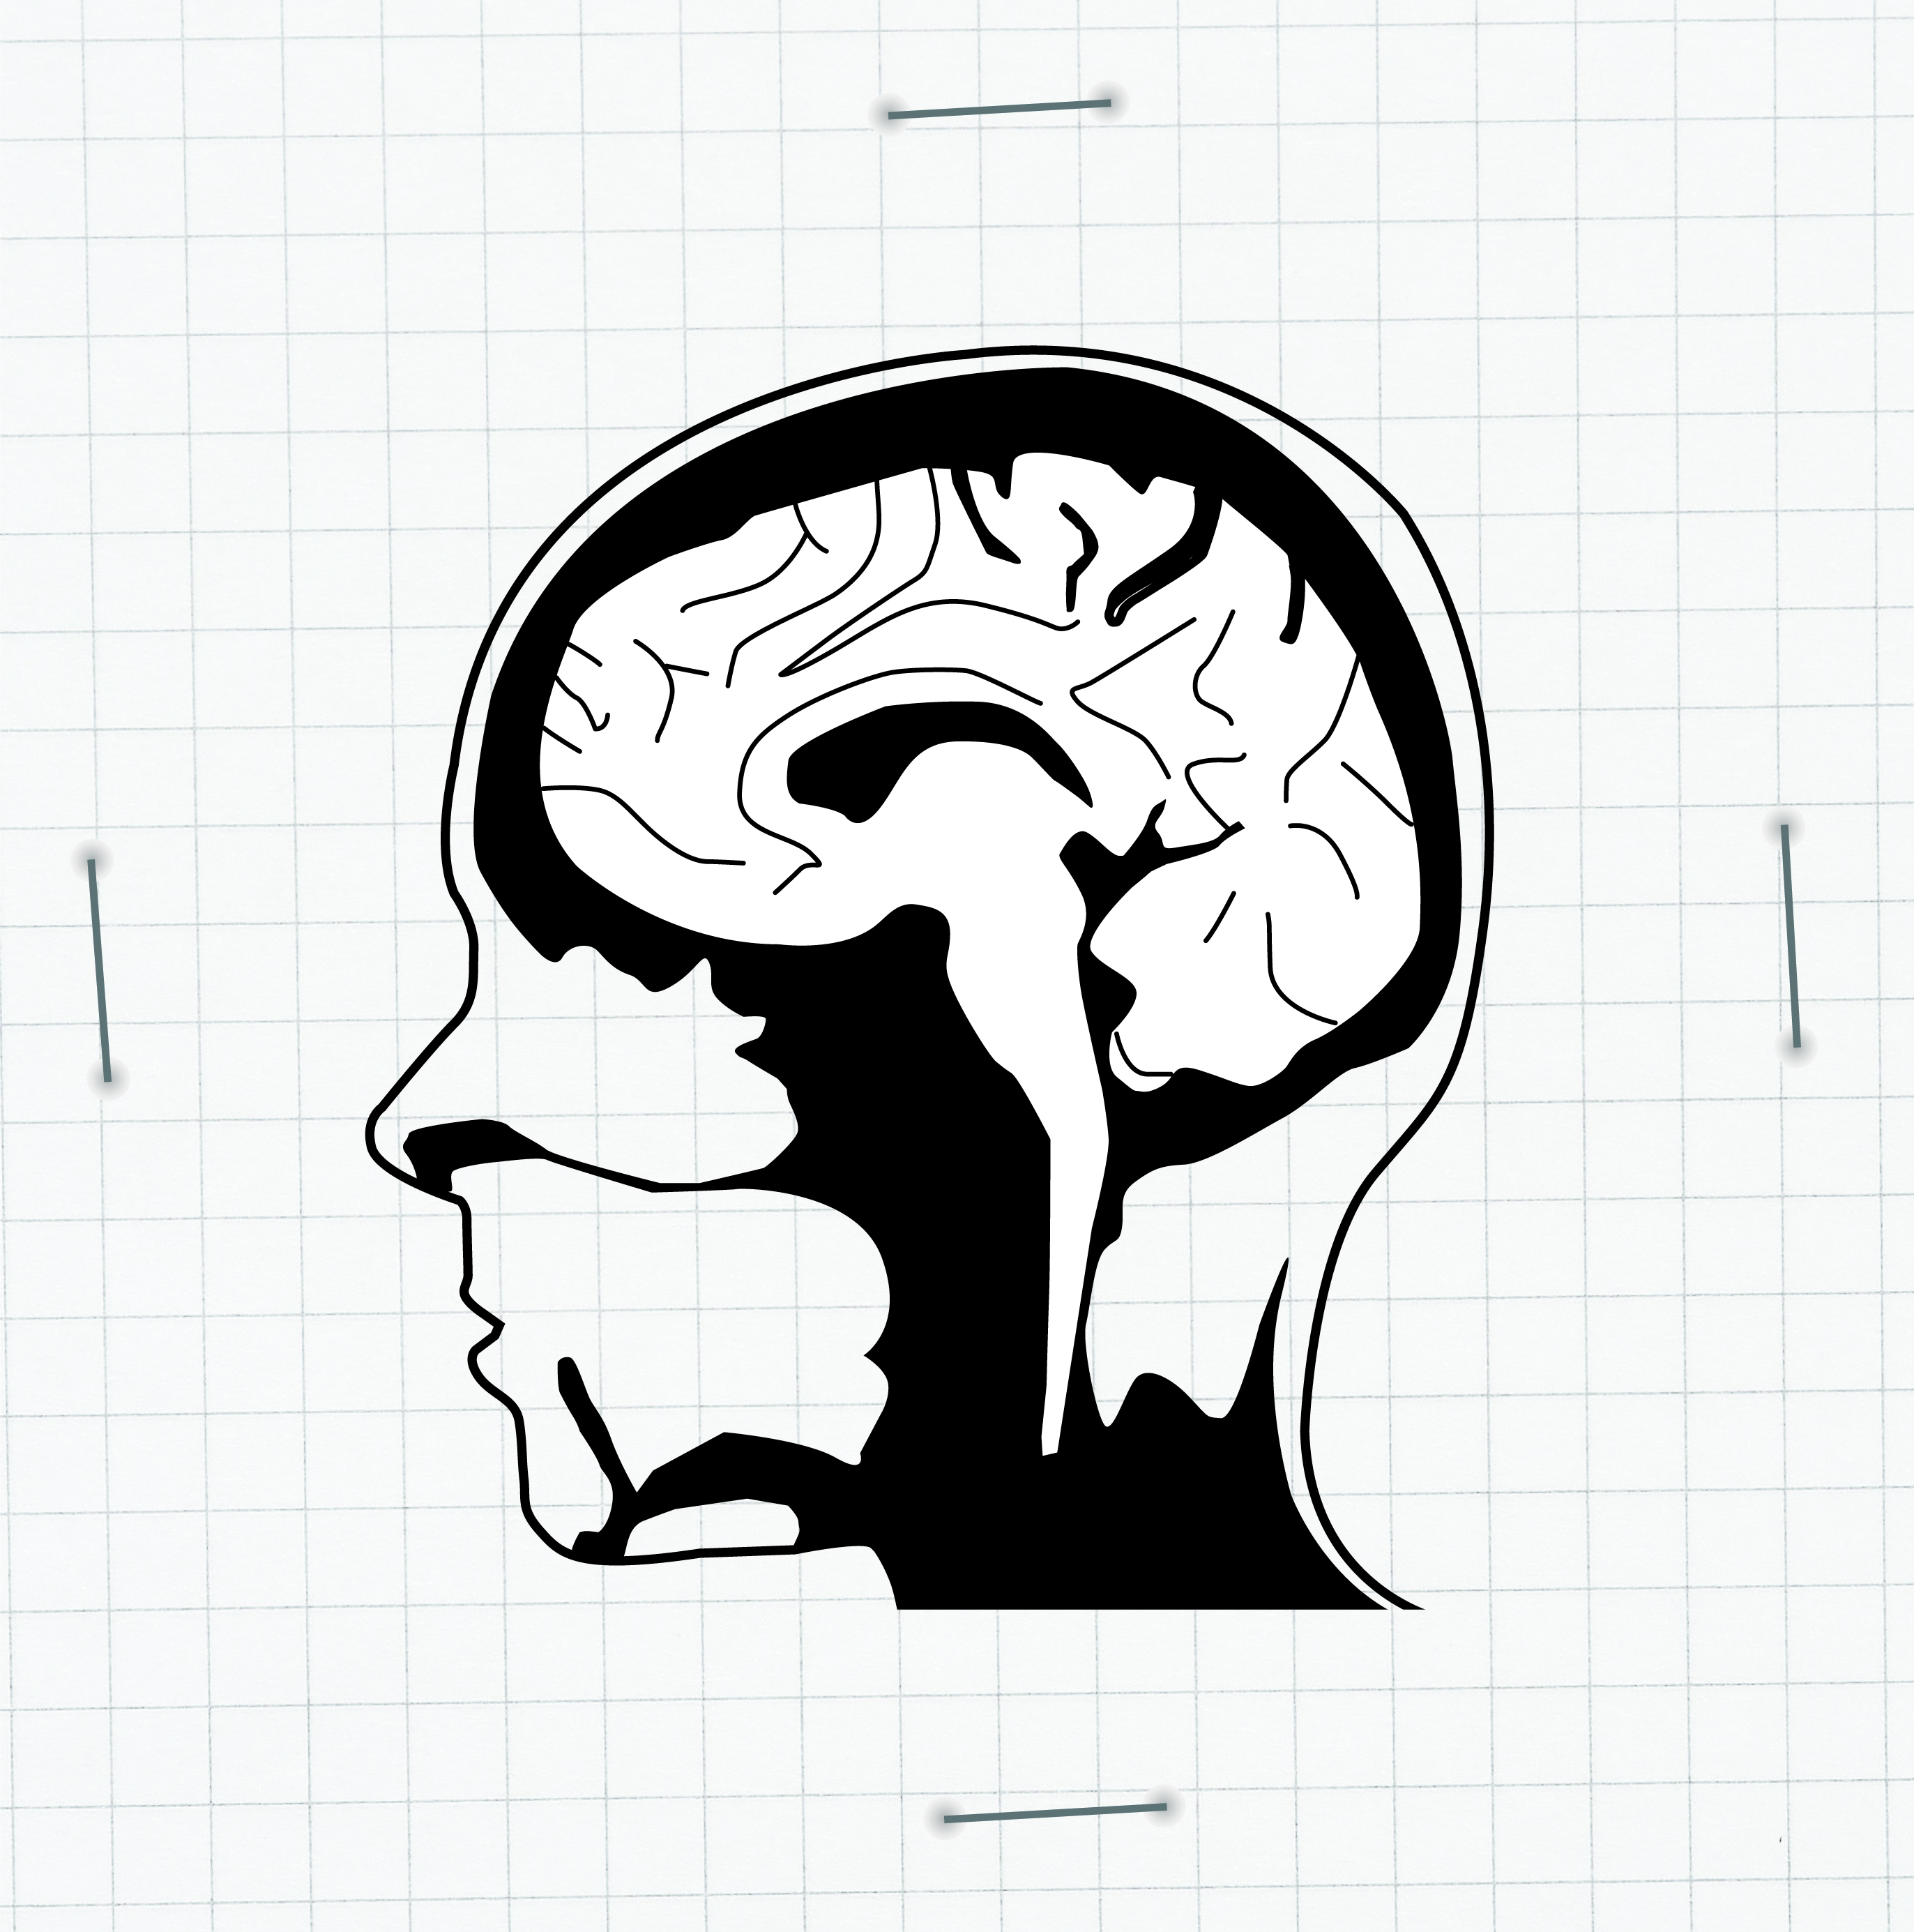
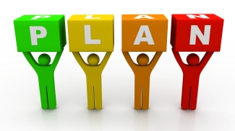

It is time to apply your knowledge (and test a friend!)
Task: Write a short description of a character – you can choose all their qualities and the scenario but you need to think about your language choices carefully as your friend will be analysing your work!
Think! How will you tell them about your character without just saying it?
Plan your character first – don’t forget your SAMOSAP.
What connotative word choices will you use?
Write your description here.
Note – write every other line to ensure your friend has space to annotate and correct your work!

Slide 15
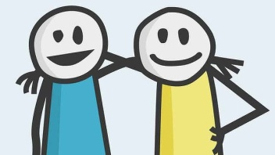
A task for your friend!
Using a green pen go through and SPaG check your partners work
Highlight four phrases that you think you can analyse
Number these phrases
Underneath write a detailed explanation about what this tells us about their character
Write two more sentences to extend their description – think, show don’t tell!

Slide 17
Word (Adjective)
Letter
Ph
Definition
Sentence (using your word):
Synonyms
Antonyms
Word (Adjective)
Letter
Th
Definition
Sentence (using your word):
Synonyms
Antonyms

Slide 18
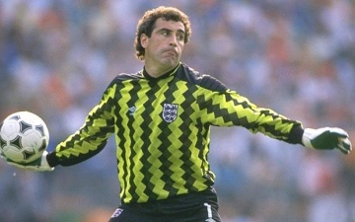
England’s most-capped player
Reading comprehension : Read the extract and answer the questions in as much detail as possible.
Arsenal Ladies star Yankey overtakes Shilton record with 126th England cap but neither achievement should be compared
It will be a quiz question that will perplex even the geekiest of football fans: ‘Who is England’s most capped player?’
‘Easy, Peter Shilton,’ the chaps in the pub will say, scribbling down the name of the twice European Cup-winning goalkeeper , a man who played 125 times for his country during a 20-year international career.
Wrong. Sorry fellas, you didn’t even manage to get the gender right: it’s Rachel Yankey now.
Most people will not have even heard of Yankey, the Arsenal midfielder who made history by winning her 126th England cap in a 1-1 draw against world champions Japan, but the accolade is now – strictly speaking – hers and hers alone.
Congratulations to Yankey on a remarkable achievement, but consider this: Shilton’s last game was the 1990 World Cup third place play-off defeat by Italy. Yankey’s record breaking feat came in a friendly in front of 4,500 school children taking advantage of free tickets at Burton Albion’s Pirelli Stadium. Please let us not do either player a disservice by trying to compare the two.
I involuntarily cringe when I hear television and radio presenters ticking the equal opportunities box by lauding Yankey as England's ‘most capped player of all time’. It might be technically true , but it is downright disrespectful to assume Shilton’s 23 year old record should be scrubbed out and forgotten . If Shilton ventured this opinion he would no doubt be labelled as a sexist lout, so I’m going to argue on his behalf.
Yes he was a goalkeeper, but he also happened to be a professional sportsman vying to be his country’s No1 in the same era as Ray Clemence. It is insulting to see those memories – the three World Cups , two European Championships and 65 clean sheets – erased in the rush to e politically correct. The tenuous comparison with Yankey’s career is almost painful.
This is, however, in no way intended to disparage Yankey’s achievement. She is a stunningly talented player in her own right a footballer who has been at the forefront of a quiet evolution in women’s football during her 17 year career in an England shirt.
Laura Williamson, Mail Online, Wednesday 2 October 2013

Slide 19

uestions
Find two pieces of information about Peter Shilton and two about Rachel Yankee.
How does the writer suggest that we do not take Rachel Yankey’s achievement at face value? You should write about:
The headline
The words the writer uses to compare Yankey’s and Shilton’s careers
The statistics that are used
What tells you that this is a newspaper article and not some other kind of text?
Find five strong adjectives in the article. What effect do they have on the tone (overall feel) of the piece?
Label the AFOREST techniques and explain their effect on the reader.
Look at the last two paragraphs.
How does the writer want us to feel about Rachel Yankee? Which words and phrases tell you this?
How does the writer want us to feel about Peter Shilton? How do you know?
Glossary
Most-capped: has represented their country’s football team in the highest number of international football games.
Face value: the apparent value of something , which might be different from its actual worth

Slide 20
Answer your questions in detail here:

Slide 23

Section two: Checking and proofing
To be completed by:
______________________________
What do I need to complete over the next two weeks?
Spelling test 2
Complete Do you know the meaning of this word? page
Complete the Think a Link page
Complete the spider diagram on proof-reading
SPaG check the writing
Read the instructions on proof reading and editing
Complete the tasks on planning and editing
Re-write the text
New Vocabulary: Au and Aw
Comprehension on The Boys’ Toilets
Self Assessment: What do I still need to practise from this section?

Slide 24
Spelling test 2
You will be tested on your spellings in every
literacy lesson.
You are expected to get at least 17/20 right each time. If you do not manage this you will need to re-take the test at another time.
 | Read | Write | Cover and write
Commonly misspelt words | Continuous
 | Creation
 | Definite
 | Embarrass
 | Explanation
 | Furthermore
 | Imaginary
 | Improvise
 | Moreover
 | Outrageous
 | Parallel
 | Participation
 | Physical
 | Proportion
 | Proposition
Topic specific words

Slide 25
Do you know what all these words mean?
If there are any words on your spelling list that you don’t understand then write them underneath with a definition.
Word | Definition

Slide 26
Can you think a link?
Sometimes when we learn words it helps us to learn a rhyme or a saying to help us remember how to spell the word.
Can you create any for the words in the spelling list to help you remember them?
Word | Think a link

Slide 27
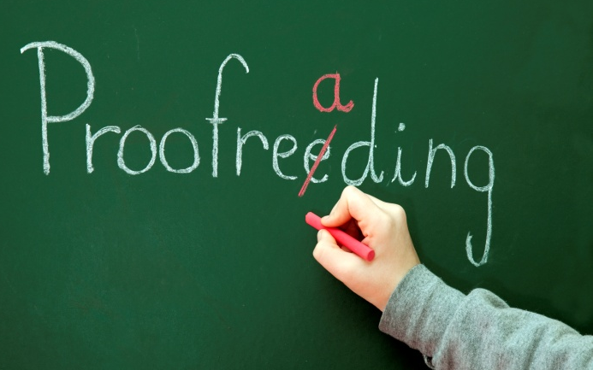

Why is it important to proof read your work and make amendments?
Create a spider diagram below with as many ideas as you can think of. Don’t just apply this to your school work – think about outside of school as well.
Why should I check my work?

Slide 28

When you are checking through your work the first thing you
should check for is correct punctuation and spelling. This is
going to be a large focus when you take your exams so it is
better to ensure we have it all nailed now!
A wrongly placed comma or lack of full stops can change the whole meaning of your piece which could also mean that you lose marks.
Task: Use a green pen to add in any missing spelling and punctuation errors our writer has made.
suddenly i was feeling very sad and alone but i didnt know why i stared into the empty bowl but the gold fish just bobbed on the surfas in a lyfeless way the water was very clean and sparklin jeremy was dead and i had to dispose of his body should i bury him in the garden or should i flush him down the toilet as i thought about it time passed more quickly than i realised it was now two late too go into the garden i walked up the stares to the toilet carryin the heavy bowl i struggld to tip the water into the toilet bowl i didnt fink about what would happen next and as i tryed to flush the water rows up and poured out onto the floor jeremy slide across the tiles toward the door i saw a fluffy paw reach out from the doorway jeremy was gone

Slide 29
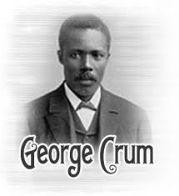

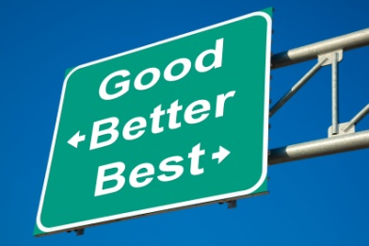
George Crum – accidental inventor of the crisp!
One day a customer sent back his plate of potatoes many times and kept asking for them to be more fried and thinner. Crum lost his temper, sliced the potatoes insanely thin and fried them until they were hard as a rock. To the chef's surprise, the customer loved them and wanted more!
Why did I tell you this?
It is important to realise that people make mistakes and they can be corrected to make something better through editing and experimenting. Do not be afraid to change your work after you have written it – it WILL make it better!
We are now going to spend time editing the writing from the page before – I think we all agree it is pretty poor!
Highlight any words that you think could be improved - put them into the table on the next page and use a thesaurus to find synonyms to replace them.
Use one colour to highlight two sentences – you are going to change these sentences into complex sentences
Use another colour to highlight two different sentences – you are going to change these sentences into –ly, -ed, -ing sentence starters
Highlight one sentence to change into a simile
Highlight one sentence to change into a metaphor
Highlight one sentence to change into personification
Can you add in any extra information that you think the writer has missed?
Use the following pages to help you create a plan!

Slide 30
Thesaurus skills needed!
Original word | Exciting and ambitious synonyms
Sad | Melancholy, depressed, miserable, gloomy, cheerless

Slide 31
 | Original sentence | Improved sentence
Complex sentences
-ly –ed -ing
Simile
Metaphor
Personification
Any additional information?

Slide 32
DO NOT simply re-write it how it was – use all your
plans and additional ideas to make your work excellent!
Task: You are now going to re-draft the first piece of writing

Slide 34
Word (Adjective)
Letter
Au
Definition
Sentence (using your word):
Synonyms
Antonyms
Letter
Word (Adjective)
Aw
Definition
Sentence (using your word):
Synonyms
Antonyms

Slide 35

‘The Boys’ Toilets ‘ by Robert Westall, From Ghost Stories
Reading comprehension : Read the extract and answer the questions in as much detail as possible.
Section 1: The January term started with a scene of sheer disaster. A muddy excavator as chewing its way across the netball-court, breakfasting on the tarmac with sinuous lunges and terrifying swings of its yellow dinosaur neck. One of the stone balls had been knocked of the gate posts, and lay in crushed fragments, like a Malteser trodden on by a giant. The entrance to the science wing was blocked with pile of ochreous clay, and curved glazed drainpipes were heaped like school dinners ‘ macaroni.
The girls hung round in groups. One girl came back from the indoor toilets saying Miss Bowker was phoning the Council, and using words that Eliza Bottom had nearly been expelled for last term...
The next girl came back from the toilets saying that Miss Bowker was nearly crying.
Which was definitely a lie, because here was Miss Bowker now, come out to to address them in her best sheepskin coat. Though she was wearing fresh make-up, and her eyes were suspiciously bright, her famous chin was up. She was brief and, and to the point. There was an underground link in the central heating; till it was mended they would be using the old Harvest Road Boys’ school. They would march across now, by forms, in good order, in charge of the prefects.
Section 2: Then the marching little columns came to a miserable little hump-backed bridge over a solitary railway line., empty and rusting. Beyond were the same kind of houses; but afflicted by some dreadful disease, of which the symptoms were a rash of small window-panes, flaking paint, overgrown funereal privet-hedges and sagging gates that would never shut again. And then it seemed to grow colder still, as the slum-clearances started, a great empty plain of broken brick, and the wind hit them full, sandpapering faces and sending grey berets cartwheeling into the wilderness.

Slide 36

uestions
What kind of atmosphere is built up in section 1?
Pick three images from section 1 that help to build up this atmosphere. Write down two ideas for each image what is the denotation? What is the connotation? (If you cannot remember what this means check in section one of the literacy pack!)
What mood and effect is created by the following quotes?
‘a miserable little hump-backed bridge’
‘a solitary railway line’
‘houses...afflicted by some dreadful disease’
How does the description of the weather add to the mood?
What does the word ‘funereal’ suggest about the privet hedges?
Can you highlight any other language devices in this piece and explain their detonation and connotation?

Slide 37
Answer your questions in detail here:

Slide 39

Section three: Metalanguage
To be completed by:
______________________________
What do I need to complete over the next two weeks?
Spelling test 3
Complete Do you know the meaning of this word? page
Complete the think a link page
Complete the task on revising metalanguage
Read the page on Adverbs
Complete the three tasks on adverbs
New Vocabulary: Au and Aw
Comprehension on Nothing to be afraid of
Self Assessment: What do I still need to practise from this section?

Slide 40
Spelling test 3
You will be tested on your spellings in every
literacy lesson.
You are expected to get at least 17/20 right each time. If you do not manage this you will need to re-take the test at another time.
 | Read | Write | Cover and write
Commonly misspelt words | Queue
 | Reaction
 | Reference
 | Saturday
 | Separate
 | Sequence
 | Sincerely
 | Straight
 | Strategy
 | Technique
 | Unfortunately
 | Wednesday
 | Threw
 | Through
 | Conjunction
Topic specific words

Slide 41
Do you know what all these words mean?
If there are any words on your spelling list that you don’t understand then write them underneath with a definition.
Word | Definition

Slide 42
Can you think a link?
Sometimes when we learn words it helps us to learn a rhyme or a saying to help us remember how to spell the word.
Can you create any for the words in the spelling list to help you remember them?
Word | Think a link

Slide 43
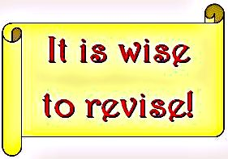


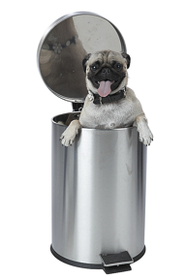
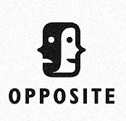
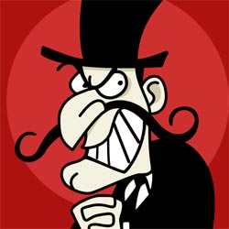
Last term we started to learn about metalanguage, before we learn anymore we are going to revise some of the ones that we looked at before.
Task: Write a short definition and then show a short example. You can work as a group or pair on this task.
Active voice
Definition:
Example:
Passive voice
Definition:
Example:
Preposition
Definition:
Example:
Acronym
Definition:
Example:
Antagonist
Definition:
Example:

Slide 44


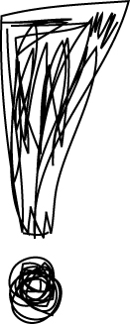
Adverb
How can we tell what an adverb is?
Adverbs can modify (change) a verb, an adjective, a whole clause or another adverb. By using them it adds more detail and therefore more marks – to our writing.
The way I like to remember what an adverb is by breaking the word down. Ad (you are adding something) to the verb (or adjective).
Here are some examples:
Gregory soon started snoring loudly.
The adverbs modify the verbs started and snoring.
That hockey match was really exciting!
The adverb modifies the verb exciting.
We don’t get to play on the Xbox very often.
The adverb modifies the adverb.
Fortunately, it didn’t rain.
The adverb modifies the whole main clause.
Task!
You now have two tasks to complete.
Underline the adverb and explain what the adverb is modifying – like I have shown above.
Read the adverb word bank and add in an extra one for each letter of the alphabet
Modify the sentences adding in an adverb and explaining what you have done.

Slide 45
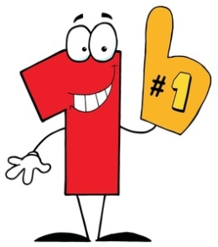
Underline the adverb(s) | Explain what has happened
The class was abnormally loud.
It was bitterly cold outside and i quickly wrapped my scarf around my neck.
Coincidentally, I bumped into my old friend at the busy supermarket.
She eloquently spoke to the crowd while she accepted her Oscar.
He haphazardly chopped up the vegetables and rapidly boiled the water.
Skilfully she flew down the slopes on.
Visibly annoyed, the tired mother begrudgingly purchased the sweets.
Notes:
http://www.enchantedlearning.com/wordlist/adverbs.shtml

Slide 46

Alphabet adverb bank
Arrogantly |  | Impatiently |  | Quaintly
Blindly |  | Joyfully |  | Reluctantly
Clumsily |  | Keenly |  | Silently
Decently |  | Loosely |  | Thoroughly
Emotionally |  | Mechanically |  | Unexpectedly
Famously |  | Nightly |  | Viciously
Graciously |  | Obviously |  | Widely
Habitually |  | Painlessly |  | Yearly

Slide 47

 | Original sentence
 | New and improved sentence
 | What did I add?
 | She went to the park to meet her friends.
 | I love the taste of chocolate.
 | The rain was pouring down and hitting the concrete.
 | The beach was beautiful and the sea was blue.
 | The dead body was rotting in the alleyway.
 | The cork popped out of the champagne bottle.

Slide 48
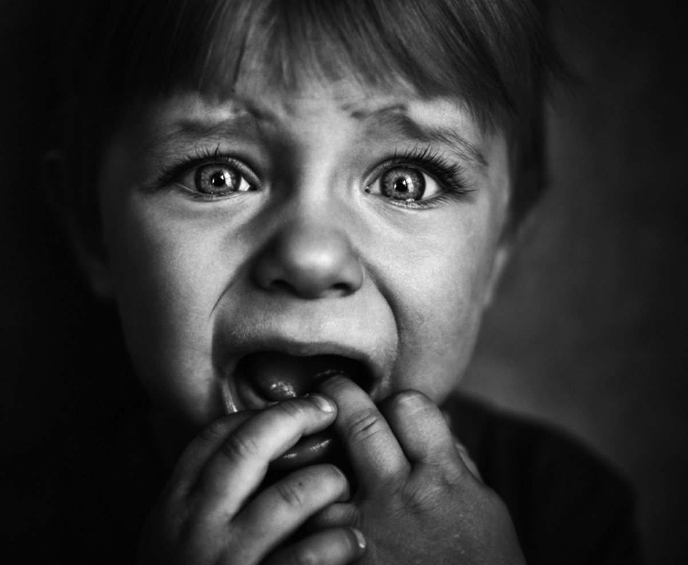
Nothing to be afraid of by Jan Mark
Reading comprehension : Read the extract and answer the questions in as much detail as possible.
This extract is from the beginning of a novel
Section 1: ‘Robin won’t give you any trouble,’ said Auntie Lynn. ‘He’s very quiet.’
Anthea knew how quiet Robin was. At present he was sitting under the table and, until Auntie Lynn mentioned his name, she had forgotten he was there. Auntie Lynn put a carrier bag on the armchair.
‘There’s plenty of clothes, so you won’t need to do any washing, and there’s a spare pair of pyjamas in case – well, you know. In case...’
‘Yes,’ said Mum firmly [...]
Mum almost told Auntie Lynn to stop worrying and have a good time, which would have been a mistake because Auntie Lynn was going up North to a funeral.
Auntie Lynn was not really an Aunt, but she had once been at school with Anthea’s mum. Robin was not anything much, except four years old, and he looked a lot younger; probably because nothing ever happened to him. Auntie Lynn kept no pets that might give Robin germs, and never bought him toys that had sharp corners to dent him or wheels that could be swallowed. He wore balaclava helmets and bobble hats i winter to protect his tender ears, and a knitted vest under his shirt in summer in case he overheated himself and caught a chill from his own sweat.
Section 2: His face was as pal and flat as a saucer of milk, and his eyes floated in it like drops of cod liver oil; also with extract of milk, concentrated orange juice and calves-foot jelly. When you picked him up you expected him to squelch, like a hot water bottle full of half-set custard.
Anthea lifted the table cloth and looked at him.
‘Hello, Robin.’
Robin stared at her with his flat eyes and went back to sucking his wooly doggy that had flat eyes also, of sewn-on felt, because glass ones might find their way into Robin’s appendix and cause damage.

Slide 49

uestions
In section 1 what kind of things can you infer (understand) about ‘Auntie’ Lynn’s treatment of her son? Choose three quotes from the text and explain what they tell you.
Write a detailed response explaining what you infer about the character of Robin in section 1.
What is implied about Robin in section 2? Use quotes to back up your ideas.
Who do you think the narrator is and why? What specific language tells us this?
Why do you think the writer chose to show the story from this perspective?
Do you think Auntie Lynn’s protective nature is over the top? Remember to justify your answer in detail.

Slide 50
Answer your questions in detail here:

Slide 52
Word (Adjective)
Letter
Wh
Definition
Sentence (using your word):
Synonyms
Antonyms
Letter
Word (Adjective)
W
Definition
Sentence (using your word):
Synonyms
Antonyms

Slide 53
Spelling test time
 | Test 1 | Test 2 | Test 3
Commonly misspelt words
Topic specific words
 | Total: /20 | Total: /20 | Total: /20

Slide 54
Choose your words wisely!
Relevant | Interesting | Ambitious

