Slide 1
Population control
The Giver

Slide 2
Thought experiment: The cave
You are part of a tourist group exploring some caves by the ocean.
When leaving a particularly narrow cave mouth, an overweight lady gets stuck - trapping the entire group in the cave.
With the tide coming in fast, unless you can move the lady you will all drown.
One of your group is carrying dynamite. You can use it to blow open the cave mouth, but the lady will die if you do.
What do you do?

Slide 3

Utilitarian
Humanitarian
Better that one person dies than everybody dies.
It’s wrong to kill anybody.

Slide 4
Learning Objectives
To understand the issues surrounding population control.
To analyse the use of language in The Giver
To evaluate arguments for and against population control
Question: Why might a society want to control how big their population is? How might they do this?
Why might society want to control population?

Slide 5
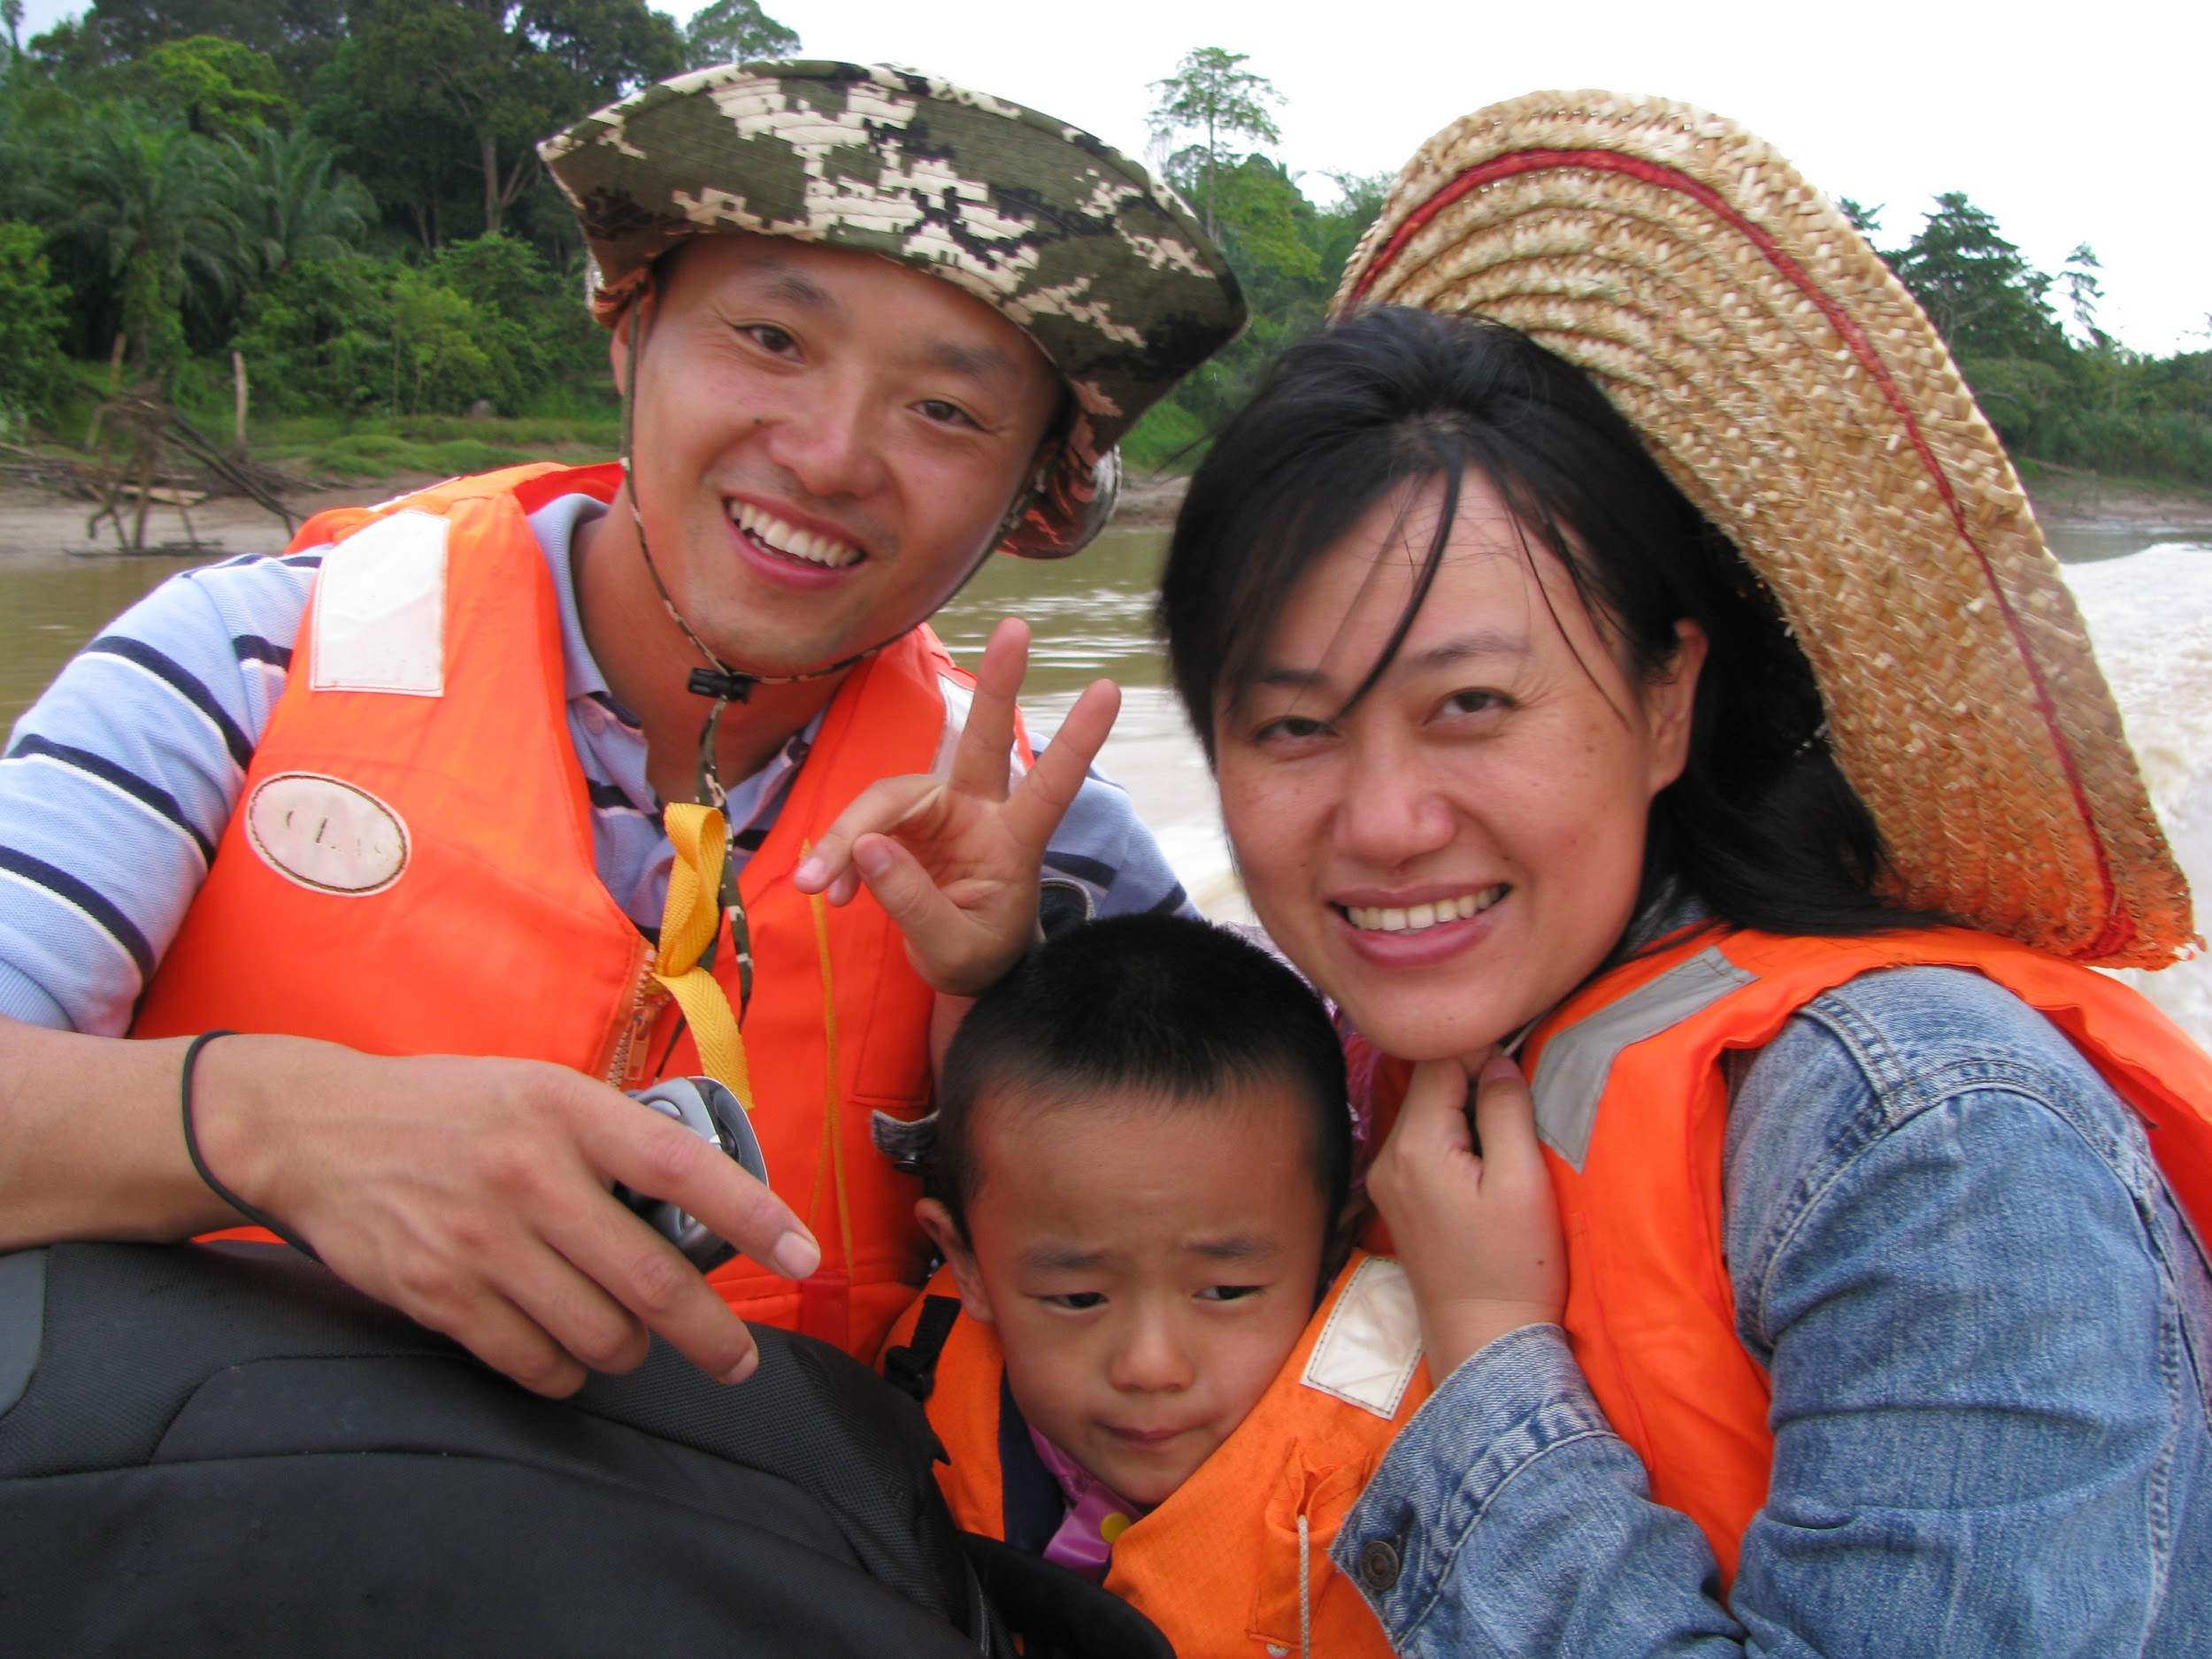
China
China is the country with the largest population in the world. In 1979, the Chinese government feared that population growth was getting too large to be sustainable, so they instituted a new law - only one child was allowed per family.
What do you think would be the pros/cons of a law like this?

Slide 6

China
Many women, fearing breaking the law, turned to abortion and sterilisation.
In addition to this, because of a tradition preference for boys, a large proportion of baby girls were abandoned or killed. This has led to Chinese men outnumbering Chinese women by more than 60 million.
The policy was relaxed in 2013. Couples can now apply to have a second child if their first child is a girl.

Slide 7
Extract 1
"Of course," Mother said, and Jonas and Lily nodded. They had heard Father complain about the night crew before. It was a lesser job, night-crew nurturing, assigned to those who lacked the interest or skills or insight for the more vital jobs of the daytime hours. Most of the people on the night crew had not even been given spouses because they lacked, somehow, the essential capacity to connect to others, which was required for the creation of a family unit.
"Maybe we could even keep him," Lily suggested sweetly, trying to look innocent. The look was fake, Jonas knew; they all knew.
"Lily," Mother reminded her, smiling, "you know the rules."
Two children--one male, one female--to each family unit. It was written very clearly in the rules.
Lily giggled. "Well," she said, "I thought maybe just this once."

Slide 8
Questions
UNDERSTANDING: What does Lily ask of her parents in the extract?
ANALYSIS: What is the effect of the short sentences in the second-to-last paragraph?
INTERPRETATION: Why do you think Lily asks this question of her parents?
Can you tell the difference between UNDERSTANDING, ANALYSIS and INTERPRETATION?

Slide 9
UAI: Understanding, Analysis, Interpretation.
UNDERSTANDING: Do you understand what the text says?
ANALYSIS: Can you tell how the language has been used for effect?
INTERPRETATION: Can you tell why the writer has done something?

Slide 10
Is a small family better?
Draw a table to list the pros and cons of a small family, and the pros and cons of a big family. Think beyond just saying one is small and one is big. Think of the events that a small family could do and a large one couldn’t, the communication in both, money issues, and many more elements of the two. Once you have completed your table, write a concluding statement giving your own view on whether it is better to have large or small families.
Pros of a small family | Cons of a small family

Slide 11
Extract 2
"I want to get to sleep early tonight," Father said. "Tomorrow's a busy day for me. The twins are being born tomorrow, and the test results show that they're identical."
"One for here, one for Elsewhere," Lily chanted. "One for here, one for Else--"
"Do you actually take it Elsewhere, Father?" Jonas asked.
"No, I just have to make the selection. I weigh them, hand the larger over to a Nurturer who's standing by waiting, and then I get the smaller one all cleaned up and comfy. Then I perform a small Ceremony of Release and--" He glanced down, grinning at Gabriel. "Then I wave bye-bye," he said, in the special sweet voice he used when he spoke to the newchild. He waved his hand in the familiar gesture.

Slide 12

Release
Read up to at least chapter 10.
You have read about the release of the elderly. Use your knowledge from the book to explain what release is. Make sure to mention quotes and pages from the book that helped you understand what release is.

Slide 13
Review questions
What is familiar about family life in the society? What is different?
What do we learn about the way the society tries to control the population?
What are the reasons given in support of population control?
Do you agree or disagree and why?

Slide 14
Names
In the book names are very important. No two people that are living in the community have the same name. Names are only given again when someone is Released or there was a Loss. The Elders pick the names for the new children just like your parents do for you.
Look up Jonas’ name; what does it mean?
Do you think is represents who he is as a person? Explain why or why not.
Do the same for your own name and your best friend’s name. Make sure to support your answers.

