Slide 1

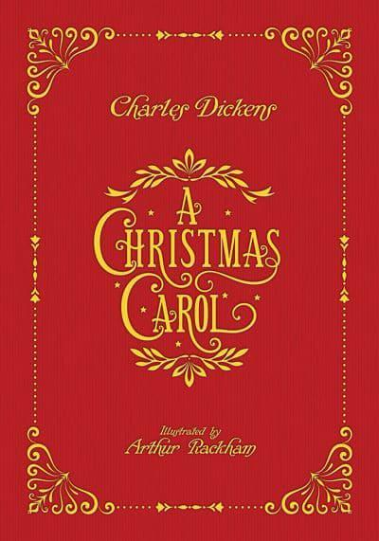
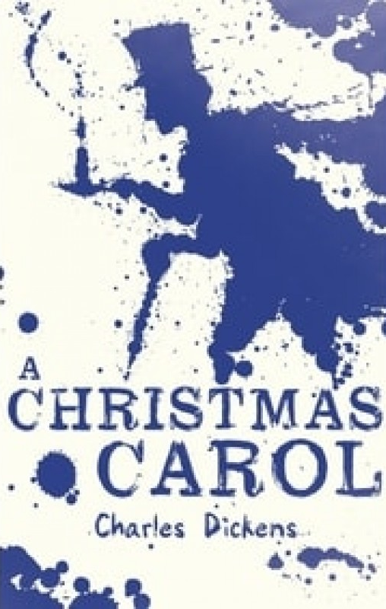
A Christmas Carol
by Charles Dickens
When studying a piece of literature it is important that you know the context in which the author was writing. This helps us to fully understand the ideas, attitudes and feelings that they are trying to convey.
For this reason before we begin reading the book we will first have a quick overview of the life of the author himself then we will take a quick look at Victorian England, the period in which Charles Dickens lived.

Slide 2
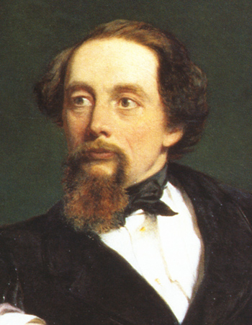
Charles Dickens
Watch this short video and answer the following questions: Click here for the video
When was Charles Dickens born?
Describe his family.
What happened after the family moved to London?
Describe his writing career: how did he become a writer? Where did he find inspiration? How did his career end?

Slide 3
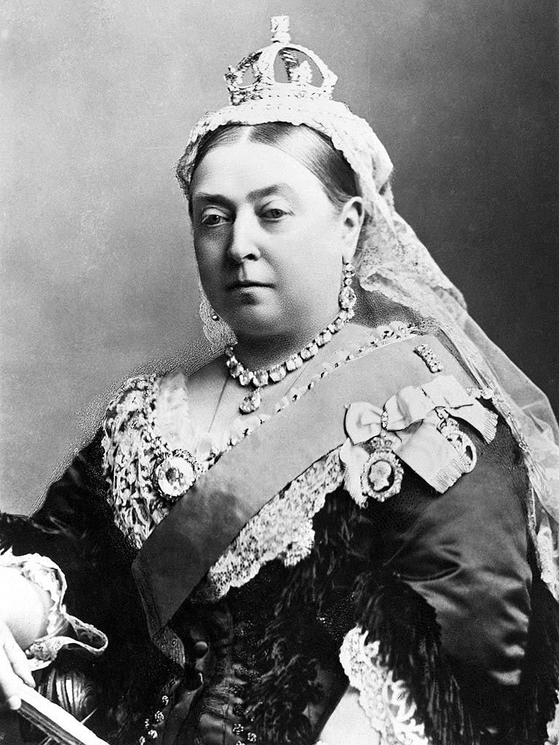
Victorian England
Queen Victoria ruled England from 1837 to her death in 1901, for this reason the 1800’s in England are often referred to as the Victorian era.
On a page of your book create a spider diagram of what you already know about life in Victorian England.
Now as you read through the following slides and watch the video clips add any new information you have found to your spider diagram.
If you’ve never made a spider diagram before the next slide will help you begin.

Slide 4
Add information here about education in this period.
Social structure: are there upper/lower classes
Economy – is the country rich/poor.
Industry
Agriculture
Foreign policy; Empire/wars etc..
Victorian England
Religion: what did people believe?
Science and Medicine: were there any new scientific breakthroughs?
Famous people from that era.
Fashion
Music/Artists
Inventions during this period

Slide 5
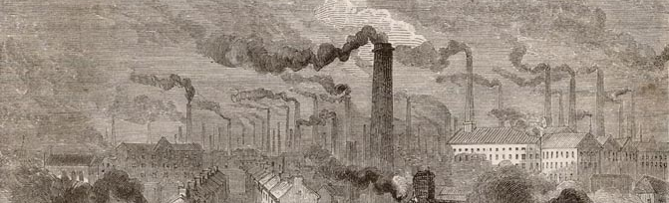
Victorian England
The industrial revolution brought great wealth and development to the country but it also caused over crowding and pollution. People moved in their thousands from rural to urban areas to find work, but lack of adequate housing caused overcrowding in the cities. Poor sanitation led to widespread disease and increased mortality, especially in children.
Working conditions in the factories were terrible, with long hours and low pay. It was common for children to work, even from the age of 4 in factories until 1847 when the factory act ruled it illegal for children under 9 to work. There were calls for social reform. Watch this short video summary of the Industrial revolution in England.

Slide 6
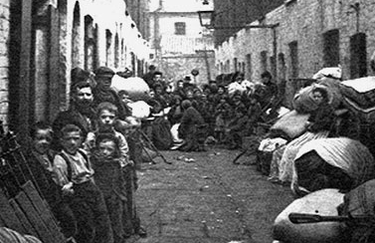
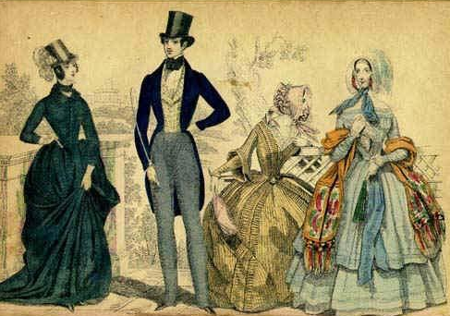
Social divide
The divide between the rich and the poor was vast. Low wages meant little money for food, so diet was poor. This in turn led to sickness and low life expectancy. People turned to crime in desperation for food which worsened conditions for the poor. There were calls for reform from the middle classes. Dickens himself used his writing to highlight the plight of the poor, particularly children.

Slide 7
Victorian England
If you want to find out more explore these websites and watch this video: Life in the Victorian Era.
Silly Names of the Victorian Era (just for fun)
http://en.wikipedia.org/wiki/Queen_Victoria
http://www.bbc.co.uk/schools/primaryhistory/victorian_britain/children_in_factories/
http://www.victorianchildren.org/victorian-child-labor/
http://www.bbc.co.uk/schools/gcsebitesize/history/shp/britishsociety/thepoorrev1.shtml

Slide 8
Writing Task
Using what you now know about life in the Victorian era complete the following task:
Imagine that you are a child working in a factory in London during the Victorian era. Although many children couldn’t read and write then, we will image you can.
Write a diary entry describing a normal day in your life. Try to engage all your senses; what you hear, taste, smell, see and touch as well as what you do and how you feel.
There’s and simple example on the next slide to help you along, you can use it as a starting point and improve it if you prefer.

Slide 9
Example diary entry
Dear Diary,
I’m so tired I can hardly write tonight. I’ve been at work all day at the factory….
We had a 10 minute lunch break and my friend shared some bread with me which was really kind of her as I’m sure she would have liked to eat it all, there wasn’t much. At least I have a job though, even if I don’t earn much, it helps mum and dad. My friends dad had to go to the debtors prison and we don’t want that to happen. I best try and get some sleep now, will be up at 5 to go to work. It’s not easy to sleep with 5 in a bed though, its so crowded our family have to share one room in a house with 3 other families. My brother keeps kicking me in the back! I can hear my stomach rumbling, might get porridge for breakfast if we’re lucky. Night.

Slide 10
A Christmas Carol
by Charles Dickens
Stave One
Dickens presents his novella (short novel) in staves rather than chapters, as though it were a piece of music, giving reference to the name ‘ A Christmas Carol’. In stave one we first meet the main character Ebenezer Scrooge.

Slide 11
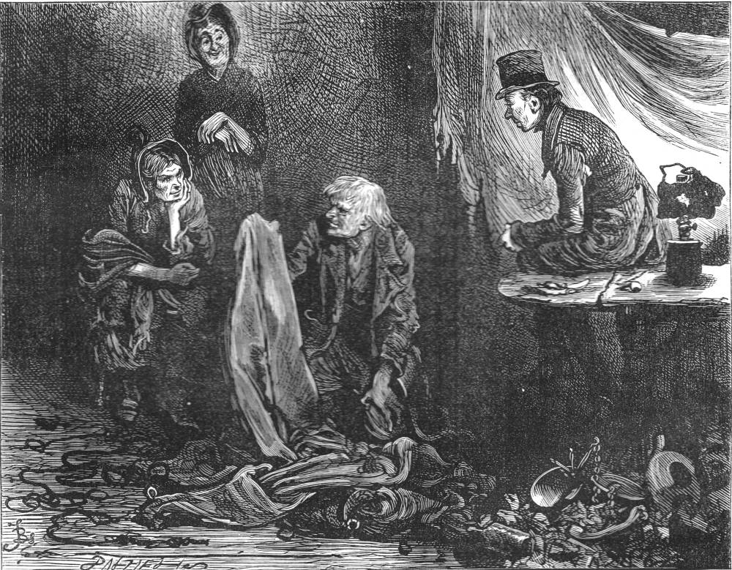
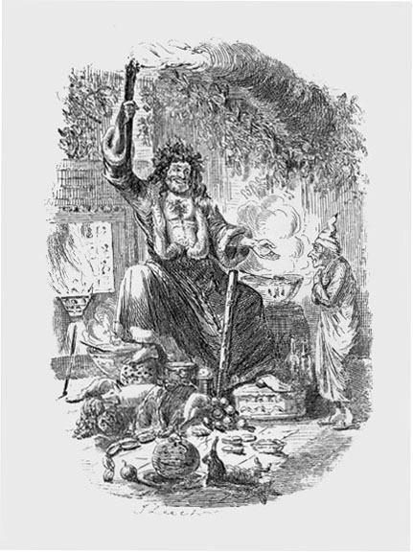
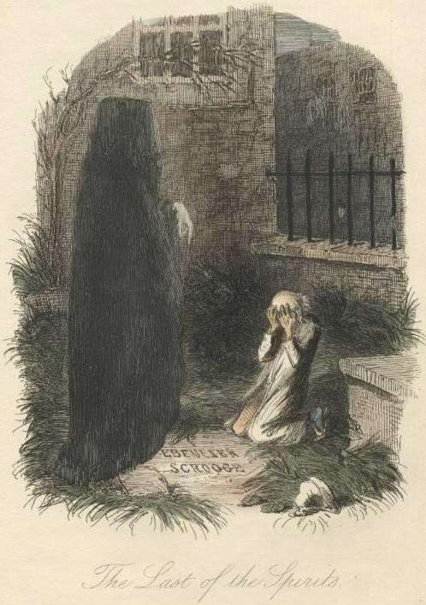
Stave One
A Christmas carol is one of Dickens best known novellas and has been reproduced many times and made into films a number of times, so you probably already have an idea of the story.
Look at these illustrations from the original novella. What can you infer from them about the story and the character Scrooge?

Slide 12
Stave One: Ebenezer Scrooge
Oh! But he was a tight-fisted hand at the grindstone, Scrooge! a squeezing, wrenching, grasping, scraping, clutching, covetous, old sinner! Hard and sharp as flint, from which no steel had ever struck out generous fire; secret, and self-contained, and solitary as an oyster. The cold within him froze his old features, nipped his pointed nose, shriveled his cheek, stiffened his gait; made his eyes red, his thin lips blue and spoke out shrewdly in his grating voice.
Read this excerpt of Dickens’ description of Scrooge.
Make a list of the words and phrases that reveal his character.

Slide 13
Stave One: Ebenezer Scrooge
Oh! But he was a tight-fisted hand at the grindstone, Scrooge! a squeezing, wrenching, grasping, scraping, clutching, covetous, old sinner! Hard and sharp as flint, from which no steel had ever struck out generous fire; secret, and self-contained, and solitary as an oyster. The cold within him froze his old features, nipped his pointed nose, shriveled his cheek, stiffened his gait; made his eyes red, his thin lips blue and spoke out shrewdly in his grating voice.
Look up in any words you don’t understand and write the definitions out.
What is the effect of writing so many adjectives in a single sentence like this? Why do you think Dickens made this choice?

Slide 14
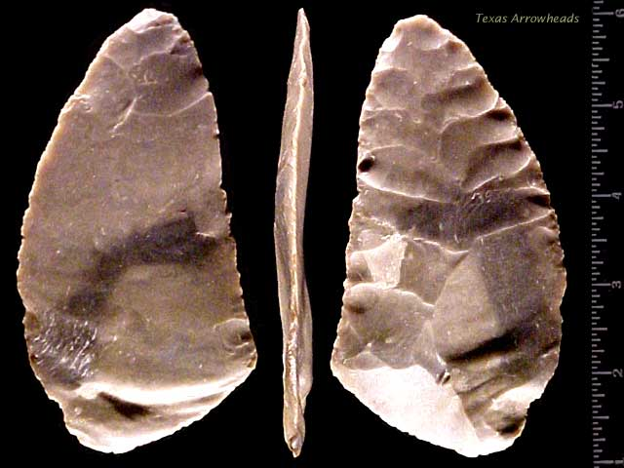
Stave One: Ebenezer Scrooge
‘Hard and sharp as flint’
What does this simile tell us about his character?
Think about the properties of flint: What is it? What is it used for? What colours? How does it feel?
Now you have considered what flint is like, transfer these ideas to Scrooge. What does it tell us about him?
NB: a simile is an expression involving the comparison of one thing with another thing of a different kind. It is used to make a description more emphatic or vivid to the reader or listener.

Slide 15
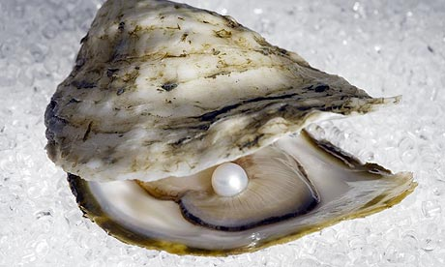
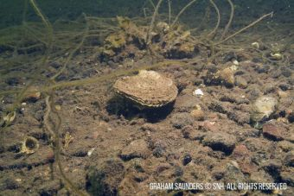
Stave One: Ebenezer Scrooge
‘Solitary as an oyster’
What does this simile tell us about his character?
Think about where an oyster is found. What is it like there?
Also think what is hidden inside – could this be a hint to something hidden in Scrooge?
Now you have considered what an oyster is like, transfer these ideas to Scrooge. What does it tell us about Scrooge?

Slide 16
Stave One: Ebenezer Scrooge
Dickens also uses metaphors to describe Scrooge, ‘he was tight-fisted hand at the grindstone’. What do you think this metaphor means?
Find another example of a metaphor in stave one and explain its meaning.
Building a clear and detailed picture of your main character is a very important part of writing a novel. Your reader has to feel that they know your characters in order for them to enjoy and engage in the story. How does the use of similes and metaphors help you as the reader to understand the character of Scrooge?

Slide 17
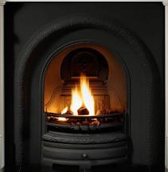
Stave One: Ebenezer Scrooge
Fire and warmth is used as symbolism for the Christmas spirit of hope, joy and generosity, throughout the novella.
Dickens compares Scrooge to the cold to tell us something about his character, what does it tell us?
We then see it used in his counting house ‘Scrooge had a very small fire, but the clerk’s fire was so very much smaller’ which reflects his attitude towards others.
As the story unfolds we see this warmth increase in Scrooge as he embraces the Christmas spirit.

Slide 18
Stave One
‘The door of Scrooge's counting-house was open that he might keep his eye upon his clerk, who in a dismal little cell beyond, a sort of tank, was copying letters. Scrooge had a very small fire, but the clerk's fire was so very much smaller that it looked like one coal. But he couldn't replenish it, for Scrooge kept the coal-box in his own room…’
What do we learn about Scrooges relationship with his clerk from this extract?
What does this excerpt tell us about their social positions? Try to include a relevant quote from the text above in your answer by using PEE – make your point, add your evidence, explain the connection.

Slide 19
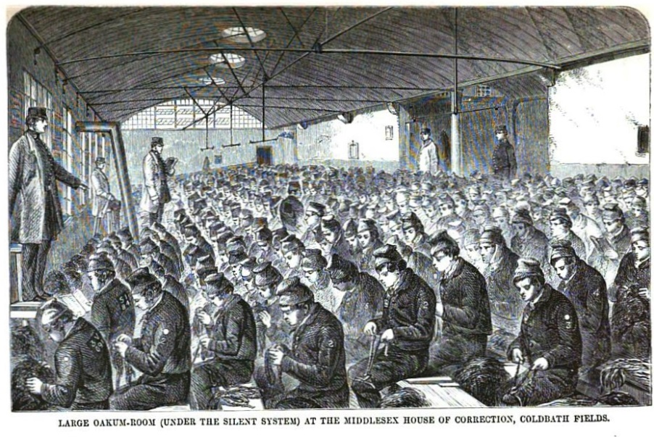
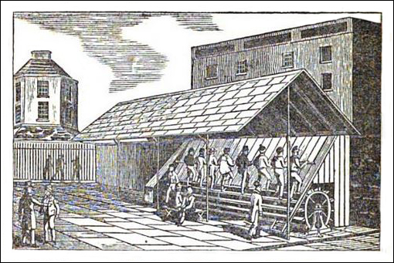
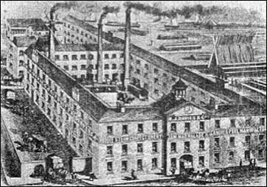
Stave One
Prison
You will come across a few important contextual references as you read the first stave:
The Poor house / workhouse: Because the cost of looking after the poor was so high in 1834 the Poor Law Amendment Act was passed by Parliament. This stopped financial help going directly to poor people except in exceptional circumstances. Now if people wanted help they had to move to the workhouse to get it.
Prisons – the Treadmill: The crime rate rose rapidly in the 1800’s. The Government responded by building prisons. They were unpleasant places, to deter people from committing crimes. Once inside, prisoners were made to do hard, boring work. Walking a treadmill or picking oakum (separating strands of rope) were the most common forms of hard labour.
Treadmill
Workhouse

Slide 20
Stave One
The issues surrounding the lives of the poor are often raise by Charles Dickens in his Novels.
Bob Cratchit and his family represent ‘the poor’ in A Christmas Carol. What is Scrooges view of the poor?
The way Bob Cratchit and his family are portrayed is a reflection of how Dickens views the poor. As we read more and find out more about Bob Cratchit and his family you will see how different these views are.
As you read through the novella keep in mind that Dickens is trying to challenge upper class views on the poor in society.

Slide 21
Stave One
Now read through the rest of stave one. As you read make a note of quotes as evidence that reinforce or further build your ideas about Scrooges character. You can create a table like this to help keep track. This will be used as a basis for an essay.
Character trait / adjective | Location | Quote / Evidence

Slide 22
Stave One: The Poor
“decrease the surplus population”
Cold, economical language: the poor are numbers on a ledger to Scrooge.
Scrooge dehumanises the poor and separates them from the rich.
As the poor don’t add wealth into society, he considers them of no use – surplus to requirements.
Watch this video clip. This quote from Scrooge clearly shows his attitude to the poor. Use this quote along with evidence from stave one and what you know of the Victorian era to answer the following question:
What is Scrooge’s attitude to the inequalities in society?

Slide 23
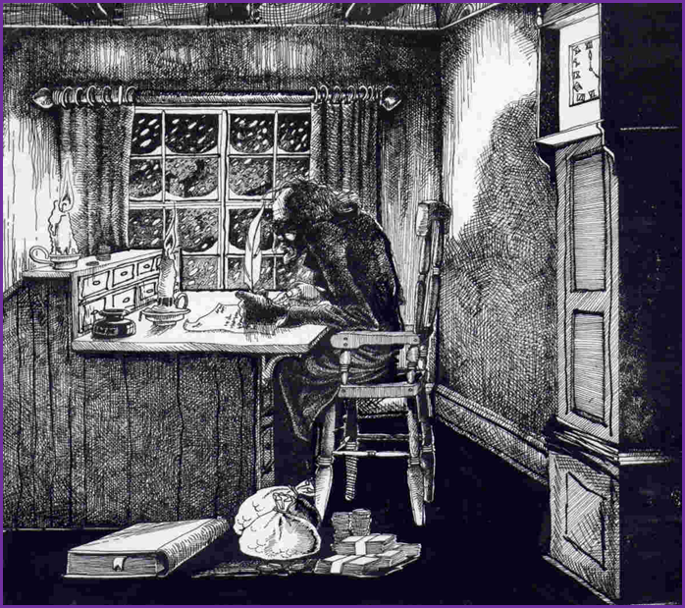
Character essay: How does Dickens present the character of Scrooge in the first stave of the Novella?
Use PEE – Point, Evidence, Explain as a frame and your table of evidence. Try to make at least 3 points.
e.g.
Make your point – ‘Dickens presents Scrooge ….’
Add your evidence – ‘Dickens uses the simile as.…’
Explain – ‘this suggests that...’
Stave One

Slide 24
Character essay: How does Dickens present the character of Scrooge in the first stave of the Novella?
Point - A number of different metaphors are used to describe Scrooge’s character. For example…
Add your quote as evidence and then your explanation.
Point - Dickens also uses a variety of similes to describe Scrooge. . + Evidence and Explanation
Point - Dickens takes time comparing Scrooge to the weather and in particular to the cold. He uses a number of linked images of cold to illustrate an aspect of Scrooge’s character . . .+ Evidence and explanation.
Conclusion - In conclusion, Dickens’ presentation of Scrooge is/includes/consists of . . .

Slide 25
Mood and Atmosphere
Meanwhile the fog and darkness thickened so, that people ran about with flaring links, proffering their services to go before horses in carriages, and conduct them on their way. The ancient tower of a church, whose gruff old bell was always peeping slyly down at Scrooge out of a Gothic window in the wall, became invisible, and struck the hours and quarters in the clouds, with tremulous vibrations afterwards as if its teeth were chattering in its frozen head up there. The cold became intense. In the main street at the corner of the court, some labourers were repairing the gas-pipes, and had lighted a great fire in a brazier, round which a party of ragged men and boys were gathered: warming their hands and winking their eyes before the blaze in rapture.
How does Dickens create mood and atmosphere in this extract?
Print off the extract on the next slide
Look for 5-6 ideas
Keep highlighted evidence short
Analyse language closely (always look for layers of meaning)
Ask yourself: how does this add to/change the atmosphere?
Track through and find points across the entire extract

Slide 26
Print out this section. As you read it highlight short sections or key words that help to create mood and atmosphere. E.g ‘peeping slyly’ makes it feel like something scary is about to happen. Remember the author could choose any number of different words to describe the scene but chose these words specifically to paint a certain picture and create a certain atmosphere.
Meanwhile the fog and darkness thickened so, that people ran about with flaring links, proffering their services to go before horses in carriages, and conduct them on their way. The ancient tower of a church, whose gruff old bell was always peeping slyly down at Scrooge out of a Gothic window in the wall, became invisible, and struck the hours and quarters in the clouds, with tremulous vibrations afterwards as if its teeth were chattering in its frozen head up there. The cold became intense. In the main street at the corner of the court, some labourers were repairing the gas-pipes, and had lighted a great fire in a brazier, round which a party of ragged men and boys were gathered: warming their hands and winking their eyes before the blaze in rapture.

Slide 27
Mood and Atmosphere
Possible answers:
Scrooge’s selfish attitude is linked to the weather: “fog and darkness thickened so” (pathetic fallacy)
The poor desperately hold on to their Christmas spirit: “ran about with flaring links” (symbolism)
Someone is watching, disapproving of Scrooge: “old bell was peeping slyly down at Scrooge” (personification)
The negative atmosphere grows: “The cold became intense.” (short sentence for effect)
The poor suffer yet support each other through their difficulties: “before the blaze in rapture.” (religious connotations)
How does Dickens create mood and atmosphere in this extract?
Can you find:
Pathetic fallacy / personification
Symbolism – fire
Short sentences
Powerful adjectives
Connotations
Try to include all the above in your answer. Use the PEE framework again.

Slide 28
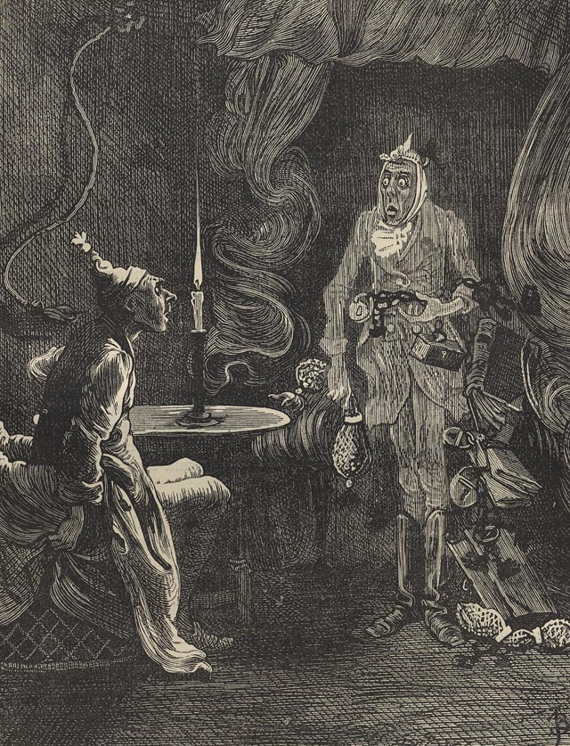
A visit from Marley’s Ghost.
Read through the last few pages of stave one, when Marley visits Scrooge and answer these questions.
Why does the Ghost of Marley wear chains? What do the chains represent?
Is Marley happy in death? Why or why not?
What message does he have for Scrooge?
What message is Dickens trying to give to society?
Watch the video clip here.
What prediction does Marley’s ghost make for Scrooge?
How does Scrooge react to the visit by Marley’s ghost?
What is Scrooge feeling at the end of Stave One?

Slide 29
A Christmas Carol
by Charles Dickens
Stave Two
In Stave One Dickens set the scene and introduced the main Character Scrooge. As we read through the novella and find out more about Scrooge our feelings towards him change. Now the story can really begin...

Slide 30
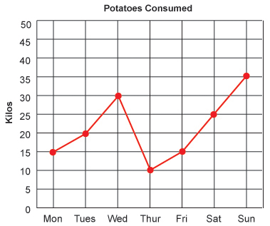
A Christmas Carol: Stave two
1. On a whole page draw a graph (X-axis: progress through the novella, Y-axis: sympathy for Scrooge from 0 to 10).
2. Before you start stave two, mark on the graph where your sympathy for Scrooge was at the start of stave one and at the end. Add a few words at each point to describe how you feel about him and why.
3. At each key event in the novella mark on how your feelings towards the character have changed and why.
Notice how your feelings toward the character change, and how the author is changing them.

Slide 31
A Christmas Carol
Stave two: The Ghost of Christmas Past
As stave 2 begins Scrooge is visited by the first of the spirits – the Ghost of Christmas past. Read the description of the spirit from ‘It was a strange figure’ to ‘distinct and clear as ever.’ The excerpt is on the next slide.
Look at the images on slide 33 of the representations of this spirit from the different films and reproductions of the novella. Decide which you think is the best representation of Dickens's original spirit of Christmas past based on the text you have read. Explain and justify your answer using evidence from the text.

Slide 32
It was a strange figure—like a child: yet not so like a child as like an old man, viewed through some supernatural medium, which gave him the appearance of having receded from the view, and being diminished to a child’s proportions. Its hair, which hung about its neck and down its back, was white as if with age; and yet the face had not a wrinkle in it, and the tenderest bloom was on the skin. The arms were very long and muscular; the hands the same, as if its hold were of uncommon strength. Its legs and feet, most delicately formed, were, like those upper members, bare. It wore a tunic of the purest white; and round its waist was bound a lustrous belt, the sheen of which was beautiful. It held a branch of fresh green holly in its hand; and, in singular contradiction of that wintry emblem, had its dress trimmed with summer flowers. But the strangest thing about it was, that from the crown of its head there sprung a bright clear jet of light, by which all this was visible; and which was doubtless the occasion of its using, in its duller moments, a great extinguisher for a cap, which it now held under its arm. Even this, though, when Scrooge looked at it with increasing steadiness, was not its strangest quality. For as its belt sparkled and glittered now in one part and now in another, and what was light one instant, at another time was dark, so the figure itself fluctuated in its distinctness: being now a thing with one arm, now with one leg, now with twenty legs, now a pair of legs without a head, now a head without a body: of which dissolving parts, no outline would be visible in the dense gloom wherein they melted away. And in the very wonder of this, it would be itself again; distinct and clear as ever.

Slide 33
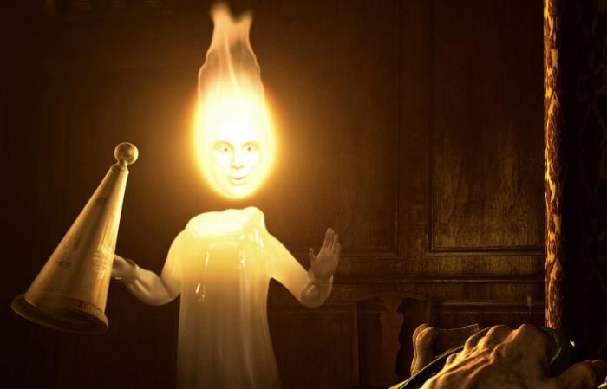
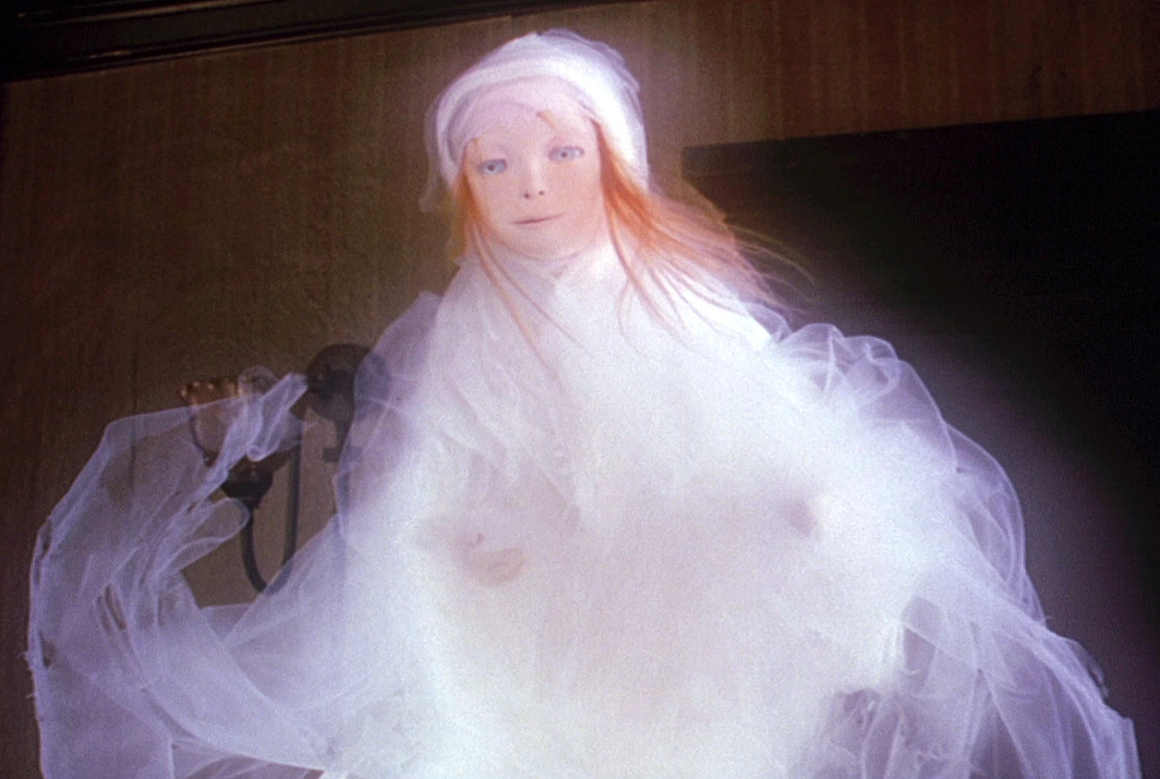
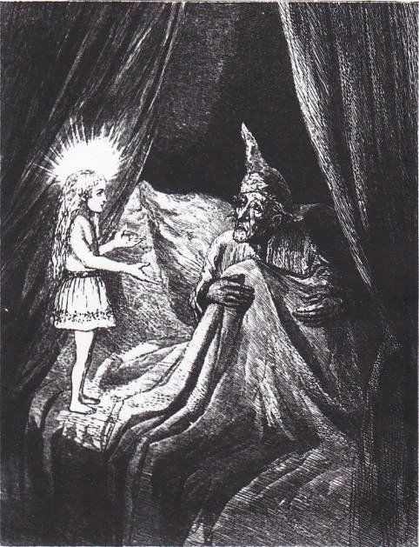
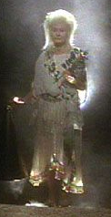
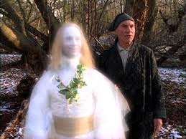
Decide which you think is the best representation of Dicken’s original spirit of Christmas past based on the text you have read. Explain and justify your answer using evidence from the text.
A
B
C
E
D

Slide 34
Now use the text to draw your own version of the Ghost of Christmas past. Annotate your drawing to show how you have interpreted the description of the Novella.

Slide 35
Questions for stave 2
Where do they go?
What is Scrooge’s first reaction?
Who do they encounter?
How does Scrooge feel about the people he encounters?
Who is the ‘solitary child’?
What is the child doing?
Has this scene changed your feelings towards Scrooge? Add a point to the sympathy graph and a quote.

Slide 36
Fezziwig’s party
Watch this short video clip to help you visualise the party
How do Mr and Mrs Fezziwig treat their workers at the end of the party?
How does Scrooge’s behaviour change throughout the party?
What do you think the ghost is trying to teach Scrooge by showing him this party?
Where do the themes of the Christmas spirit and poverty appear in the party scene?
Has this scene changed your feelings towards Scrooge? Add a point to the sympathy graph and a quote.

Slide 37
Fezziwig’s party
Notice the following:
Regardless of class, they “shake hands with every person individually”.
As the scene unfolds Scrooge begins to remember and reconnect with his former happy self.
Scrooge learns that a little money can make a big difference to poor people.
The poor, despite their circumstances, are full of the Christmas spirit showing that wealth and happiness are not connected.
Scrooge is self-reflecting and would like to make amends with his clerk, Bob.

Slide 38
The Ghost of Christmas Past
Next the Spirit takes Scrooge to revisit a point in time that changed the course of his life: the end of his engagement to Belle. As you read the extract on the next page notice the structure and features used when writing dialogue. Below is a list of techniques for dialogue writing RAPT:
R = Role: It must be clear by what the character says who it is that is speaking – the words they say should reveal who they are.
A = Audience: They should speak in a way that is appropriate to who they are speaking to, you may speak differently to a friend than to your teacher, or doctor. The way they speak should reveal something about their relationship to the person, and what they think of them.
P = Purpose: There should be a clear purpose to the dialogue.
T = Tone: the way they are speaking should be set in the correct context/time and place and in the right mood, serious, light-hearted, angry, sad..
Pick out an example of each of these features from the text on the next few slides.

Slide 39
The Ghost of Christmas Past
He was not alone, but sat by the side of a fair young girl in a mourning-dress: in whose eyes there were tears, which sparkled in the light that shone out of the Ghost of Christmas Past.
"It matters little," she said, softly. "To you, very little. Another idol has displaced me; and if it can cheer and comfort you in time to come, as I would have tried to do, I have no just cause to grieve."
"What Idol has displaced you?" he rejoined.
"A golden one."
"This is the even-handed dealing of the world!" he said. "There is nothing on which it is so hard as poverty; and there is nothing it professes to condemn with such severity as the pursuit of wealth!"
"You fear the world too much," she answered, gently. "All your other hopes have merged into the hope of being beyond the chance of its sordid reproach. I have seen your nobler aspirations fall off one by one, until the master-passion, Gain, engrosses you. Have I not?"
"What then?" he retorted. "Even if I have grown so much wiser, what then? I am not changed towards you."
She shook her head.
"Am I?"
"Our contract is an old one. It was made when we were both poor and content to be so, until, in good season, we could improve our worldly fortune by our patient industry. You are changed. When it was made, you were another man."

Slide 40
The Ghost of Christmas Past
"I was a boy," he said impatiently.
"Your own feeling tells you that you were not what you are," she returned. "I am. That which promised happiness when we were one in heart, is fraught with misery now that we are two. How often and how keenly I have thought of this, I will not say. It is enough that I have thought of it, and can release you."
"Have I ever sought release?"
"In words? No. Never."
"In what, then?"
"In a changed nature; in an altered spirit; in another atmosphere of life; another Hope as its great end. In everything that made my love of any worth or value in your sight. If this had never been between us," said the girl, looking mildly, but with steadiness, upon him; "tell me, would you seek me out and try to win me now? Ah, no!"
He seemed to yield to the justice of this supposition, in spite of himself. But he said with a struggle," You think not?"

Slide 41
The Ghost of Christmas Past
"I would gladly think otherwise if I could," she answered, "Heaven knows. When I have learned a Truth like this, I know how strong and irresistible it must be. But if you were free to-day, to-morrow, yesterday, can even I believe that you would choose a dowerless girl -- you who, in your very confidence with her, weigh everything by Gain: or, choosing her, if for a moment you were false enough to your one guiding principle to do so, do I not know that your repentance and regret would surely follow? I do; and I release you. With a full heart, for the love of him you once were."
He was about to speak; but with her head turned from him, she resumed.
"You may -- the memory of what is past half makes me hope you will -- have pain in this. A very, very brief time, and you will dismiss the recollection of it, gladly, as an unprofitable dream, from which it happened well that you awoke. May you be happy in the life you have chosen."
She left him, and they parted.
"Spirit!" said Scrooge, "show me no more! Conduct me home. Why do you delight to torture me?"

Slide 42
The Ghost of Christmas Past
Scrooge is clearly not enjoying his time with the Ghost of Christmas Past, here is another video clip of the visit to the past.
"Spirit!" said Scrooge, "show me no more! Conduct me home. Why do you delight to torture me?"
Imagine Scrooge could speak to his younger self, either at the party or after his conversation with Belle, what do you think their conversation would be?
Using what you have learnt about the features of dialogue write a short dialogue between Scrooge and his younger self. Remember to set it out as dialogue with speech marks and a new line for a new speaker.

Slide 43
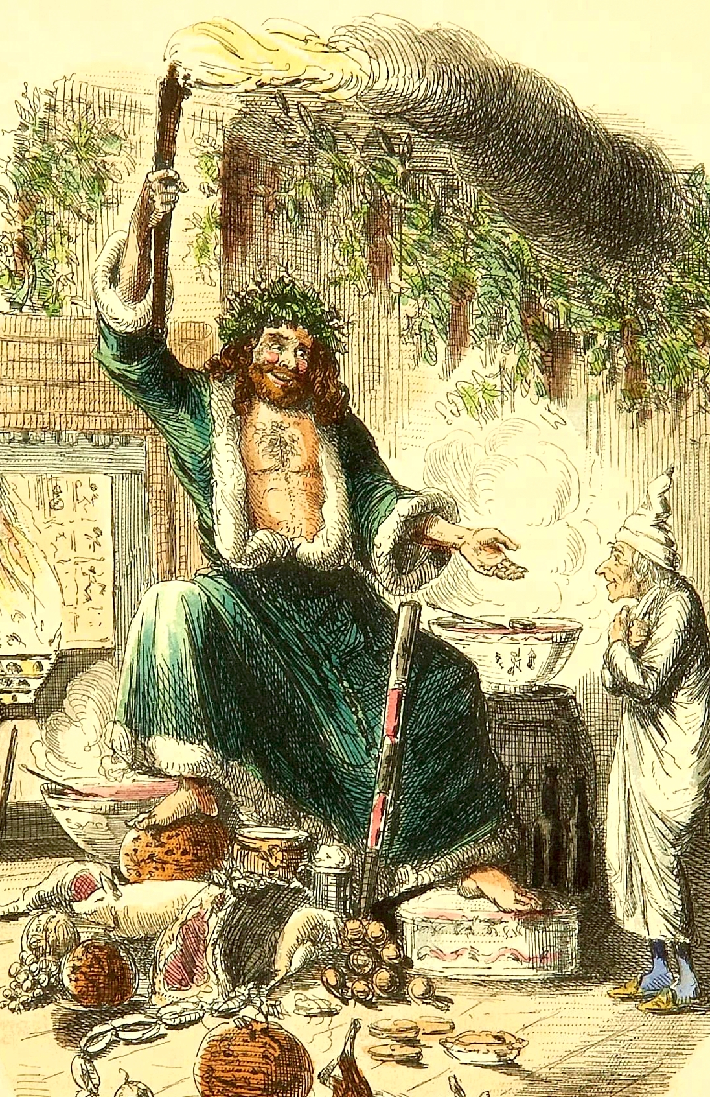
A Christmas Carol
by Charles Dickens
Stave Three
The Ghost of Christmas Present.

Slide 44
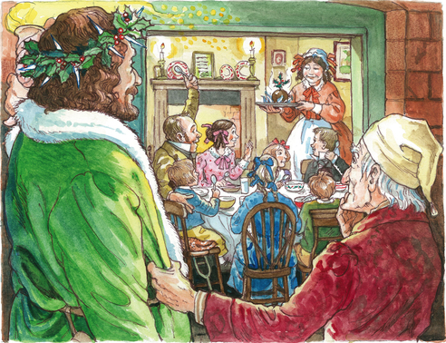
A Christmas Carol
Stave Three
In stave three the Ghost of Christmas present takes Scrooge to visit the Cratchit family. Remember that this family is representative of the poor in society.
What do you think Dickens is trying to do by including this scene of Christmas day at the Cratchit’s house?
York Notes.

Slide 45
A Christmas Carol
Stave Three
Read through the scene and then answer these questions:
Why might Dickens include a scene in which the Cratchit family cook their Christmas meal?
Why does Mrs Cratchit invite her daughter to sit down “before the fire”?
Why might Dickens include the image of Bob carrying his son?
How are the references to church important?
Why might Bob say that his son is “good as gold”?
How do the Cratchit family feel about their meal?
How does Scrooge react to watching this scene?
Why might Dickens include Bob toasting Scrooge as the “founder of the feast”?
Overall, what is the atmosphere in this scene?

Slide 46
A Christmas Carol
Stave Three: Ignorance and Want
‘Forgive me if I am not justified in what I ask," said Scrooge, looking intently at the Spirit's robe, "but I see something strange, and not belonging to yourself, protruding from your skirts. Is it a foot or a claw?"
"It might be a claw, for the flesh there is upon it," was the Spirit's sorrowful reply. "Look here."
From the foldings of its robe, it brought two children; wretched, abject, frightful, hideous, miserable. They knelt down at its feet, and clung upon the outside of its garment.
As you read further through the stave you come across these strange characters hiding in the robes of the Ghost. What is this all about?
Dickens is using these characters to represent problems within his society. The two children are allegories (symbolic) of Ignorance and Want. They represent these problems in human form.

Slide 47
A Christmas Carol
Stave Three: Ignorance and Want
Dickens uses this symbolism to share his political views.
Ignorance: People like Scrooge, who ignore the problems of the poor only add to these social problems. They create wealth for themselves at the expense of the poor (note the low wage he paid his workers).
Want: because the population has ‘boomed’ in Victorian times, many people ‘want for’ (go without) the basic necessities such as food and shelter. Combined with the ignorance of the rich, this creates massive social problems.
These children represent this situation, they are described as ‘wretched, abject, frightful, hideous, miserable’. What does this tell us about society at this time?

Slide 48
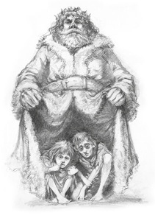
A Christmas Carol
Stave Three: Ignorance and Want
Read through the text on the next 2 slides and answer:
Why would Dickens choose children to symbolise the problems in society?
Why are the children described as being old before their time?
Why are the children monsters? How will they behave in the future? Why?
If the children belong to man, why do they cling to the Ghost of Christmas Present?
Scrooges’ words are quoted by the Ghost, what is the effect?
What does Ignorance have to do with Scrooge? Why does the ghost focus on him?
Based on this stave what is the social message that Dickens is trying to give? Give evidence from the novella to back up your answer.

Slide 49
A Christmas Carol
Stave Three: Ignorance and Want
From the foldings of its robe, it brought two children; wretched, abject, frightful, hideous, miserable. They knelt down at its feet, and clung upon the outside of its garment.
"Oh, Man, look here! Look, look, down here!" exclaimed the Ghost.
They were a boy and a girl. Yellow, meagre, ragged, scowling, wolfish; but prostrate, too, in their humility. Where graceful youth should have filled their features out, and touched them with its freshest tints, a stale and shrivelled hand, like that of age, had pinched, and twisted them, and pulled them into shreds. Where angels might have sat enthroned, devils lurked, and glared out menacing. No change, no degradation, no perversion of humanity, in any grade, through all the mysteries of wonderful creation, has monsters half so horrible and dread.
Scrooge started back, appalled. Having them shown to him in this way, he tried to say they were fine children, but the words choked themselves, rather than be parties to a lie of such enormous magnitude.

Slide 50
A Christmas Carol
Stave Three: Ignorance and Want
"Spirit, are they yours?" Scrooge could say no more.
"They are Man's," said the Spirit, looking down upon them. "And they cling to me, appealing from their fathers. This boy is Ignorance. This girl is Want. Beware them both, and all of their degree, but most of all beware this boy, for on his brow I see that written which is Doom, unless the writing be erased. Deny it!" cried the Spirit, stretching out its hand towards the city. "Slander those who tell it ye. Admit it for your factious purposes, and make it worse. And abide the end."
"Have they no refuge or resource?" cried Scrooge.
"Are there no prisons?" said the Spirit, turning on him for the last time with his own words. "Are there no workhouses?"

Slide 51
A Christmas Carol
Stave Four
The Ghost of Christmas Future

Slide 52
A Christmas Carol
Stave Four
‘“Ghost of the Future!” he exclaimed, “I fear you more than any spectre I have seen. But as I know your purpose is to do me good, and as I hope to live to be another man from what I was, I am prepared to bear you company, and do it with a thankful heart.’
We see right at the start of stave 4 that Scrooge is a changed man compared to his reaction to the Ghost of Marley in stave 1. Use these two exerts as evidence to answer the following question:
How does Dickens portray the development of Scrooges character in these two excerpts?
‘ “You don’t believe in me,” observed the Ghost. “I don’t,” said Scrooge. “What evidence would you have of my reality beyond that of your senses?” “I don’t know,” said Scrooge. “Why do you doubt your senses?” “Because,” said Scrooge, “a little thing affects them. A slight disorder of the stomach makes them cheats….There’s more of gravy than of grave about you, whatever you are!” ‘

Slide 53
A Christmas Carol
Stave Four
Print out and read the persuasive speech, ‘The Useful Haunting’ on the next slide. It tries to argue that the most influential character to Scrooge in the novella is Marley.
The following persuasive devices have been used in the speech:
Emotive language (about feelings), evidence, direct address (speaking directly to the reader or listener), rhetorical question (a question that we already know the answer to), rule of three (using 3 adjectives, nouns, verbs or adverbs in a row), repetition, short sentences and counter argument.
Find and highlight each of the persuasive devices.
How effective is the speech in your opinion and why?

Slide 54
A Christmas Carol
A Useful Haunting
Marley is the most influential character for Scrooge because Scrooge’s journey to redemption begins with Marley. He is the one who sparks the “flint” and begins to open the “oyster shell” to reveal the pearl of goodness inside of Scrooge. Only Marley can do this. He is the only character with a strong connection to Scrooge – remember Scrooge never paints over Marley’s name on the counting house sign. Marley awakens Scrooge’s emotions by sharing his pain and delivering a clear message: “these are the chains I forged in life!”
Some might argue that he terrifies Scrooge, which is completely true, but you must remember that is exactly what Scrooge needs! Could a gentle, polite message persuade Scrooge to change? I doubt it. Marley gives Scrooge the shock, the push and the encouragement that he needs to evolve into a better person. Marley’s presence gives Scrooge a better purpose, so his haunting is useful. That’s why he’s the most influential character for Scrooge.

Slide 55
A Christmas Carol
In your opinion, which ghost has had the biggest influence on Scrooge?
Collect your thoughts and find evidence from the text to back up your opinion.
Once you have your notes write a short persuasive speech giving your opinion on which ghost has had the most influence on Scrooge. Try to use as many persuasive devices as you can to make your speech convincing. On the next 2 slides there is a list of several useful persuasive writing devices.

Slide 56
Persuasive Device | Definition and Effect
Imperatives | Giving instructions to the reader. This makes them feel as if you are speaking directly to them and encourages them to take action.
Opinion | Can appear like a fact to convince the audience that it is true.
Direct address | Addressing the audience, using the word ‘you’, ‘us’ makes the audience feel you are speaking only to them or including them personally.
Anecdotes or examples | Including examples from your own life makes the audience trust and believe you. Examples make the problems seem closer to home and personal.
Repetition | Use of the same word, phrase or sound more than once in a text emphasises important ideas

Slide 57
Persuasive Device | Definition and Effect
Rhetorical Question | A question which does not need an answer makes the audience think and convinces them you are right
Rule of Three | Use of three words or phrases in a sentence builds to a climax, emphasising key points
Simile & Metaphor | A visual image, comparing an idea or object to something else, using the words like, as, is, can help the audience visualise your ideas and is very emotive.
Slogan | A catchy phrase or slogan draws attention and makes it easier for the memory of the product or message to stay with the reader.
Statistics or Quotation | Provision of evidence to support a point shows you have done your research and are telling the truth
Superlatives | Superlatives state that something is the best, e.g. the bravest man. Superlatives often end in -est, but sometimes have the word most in front of the adjective, e.g. most nervous.

Slide 58
A Christmas Carol
Once you have completed your speech practice reading it out loud. If you can, read it to someone else and see if you have persuaded them. If you are reading this book in a group, listen to each others speeches and then vote on which ghost is the most effective in bringing about a change in Scrooge.

Slide 59
A Christmas Carol
Stave five
Once you have read the first few pages of Stave five consider the contrasting similes used to describe Scrooge:
“solitary as an oyster” “merry as a schoolboy”
“hard and sharp as flint” “light as a feather”
As you previously analysed the similes in stave one, analyse these stave five similes. How do these contrasting similes show the change that has taken place in Scrooge.

Slide 60
A Christmas Carol
Stave One
Scrooge is miserable to others
Scrooge complains to Fred
Scrooge refuses the charity men
Scrooge goes home, alone
Scrooge complains about wages
Scrooge’s fire is nearly dead
Stave Five
Scrooge is positive to others
Scrooge visits Fred for dinner
Scrooge gives to charity
Scrooge goes to church
Scrooge raises Bob’s wages
Scrooge orders the fires lit
O
Here you can see the parallels in stave one and five. Why do you think Dickens did this?

Slide 61
A Christmas Carol
Although called ‘A Christmas Carol’, the story isn’t finally about Christmas; it’s about our responsibility to others all year round.
To what extent do you agree with this statement?

